Slide 1
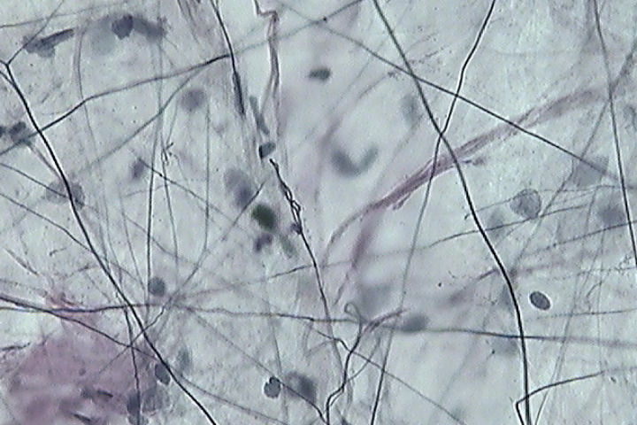
Collagen Fiber
Elastic Fiber
Notes:
Areolar Connective Tissue (400x)

Slide 2
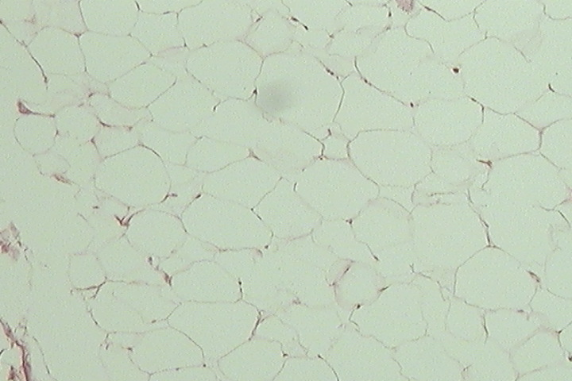
Nucleus
Adipocyte
Notes:
Adipose Tissue (100x)

Slide 3
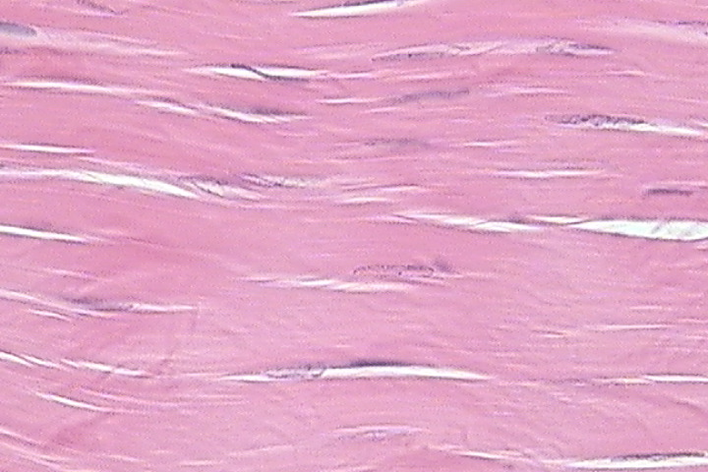
Collagen Fiber
Nucleus of Fibroblast
Notes:
Dense Regular Connective Tissue (White Fibrous Tissue 400x)

Slide 4
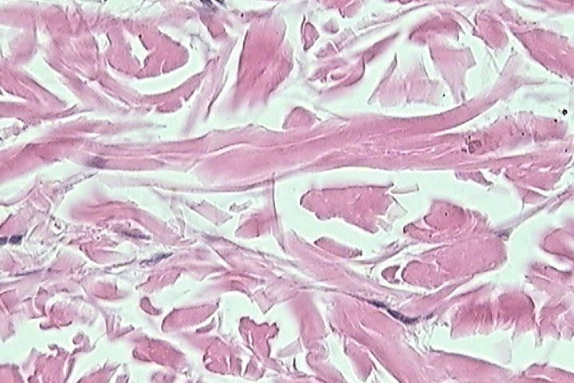
l.s. Collagen Fiber
c.s. Collagen Fiber
Notes:
Dense Irregular Connective Tissue (Dermis of Skin 400x)

Slide 5
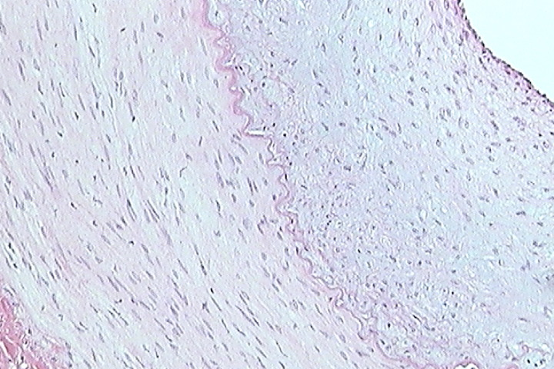
Bundles of Elastic Fibers
Notes:
Elastic Connective Tissue (Artery 100x)

Slide 6
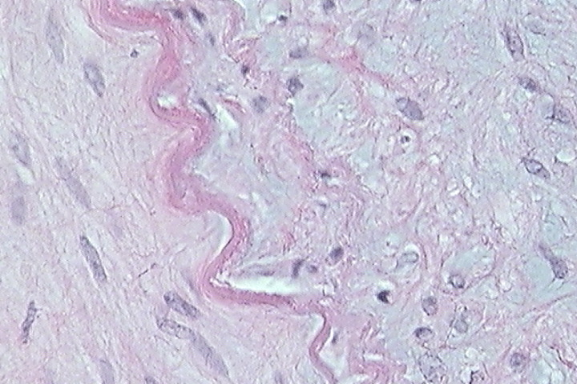
Notes:
Elastic Connective Tissue (Artery 400x) Notice individual elastic fibers scattered throughout the matrix to the right of the large bundle of elastic fibers in the middle.

Slide 7
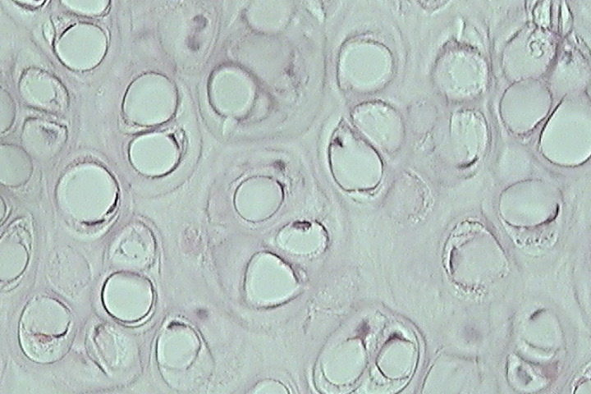
Nucleus of Chondrocyte
Chondrocyte
Lacuna
Notes:
Hyaline Cartilage (Trachea 400x)

Slide 8
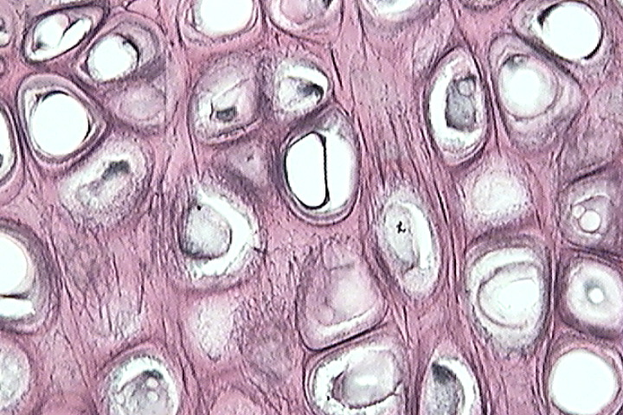
Nucleus of Chondrocyte
Chondrocyte
Elastic Fibers
Notes:
Elastic Cartilage (400x)

Slide 9
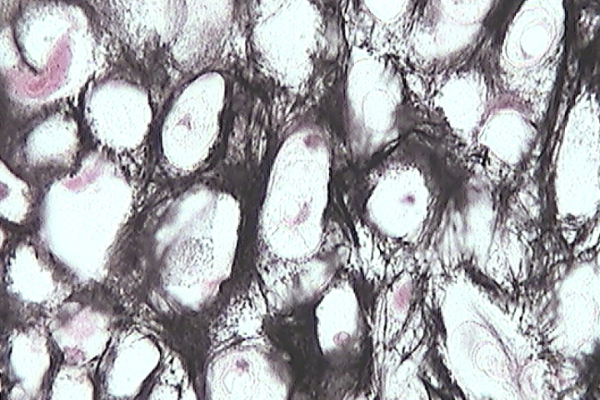
Notes:
Elastic Cartilage (400x) Many more elastic fibers in matrix than previous slide.

Slide 10
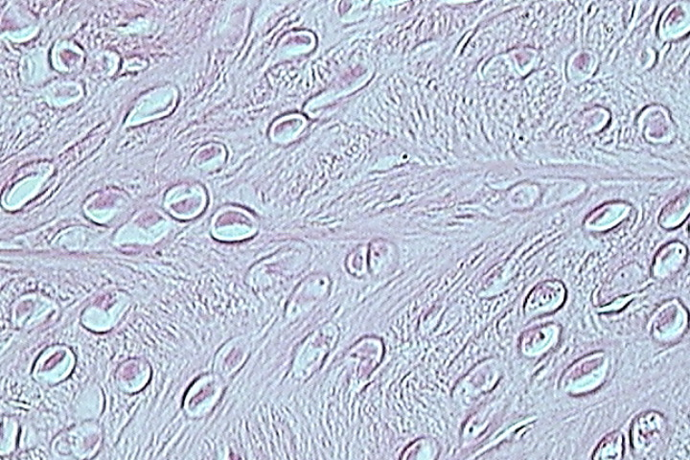
Collagen Fiber
Nucleus of Chondrocyte
Lacuna
Notes:
Fibrous Cartilage (Fibrocartilage) 400x

Slide 11
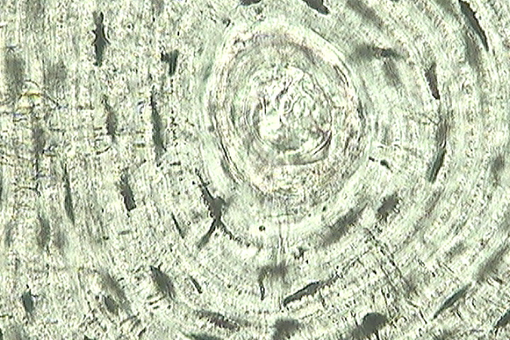
Lacuna
Central Canal
Canaliculi
Notes:
Compact Bone (ground) 400x

