Slide 1
Tough Times in Death Valley Soils:
Geochemical Stressors and Diversification of the Bacillus subtilis-B. licheniformis Clade
Sarah Kopac
November 2013

Slide 2
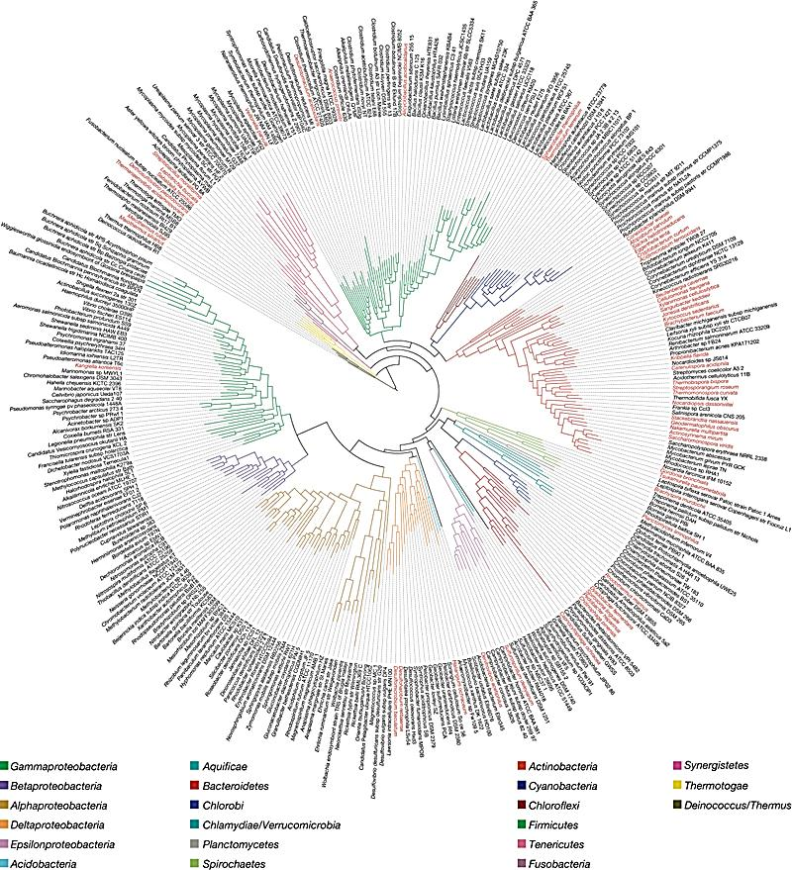
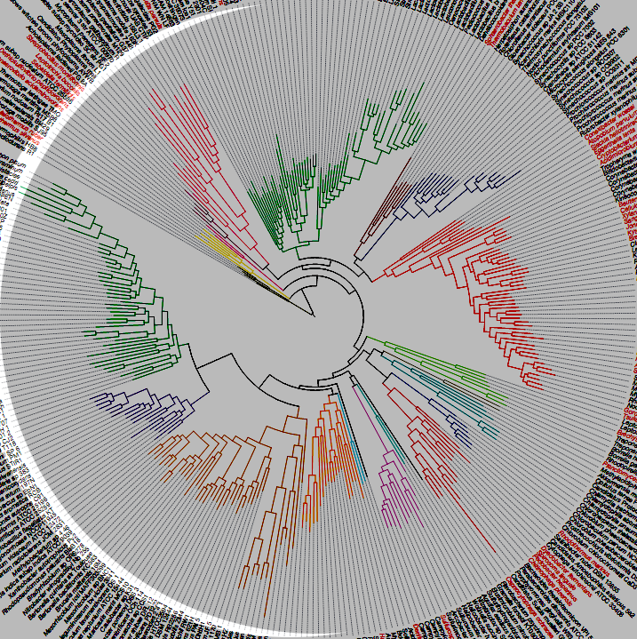
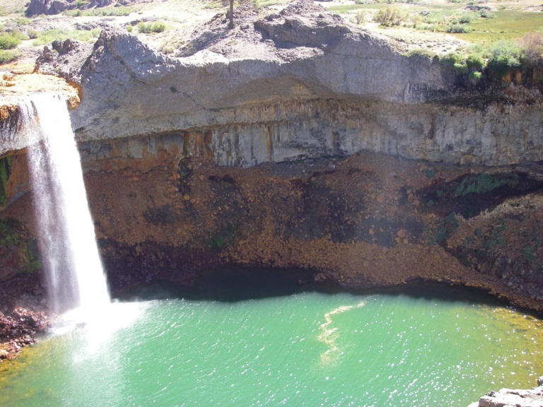
What causes the plethora of diversity in the Bacteria?
Wu et al. 2009
Notes:
Bacteria speciate a lot, and are able to adapt to crazy environments where no other organisms live. Such as

Slide 3
Main topics
Ecotypes are the functional evolutionary units in bacteria
Ecotypes are identified using phylogenetic data and ecological associations
Boron, copper, and salinity are associated with the speciation of Bacillus in Death Valley
Notes:
Outline the model of speciation which we base our studies on
Explain the methods we use to identify important evolutionary units
Present evidence for speciatrionj associated witrh boron, salinity and copper

Slide 4
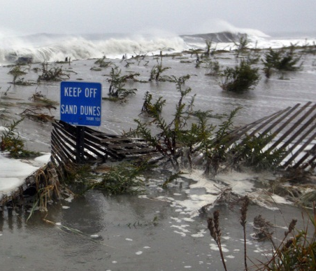
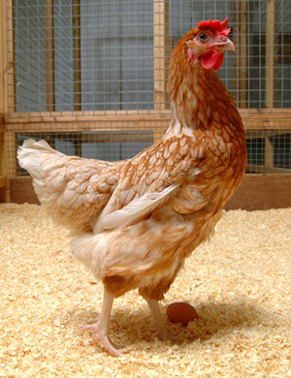
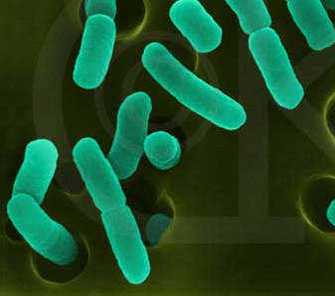
What is a bacterial species?
Any difference in genome composition signifies two separate species.
Species groups
≥97% 16S identity denotes individuals of the same species
Notes:
In order to identify the things in the environment that are causing bacterial lineages to split, we first have to identify the ecologically significant groups of bacteria. This can be difficult, as the definition of bacterial species is a point of unrest in the scientific community. There is an entire spectrum of species definitions, the extremes of which I’ve displayed here.

Slide 5
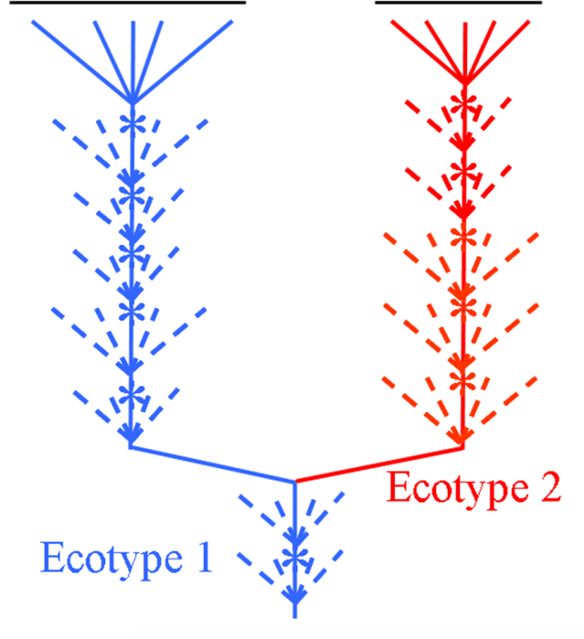
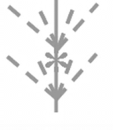
Ecotype theory incorporates phylogeny and ecology into a species concept
Ecotypes
Founded only once
Maintain limited diversity
Irreversibly separate
Notes:
Explain periodic selection and ecotype formation here

Slide 6
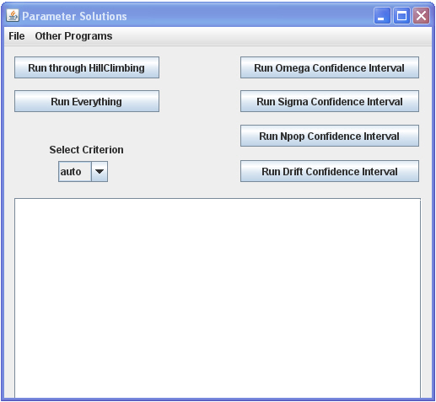
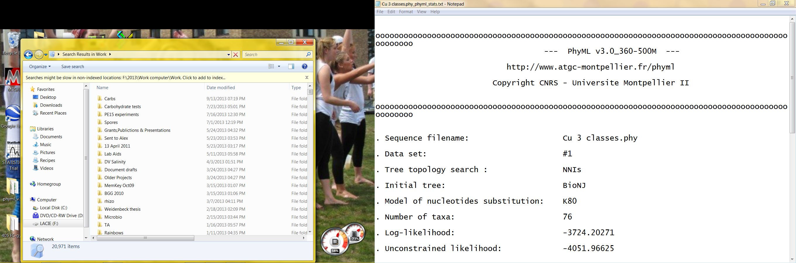
Ecotypes can be demarcated with the algorithms ES and AdaptML
Koeppel and Cohan 2008
Hunt et al 2008
Notes:
ES is able to take only DNA data and, by creating a model of how the sequence diversity arose, use it to predict the frequency of ecotype formation and periodic selection events. Ecotype Simulation then uses these parameters to determine how many ecotypes are in the original dataset and demarcates these ecotypes from the phylogeny. One advantage of ES over other algorithms is that it does not require ecological data. The downside of this is that ecotypes demarcated by ES need to be separately confirmed to be ecologically distinct.
Another algorithm used to demarcate ecologically distinct groups is AdaptML, from the Alm lab at MIT. AdaptML uses a phylogeny and ecological data inputs to demarcate sections of the phylogeny that have different ecologies. The disadvantage of AdaptML is that it will only demarcate groups that are associated with the environmental factors the scientist has measured. AdaptML and ES tend to demarcate phylogenies very similarly, with the exception that EcoSim often demarcates additional ecotypes within the groups that AdaptML finds. The advantage of AdaptML is that it allows one to test specific environmental factors, to see if these are worth further exploring.

Slide 7
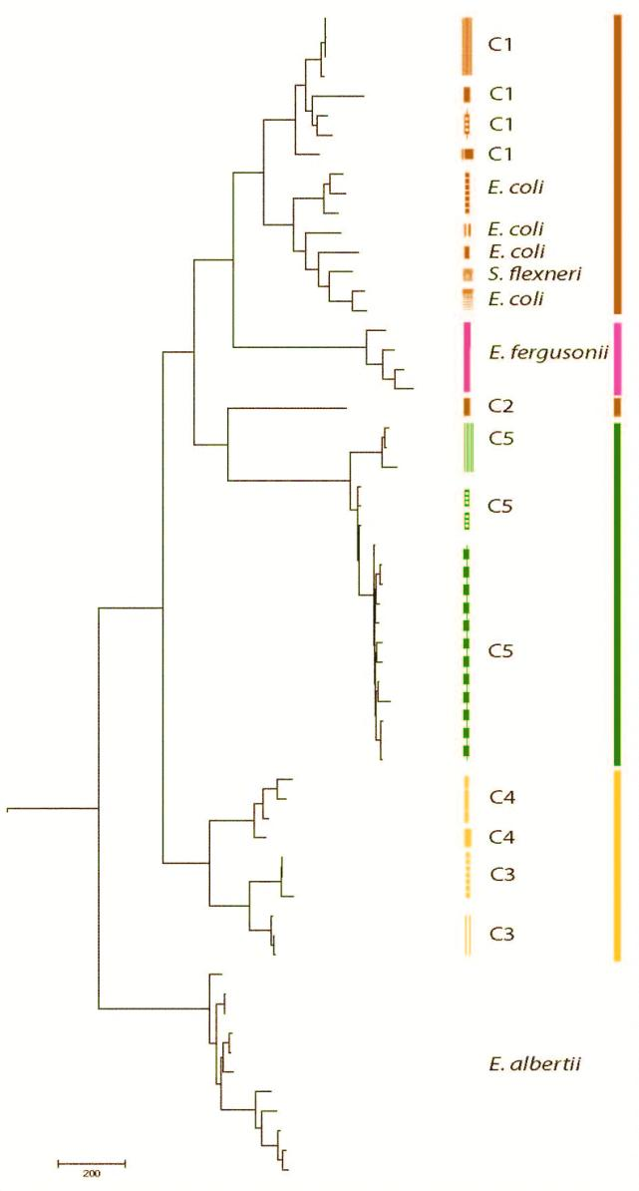
Ecological data has been found to correlate with Putative Ecotypes
EcoSim
AdaptML
Mammalian hosts
Avian hosts
Freshwater bodies
Freshwater beaches
Cohan and Kopac 2011; original data from Luo et al
Notes:
Various projects of ours have confirmed that the ecotypes that EcoSim demarcates from only DNA data are actually ecologically distinct. For example, Fred and I did a re-analysis of some data from a published work on E. coli from various environments, which had concluded from comparing functional genes that strains found in the environment and strains taken from various guts were ecologically distinct.
Using an alignment of 15 housekeeping genes, Ecotype simulation confirmed the conclusion that the environmental and gut-associated samples belonged to ecologically distinct groups, and also demarcated additional ecotypes, which may be associated with unexplored factors of these environments.
This phylogeny shows the demarcations done by EcoSim; each bar is a different ecotype and the colors represent the habitat that the samples were taken from. We also used AdaptML to further authenticate the main findings. Ask I mentioned on the previous slide, the groups found by AdaptML are broader than the ones found by EcoSim, possibly because some environmental factors were not taken into account.

Slide 8
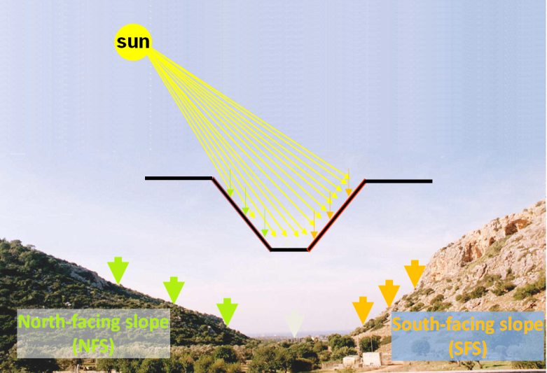
Ecotypes demarcated by sequence cluster analysis are often ecologically distinct
HOOC
HOOC
COOH
CH
3
CH
3
H
C
CH
CH
3
3
3
anteiso
unsaturated
iso
low temperature tolerance providing
high temperature tolerance providing
Sikorski & Nevo 2007
Koeppel et al. 2008

Slide 9
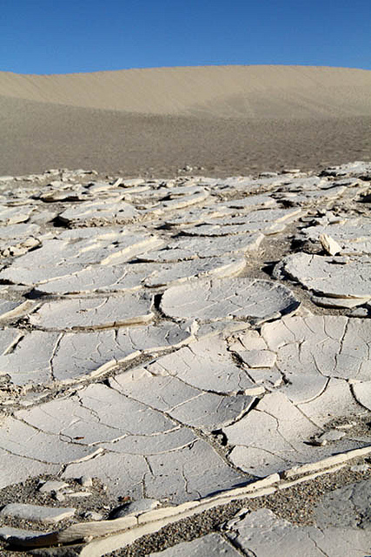
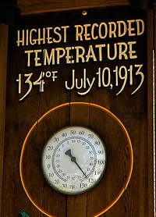
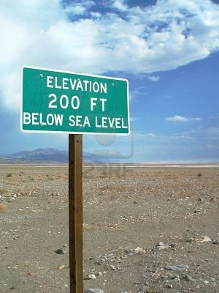
Death Valley, USA

Slide 10
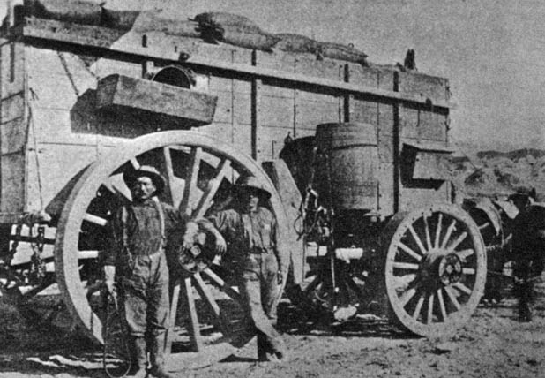
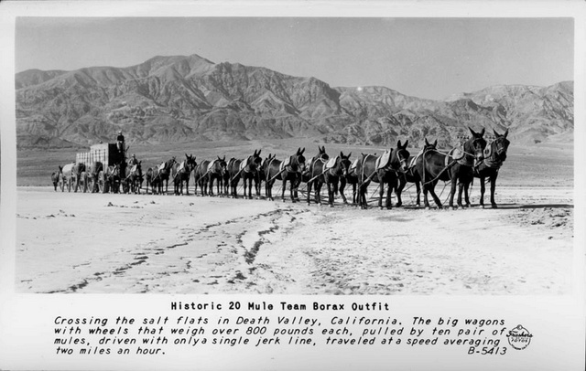
Death Valley’s history gives clues to its soil ecology

Slide 11
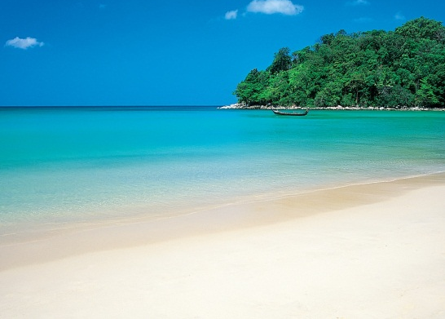
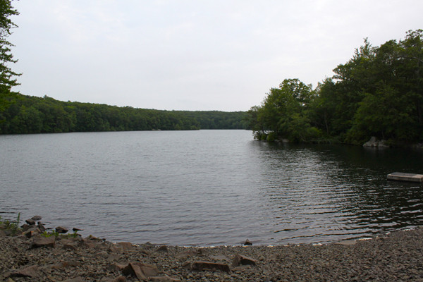
Challenges to bacteria include high salt content (electrical conductivity)
Saline vs. non-saline
Substrate type (water vs sediment)
Cultivable vs. non-cultivable
Lozupone and Knight 2007

Slide 12
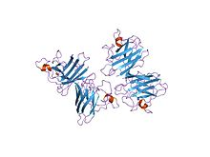
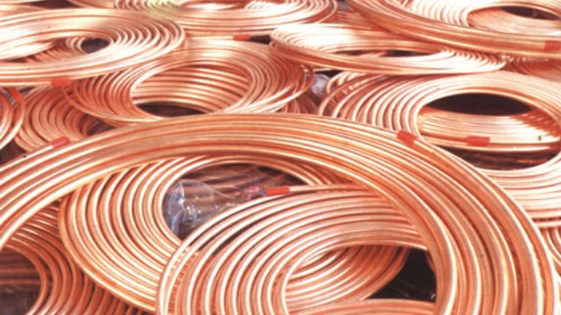
A final challenge is copper, an important coenzyme and antimicrobial
Copper/zinc superoxide dismutase

Slide 13
Soil parameters
pH
Electrical conductivity (salinity)
Lime estimate
% organic matter
Nitrate:N
Phosphorus
Potassium
Zinc
Iron
Manganese
Copper
Boron
Texture (sand/clay/silt)

Slide 14
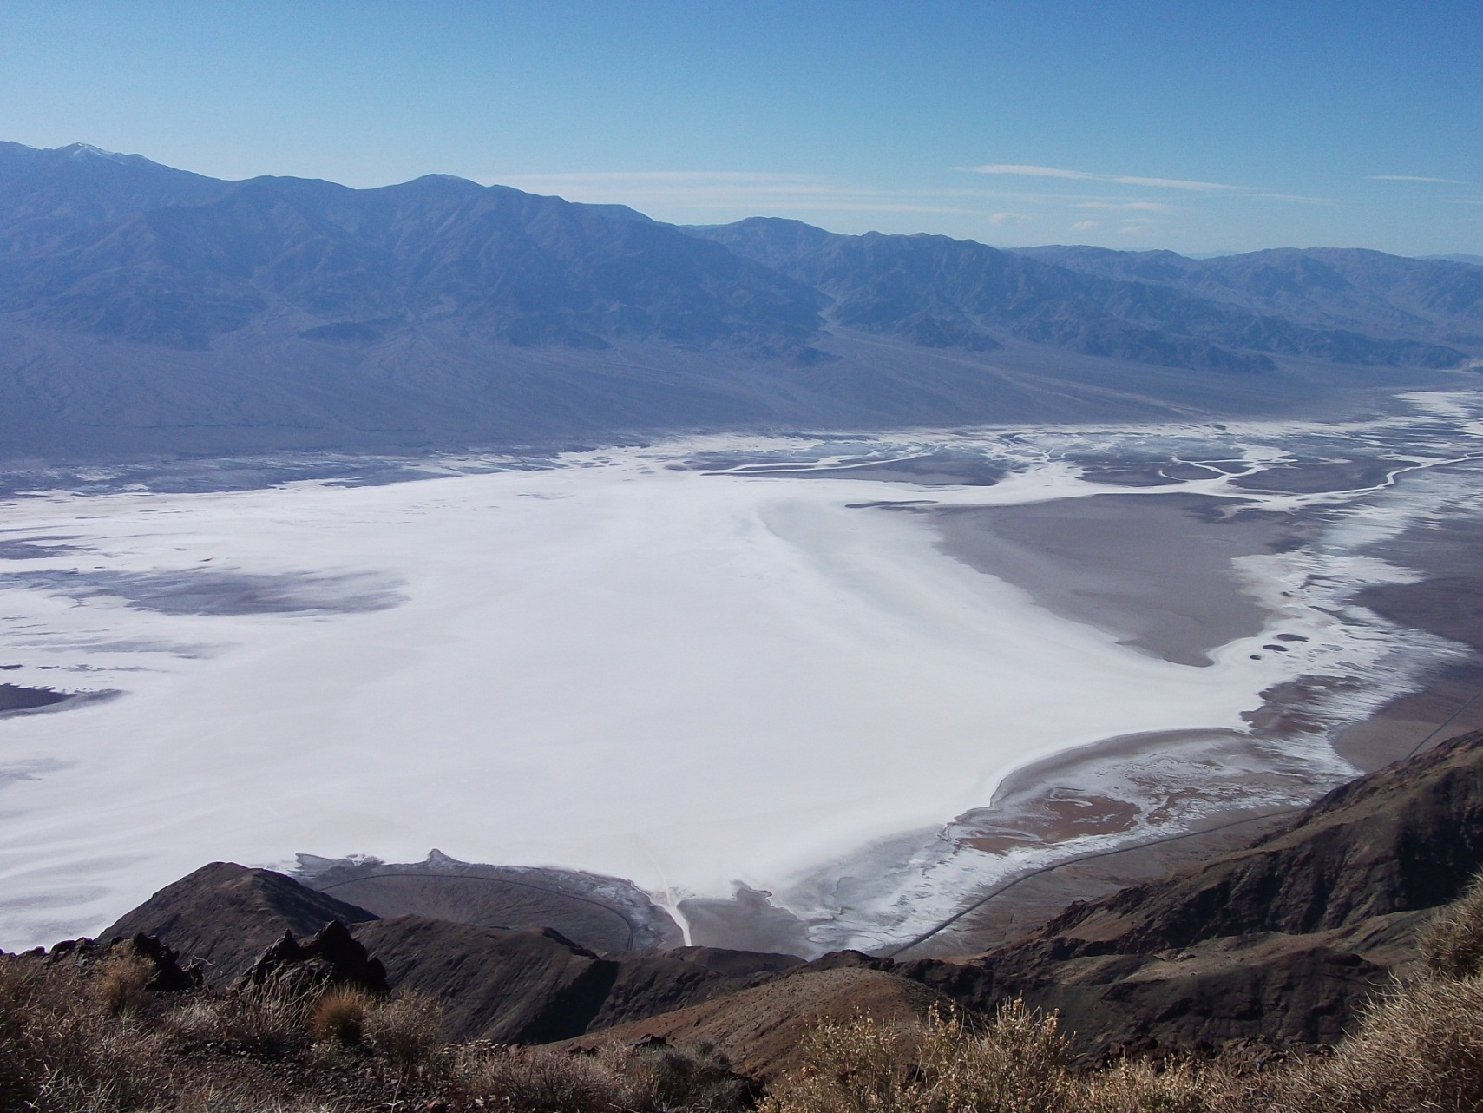
Death Valley National Park

Slide 15
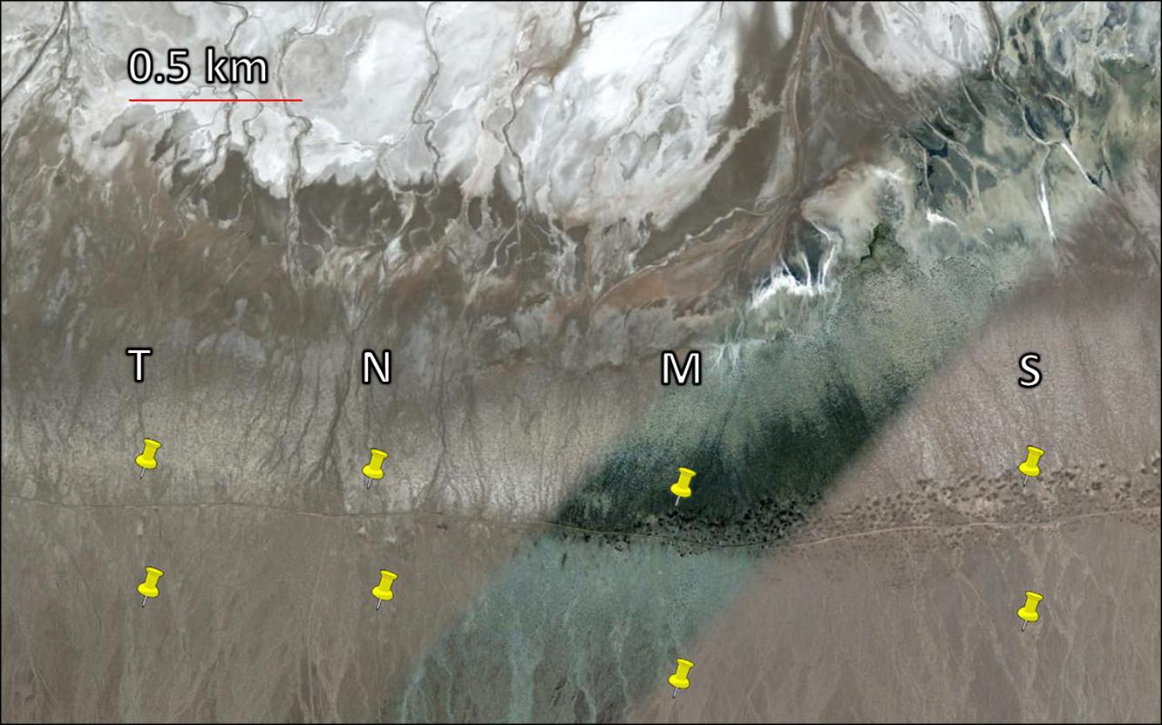
For the present study, sampling was done along four transects
High
salinity
1
2
3
4
5
6
7
8
9
10
11
12
13
14
15
16
17
18
19
20
Low
salinity
4 transects (T, N, M, S) x 20 levels x 3 replicates

Slide 16
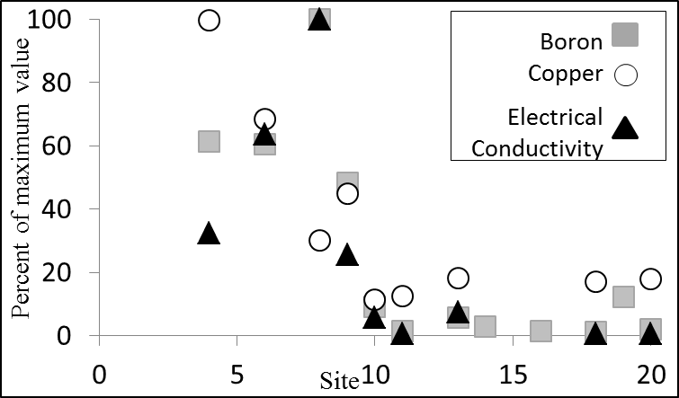
Soil conductivity, boron and copper levels vary over a transect

Slide 17
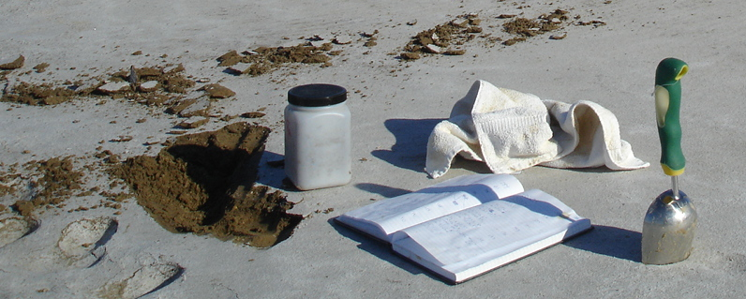
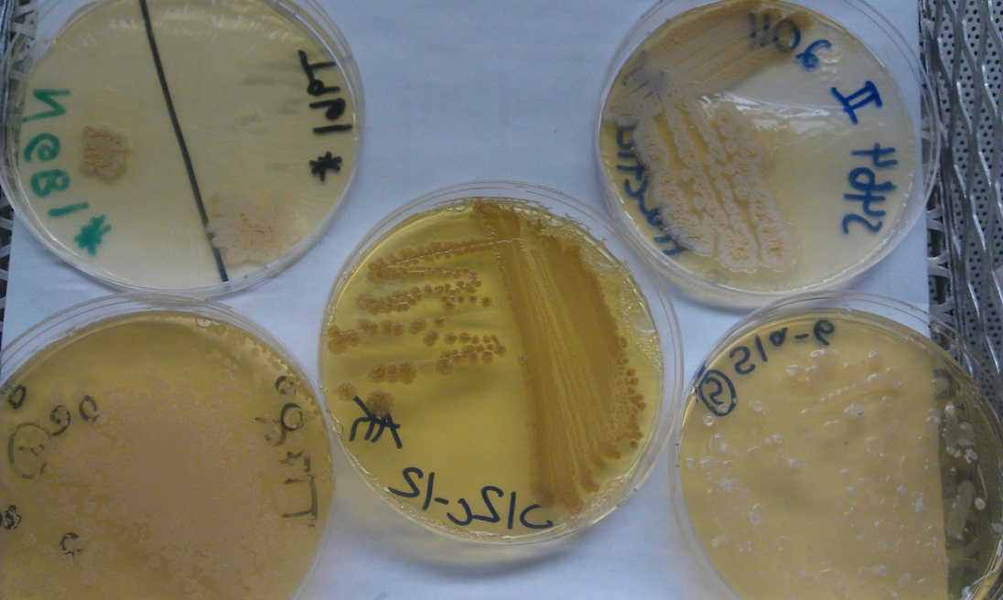
937 strains were isolated from soil samples

Slide 18
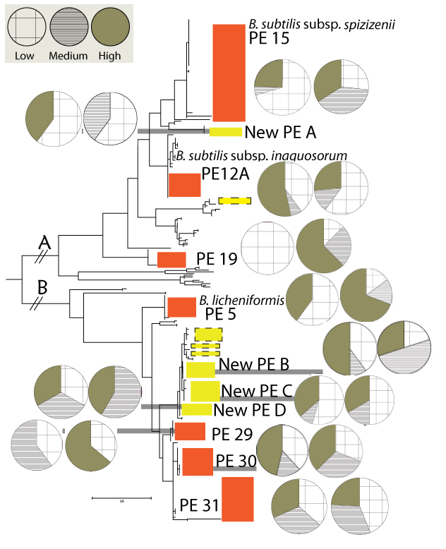
Preliminary data shows that ecotypes are associated with different salinity levels
Pie charts
Left: salinity (low, medium, high)
Right: copper (low, medium, high)
Notes:
ML Phylogeny of ~300 strains
Using DNA alignment of the gyrA gene
Ecotypes are demarcated with boxes; each box also has two pie charts to show associations with

Slide 19
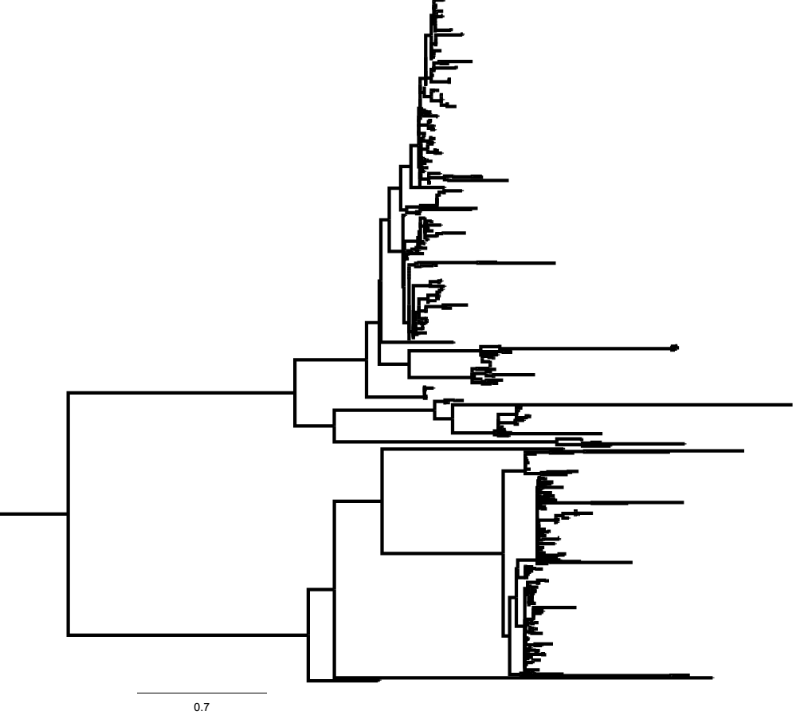
Roughly fifty putative ecotypes have been demarcated from 680 strains
B. subtilis
subclade
B. licheniformis
subclade

Slide 20
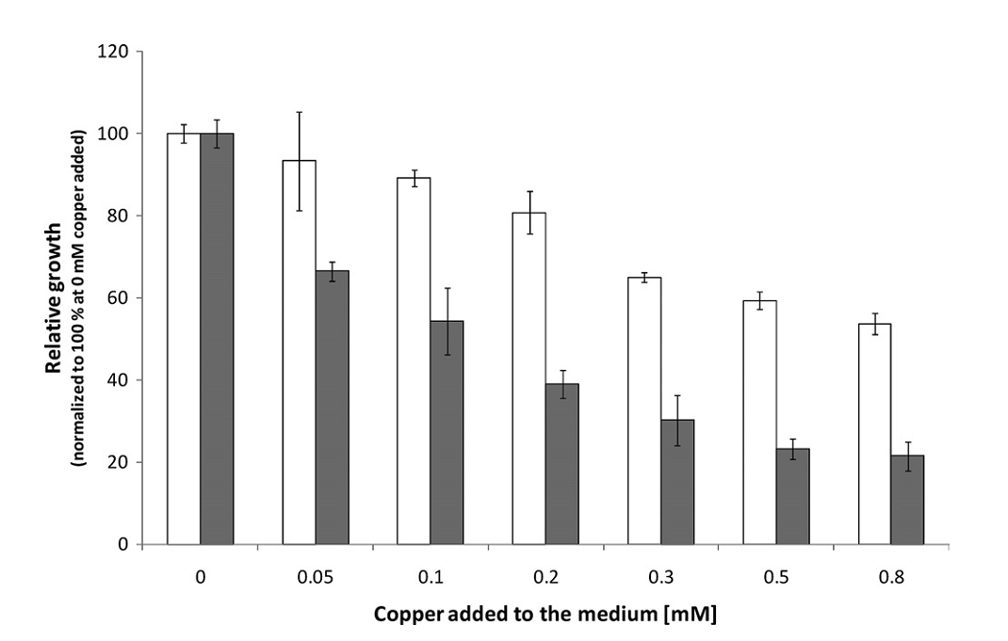
Although essential, copper can act as a stressor at high concentrations
Adapted from Chillappagari et al 2010

Slide 21
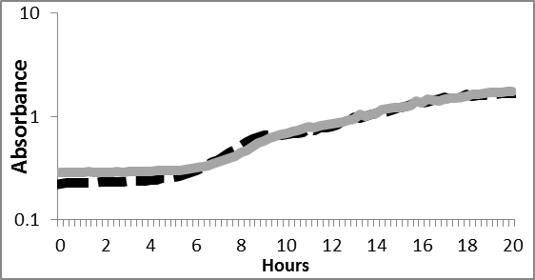

Some strains were able to grow at a reduced rate in high copper

Slide 22
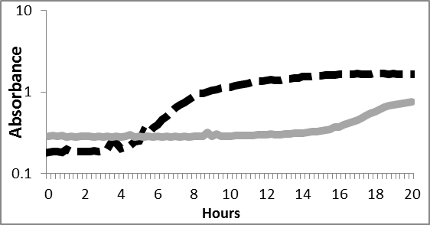
Other strains showed severely inhibited growth in high copper

Slide 23
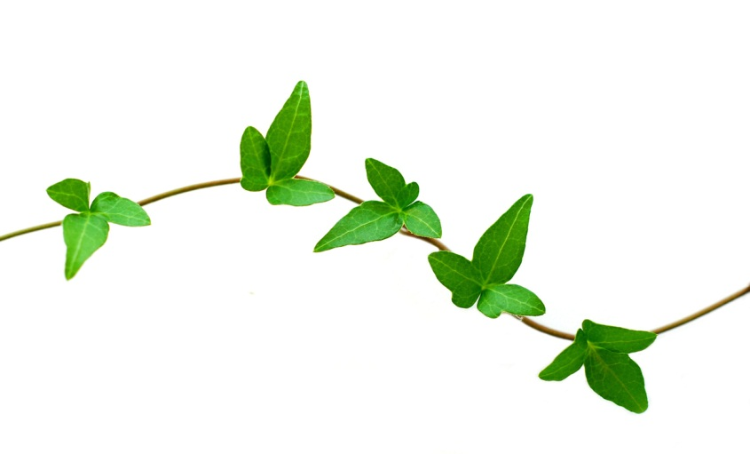
Could boron resistance be a trait of
B. subtilis-licheniformis ecotypes?
Death Valley known for boron deposits
Boron inhibits plant growth
  Cells use efflux to keep intracellular levels low
Bacillus boroniphilus discovered from soils naturally high in boron

Slide 24
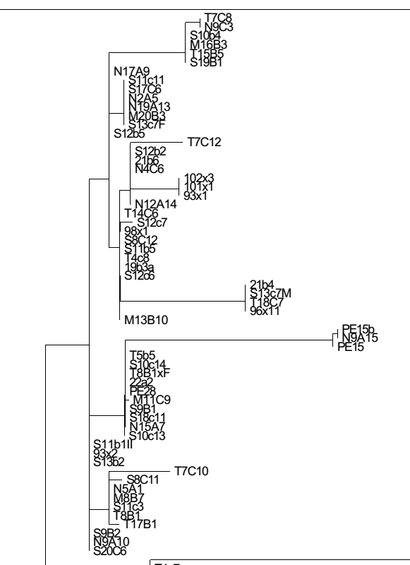
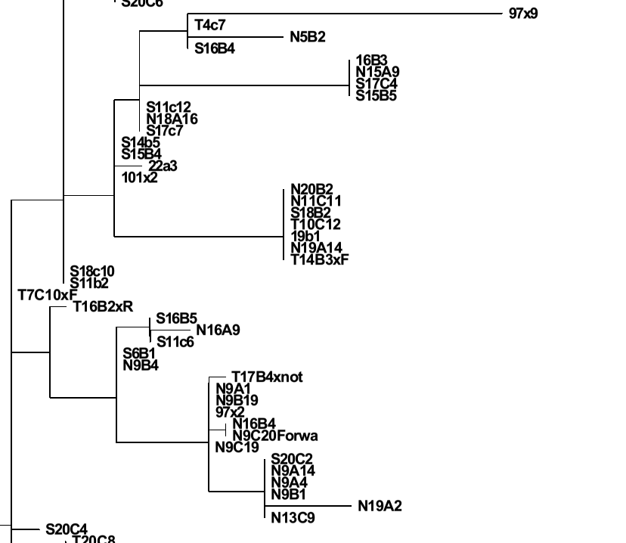
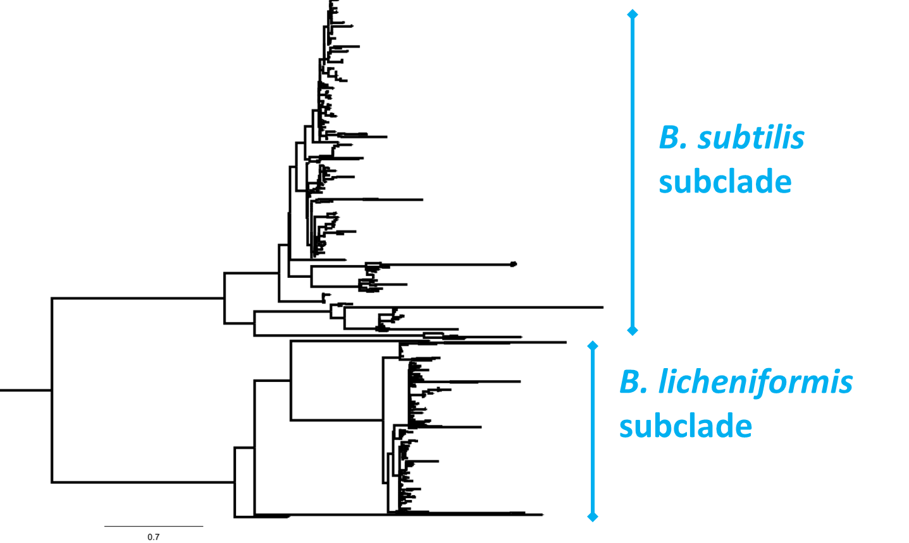
Ecotype A1
Ecotype B1

Slide 25
Ecotype C1
Ecotype D1

Slide 26
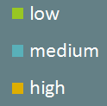
Boron associations differ between sister clades
A1 clade
B1 clade
C1 clade
D1 clade
Notes:
All are generalists, but these results might reflect differences in optimal growth conditions

Slide 27
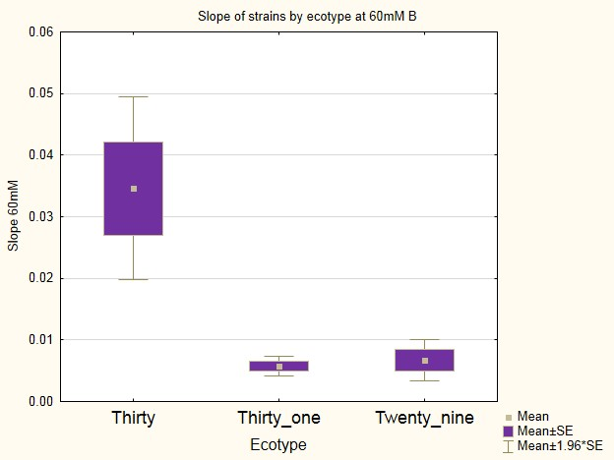
Ecotypes differ in growth at 60mM boron
p=1E-6

Slide 28
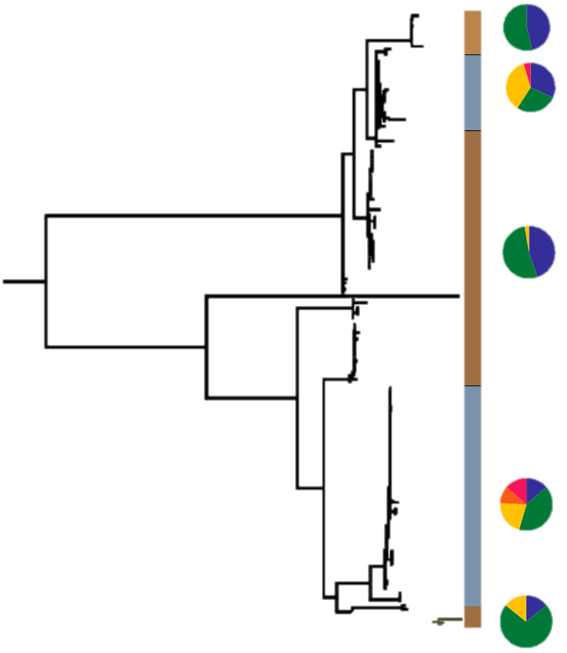
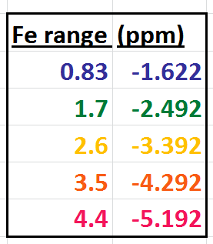
Other ions many be evolutionary significant as well

Slide 29
In summary…
We have found ecotypes associated with three environmental dimensions: copper, boron, and salinity
Closely related ecotypes differ in their ecologies
Strains and/or ecotypes differ in their tolerance for growth in these dimensions

Slide 30
Further questions
Is there a genetic basis to differences in growth tolerance?
Which combinations of environmental dimensions are most commonly associated with speciation?
Are resource-based pressures also influencing speciation in this system?

Slide 31
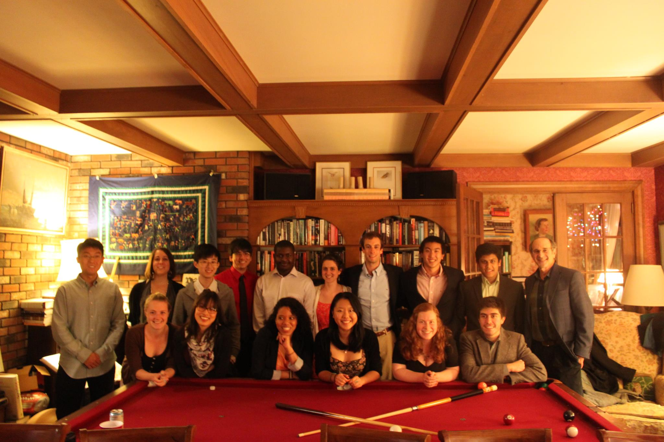



Thesis committee
Fred Cohan
Annie Burke
Danny Krizanc
Michael Singer
Michael Weir
Undergraduates (Krizanc)
Diego Calderon
Carlos Fransisco
Ling Ke
Aaron Plave
Wei Wang
Undergraduates (Cohan)
Alexa Bosel
Jon Chabon
Claire Conway
Shyam Desai
Wesley Ho
Melanie Koren
Mfundi Makama
Janine Petito
Jess Sherry
Noor Tell
Brianne Weimann
Greg Wong
MA/BAs and PhDs
Stephanie Aracena
Rob Clark
Claire Fournier
Menherit Goodwyn
Michelle Tipton
Jane Weidenbeck
Collaboraters
Alex Rooney
Heather Kline
Johannes Sikorski

Slide 32
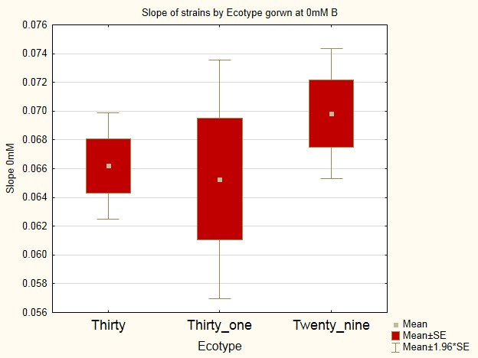
Ecotypes have similar growth at 0mM boron
p=0.761171

Slide 33
Comparisons among ecotypes show heterogeneity…
In 1 or more environmental parameters
In response to copper concentrations
In boron resistance
In genome content?
Are some environmental parameters associated with speciation more often than others?

Slide 34
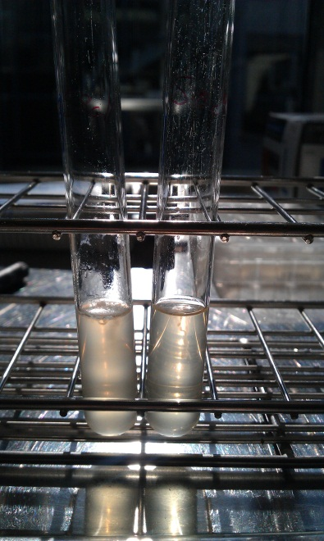
The big questions
Do members of putative ecotypes have unique physiology or/and are they associated with ecological factors?
How do these findings fit together to inform us about bacterial speciation in this environment?
Do physical factors in the environment and resource-related factors equally influence speciation?

Slide 36
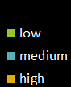
Manganese associations differ between sister clades
A1 clade
B1 clade

Slide 37
Soil analyses along sampling transects

Slide 39
The cluster of new ecotypes within the B. licheniformis subclade don’t seem to have tolerance for high copper

Slide 40
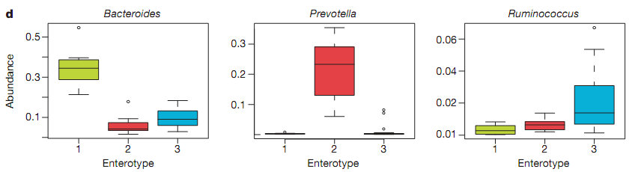
Ecotypes could associate with bacterial community types
Enterotype 1
Enterotype 2
Enterotype 3
Bacteroides
Prevotella
Arumugam et al. 2011
Ruminococcus

Slide 41
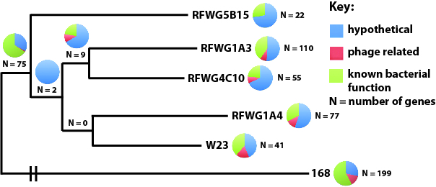
Genomic analyses
Genes unique to an ecotype or strain
  Functional characterization
Genes under positive selection
Horizontally transferred genes
Weidenbeck et al. in prep

