Slide 1
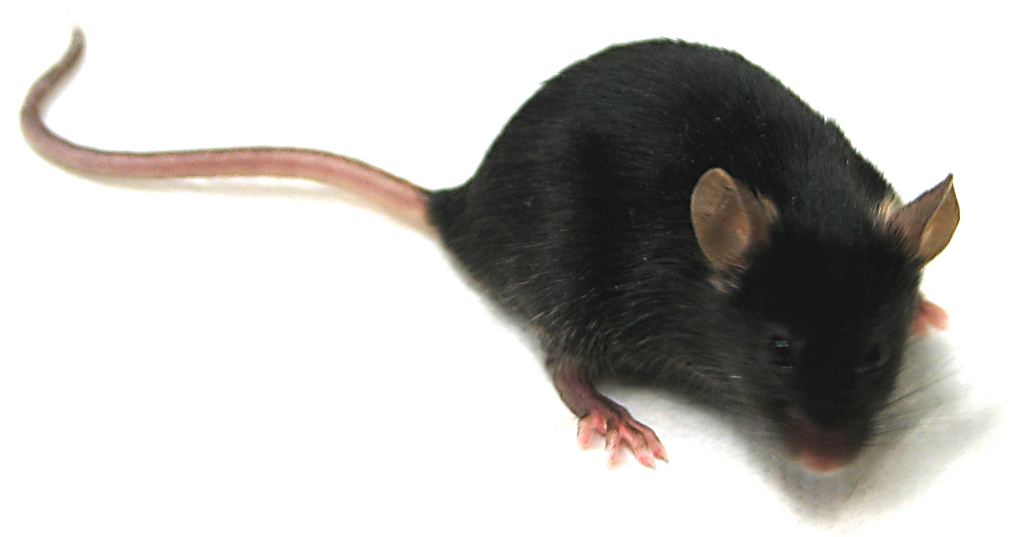
Identifying genes that control organ shape, size and disease using mice.
Scott D. Weatherbee, Ph.D.
Fairfield University Feb 27, 2013

Slide 2
OUTLINE
Overview of our interests & approach
The shorthand mutant:
Identification & gross phenotype
Characterization of the skin
Genetic interactions
Gene identity

Slide 3
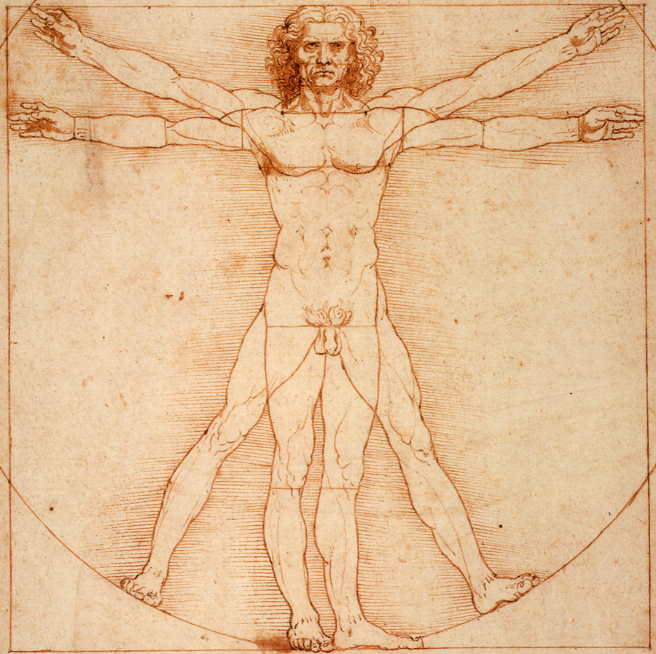

Organisms are derived from single cells
Notes:
Our lab is interested in Development. Specifically, organismal development. How do you go from a single cell, to a complex, multicellular organism with numerous integrated organ systems?

Slide 4
Cell fate decisions shape organogenesis
Rest
(quiescence)
Death
Proliferate
Differentiate
Notes:
Focus on Cell Fate Decisions during organogenesis. Our primary tissues of interest are the limb and the skin.

Slide 5
Cell fate decisions are determined by genes
SIGNAL
RECEPTOR
SIGNAL
TRANSDUCTION
TRANSCRIPTION
FACTOR
GENE
EXPRESSION
CELL DIVISION
Proliferate
Notes:
OUR GOAL THEN IS TO DETERMINE WHAT GENES CONTROL CELL FATE DECISIONS DURING ORGAN FORMATION.
EX. What are the signals? When do they act? What are the transcription factors?

Slide 6
The function of most human genes is unknown
~ 22,000 genes in the human genome
3700 genes, phenotype is known
3600 more phenotypes, gene is unknown
~ 14,700 genes with unknown phenotype
How can we identify the function of a given gene?
Notes:
EX. What are the signals? When do they act? What are the transcription factors?
Cystic fibrosis = CFTR mutation chloride transporter

Slide 7
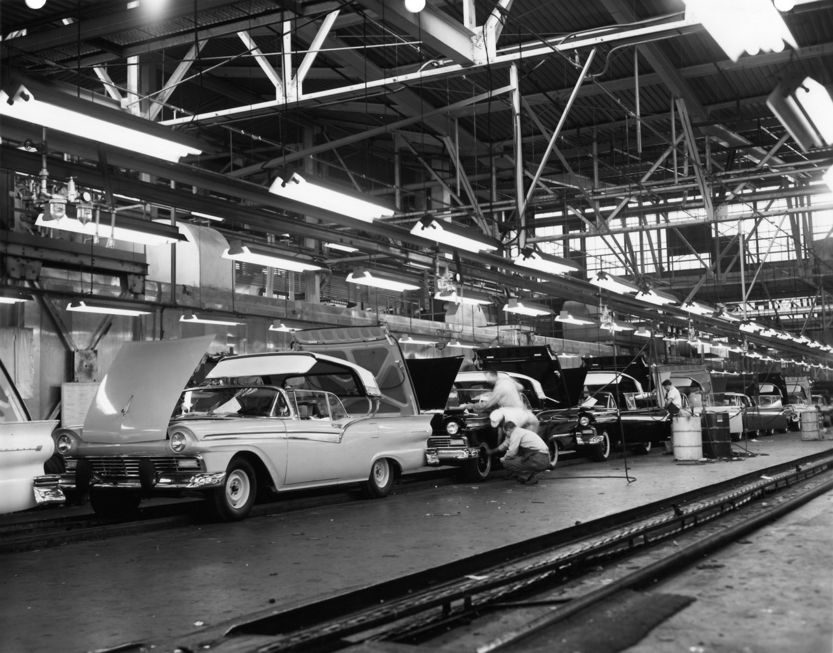
The genetics approach to define gene function
http://stadium.weblogsinc.com/autoblog/hirezpics/skyliner_line_lg.jpg
Notes:
Reverse Genetics might be what you’re more familiar with. You start with a gene that you think is interesting for some reason and knock it out. Then observe what the mouse looks like /does, etc. If we compare this to a car assembly line, it’s like tying the hands of a worker that you think is important for some reason. Maybe you choose Frank because you think his name sounds cool.
The car made without Frank may look okay, and drive okay, but one day when you need to turn on the hazard lights, they don’t work.
In some ways, Reverse Genetics is only as good as your assay.
In contrast, forward genetics I more random.
Liken it to an assembly line. Randomly tie the hands of different individuals on the assembly line & see what happens with the car.
But the advantage is that you’ve already decided the assay.

Slide 8
How can we identify gene function genetically?
Humans afflicted
with disease
Map/Sequence
ID mutation
Make model
organism
Study mechanism
Notes:
OUR GOAL THEN IS TO DETERMINE WHAT GENES CONTROL CELL FATE DECISIONS DURING ORGAN FORMATION.
EX. What are the signals? When do they act? What are the transcription factors?

Slide 9
How can we identify gene function genetically?
Humans afflicted
with disease
Map/Sequence
ID mutation
Make model
organism
Study mechanism
Gene of interest
Mutate gene
in model organism
Examine phenotype
Study mechanism
Notes:
OUR GOAL THEN IS TO DETERMINE WHAT GENES CONTROL CELL FATE DECISIONS DURING ORGAN FORMATION.
EX. What are the signals? When do they act? What are the transcription factors?

Slide 10
How can we identify gene function genetically?
Humans afflicted
with disease
Map/Sequence
ID mutation
Make model
organism
Study mechanism
Gene of interest
Mutate gene
in model organism
Examine phenotype
Study mechanism
Mutate a
model organism
Look for phenotype
Map/Sequence
ID mutation
Study mechanism
(ID human mutation)
Notes:
OUR GOAL THEN IS TO DETERMINE WHAT GENES CONTROL CELL FATE DECISIONS DURING ORGAN FORMATION.
EX. What are the signals? When do they act? What are the transcription factors?

Slide 11
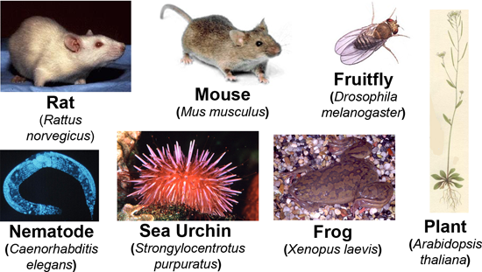
Model organisms are used to study genetics
http://biol1020-2012-2.blogspot.com/2012/10/
model-organisms-in-genetic-research.html
Small, easily reared in lab
Rapid generation time
Access to embryos
“large” number of progeny

Slide 12
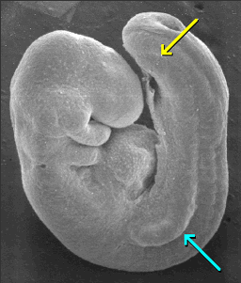
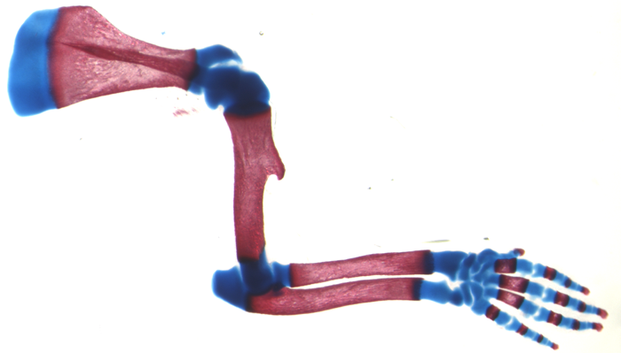
We study mouse limbs and skin
www.med.unc.edu

Slide 13
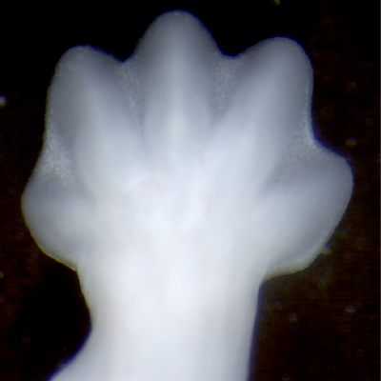
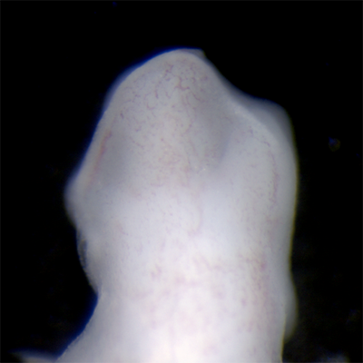
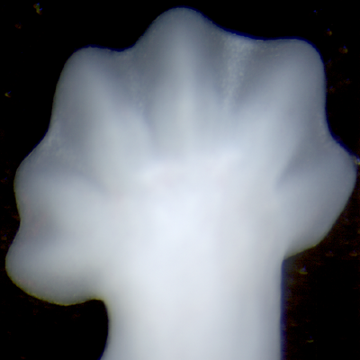
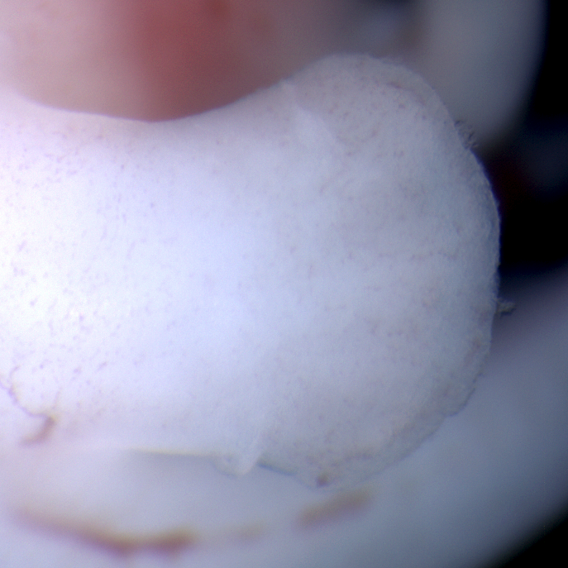
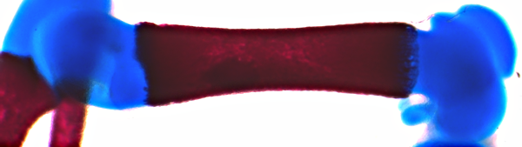
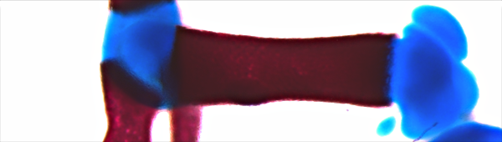
Mouse mutants provide insights into development
mitten
mitaine
schlei
kerouac
wild type
shorthand
*
wild type
pug
Notes:
13

Slide 14
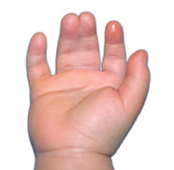
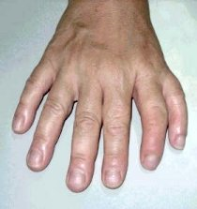
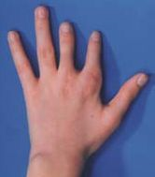
Mouse mutants model human diseases
Syndactyly
Polydactyly
Brachydactyly

Slide 15
OUTLINE
The shorthand mutant:
Identification & gross phenotype
Characterization of the skin
Genetic interactions
Gene identity

Slide 16
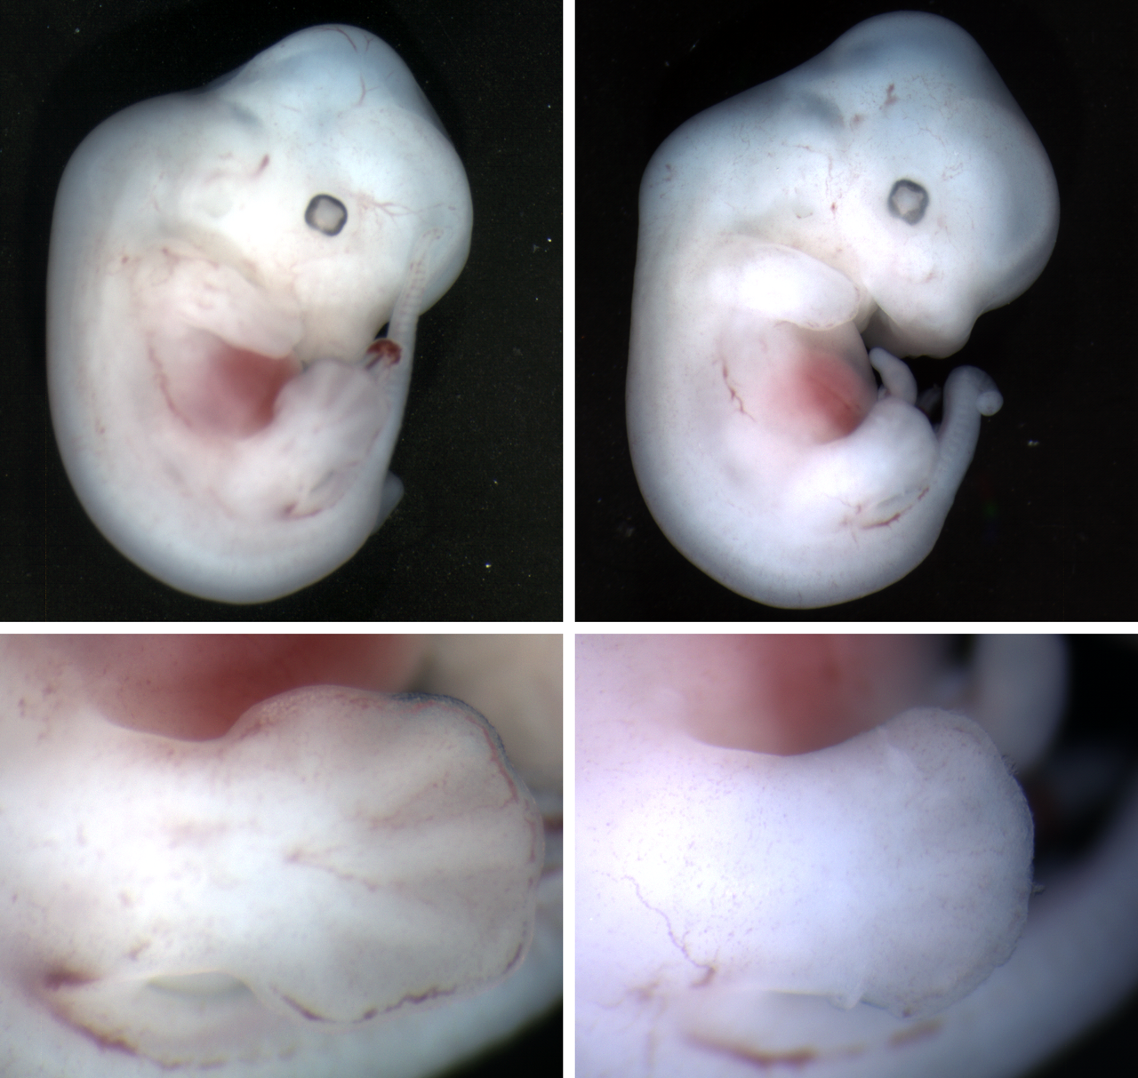
shorthand (shd) mutants first ID’d at e12.5
control shd mutant

Slide 17
shorthand (shd) mutants have short limbs
control shd mutant

Slide 18
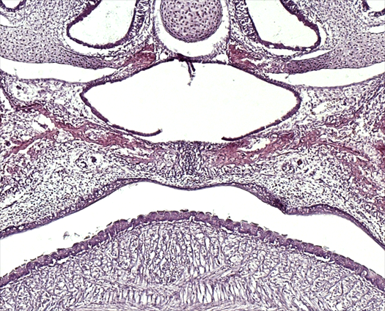
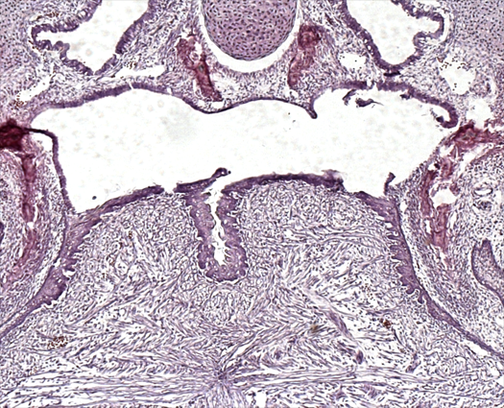
shd mutants have cleft palate
control shd mutant
ps
ps
ps
tongue
tongue
Notes:
The wildtype skull has a nearly complete fusion of the palate but in the mutants, the
bilateral palate shelves remains unfused, so you can see the more dorsal vomer and presphenoid

Slide 19
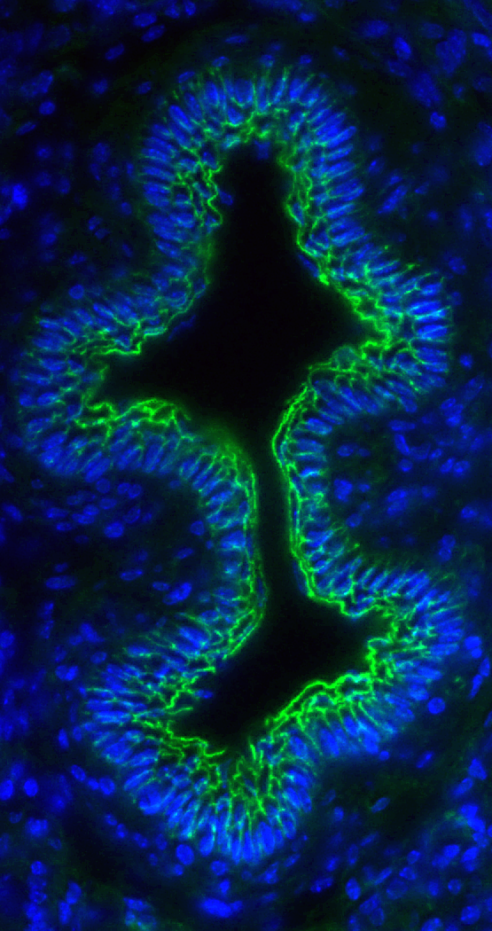
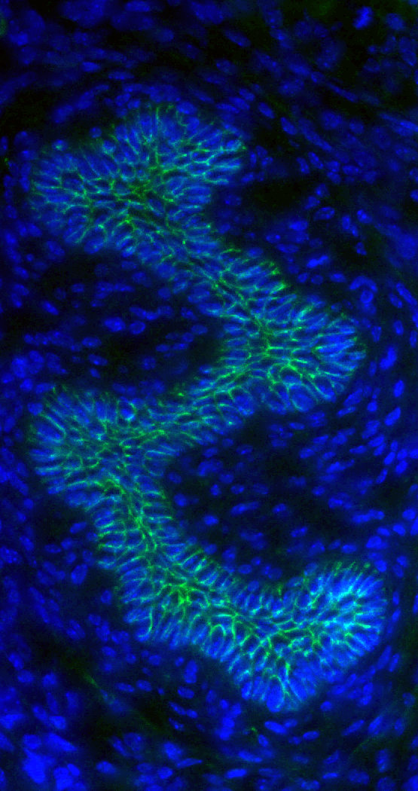
shd mutants have fused esophagi
control shd mutant
Hoechst
E-Cadherin

Slide 20
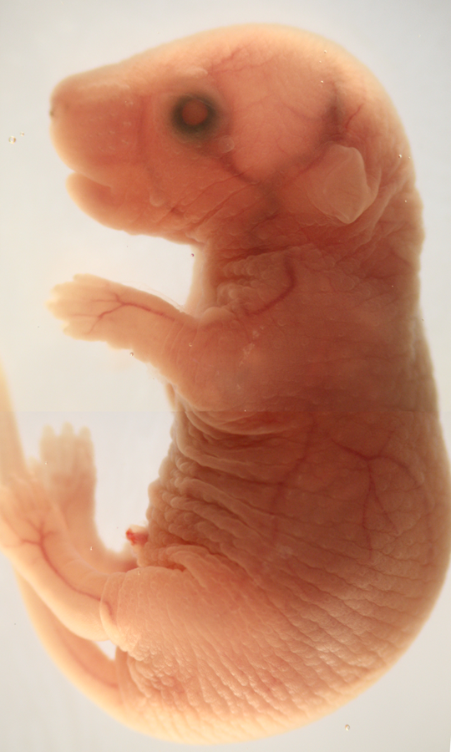
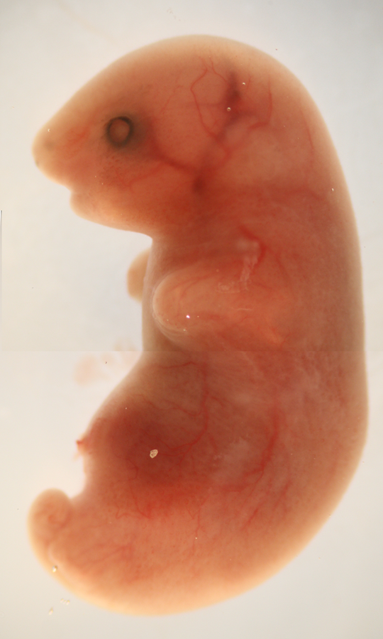
shd mutants have skin defects
control shd mutant

Slide 21
shd defects linked to keratinocytes
Cleft Palate
Fused Esophagus
Limbs Fused to Body
Taut, smooth surface
Notes:
We decided to focus on epidermis keratinocyte development.

Slide 22
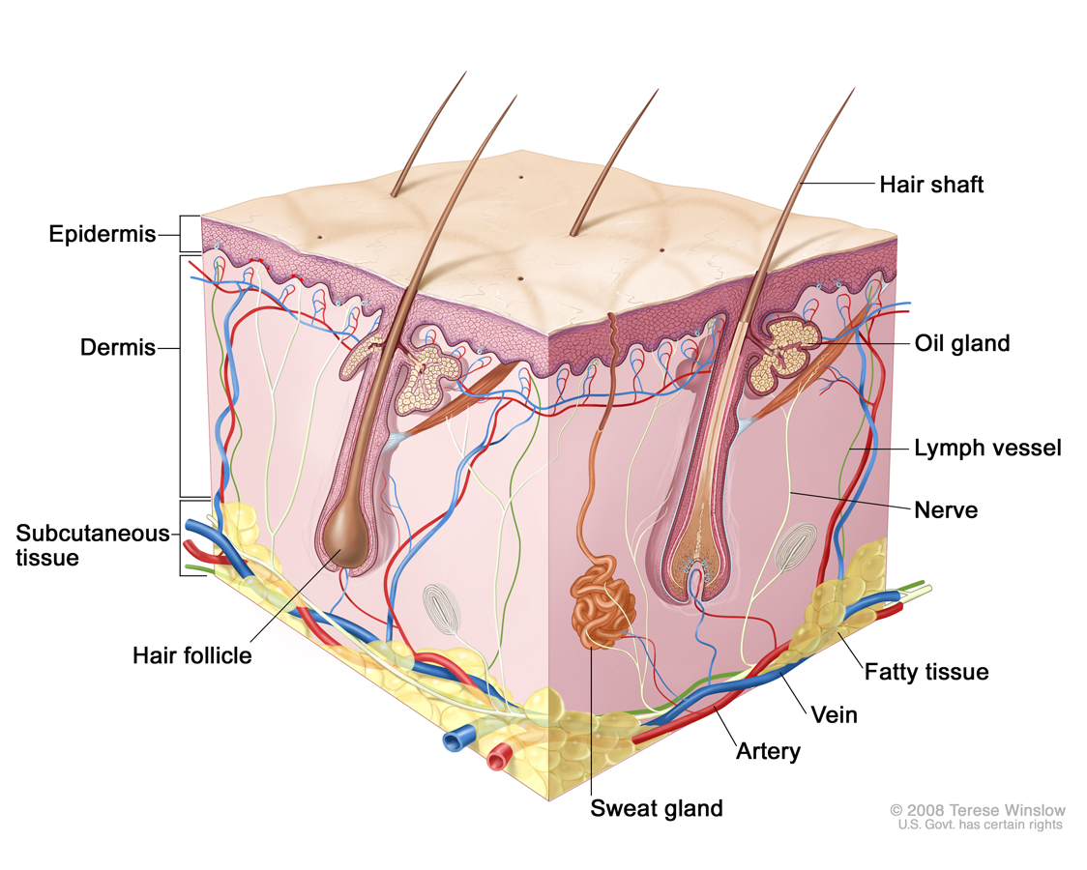
The skin is made up of multiple layers and mini-organs
http://www.uchospitals.edu/images/nci/CDR0000579036.jpg
Notes:
Mention stem cells here??

Slide 23
OUTLINE
The shorthand mutant:
Identification & gross phenotype
shd phenotype points to keratinocyte defects
Characterization of the skin
Genetic interactions
Gene identity

Slide 24
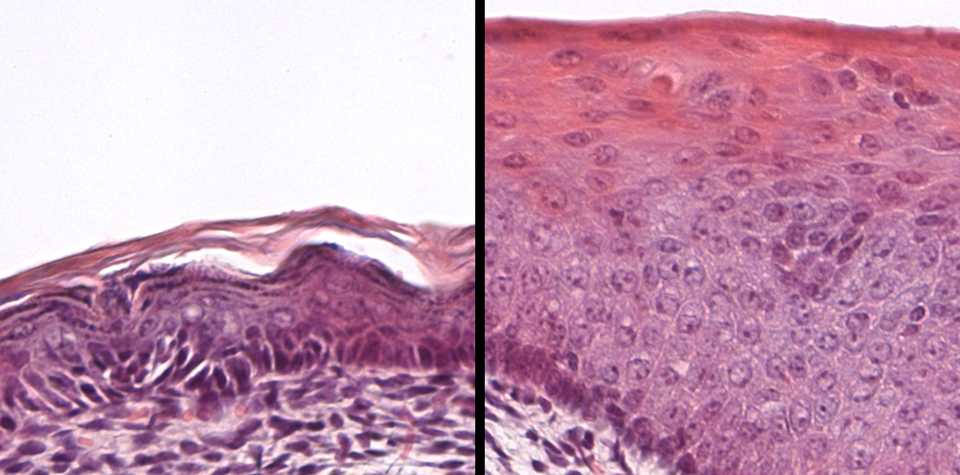
Normal, stratified epidermis just prior to birth
cornified
granular
spinous
basal
(stem cells)
x
x
x
x
Dermis
e18.5
Notes:
Proliferation is restricted to the basal layer. This is where the epidermal stem cells reside.

Slide 25
shd mutant epidermis is thick and disorganized
control shd mutant
cornified
granular
spinous
basal
Dermis
e18.5
Notes:
So we set out to examine markers of different layers to determine the ID of shd keratinocytes.

Slide 26
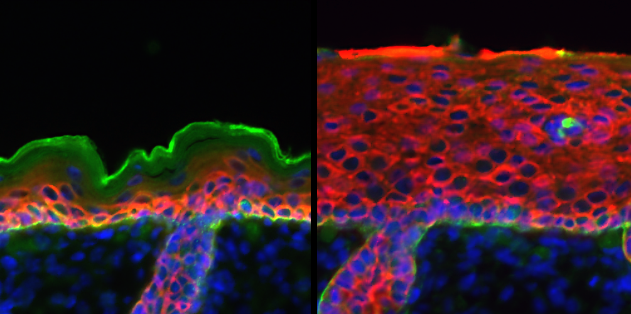
Basal markers expand in shd epidermis
wild type shd mutant
*
*
Dermis
HF
HF
e18.5
Keratin14, b4 integrin, DAPI
Notes:
Columnar morphology
We also see Keratin 5 expand

Slide 27
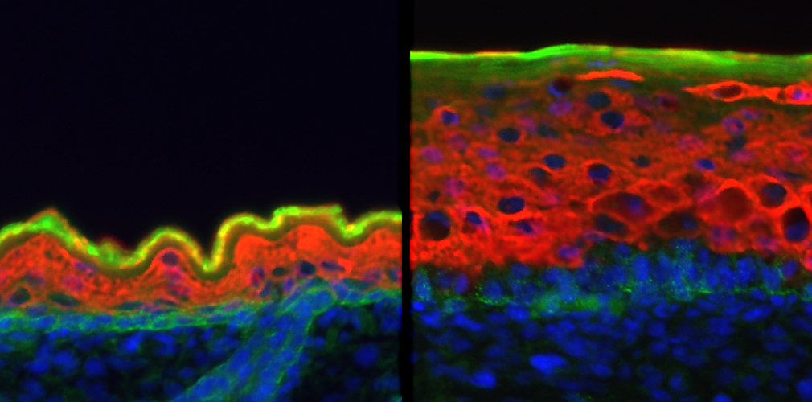
Distal shd keratinocytes express K14 & K10
wild type shd mutant
*
*
Dermis
e18.5
Keratin10, b4 integrin, DAPI
Notes:
Have a distinct basal layer, but distally, all homogeneous.
Differentiation is initiated, but fails to progress.

Slide 28
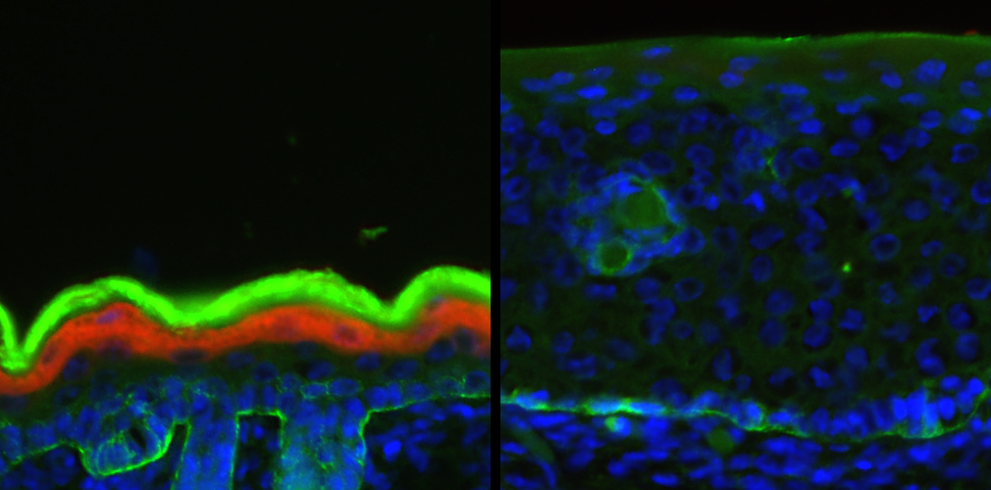
Terminal differentiation fails in shd mutants
wild type shd mutant
*
*
Dermis
e18.5
Loricrin, b4 integrin, DAPI
Notes:
But does the skin function normally?

Slide 29
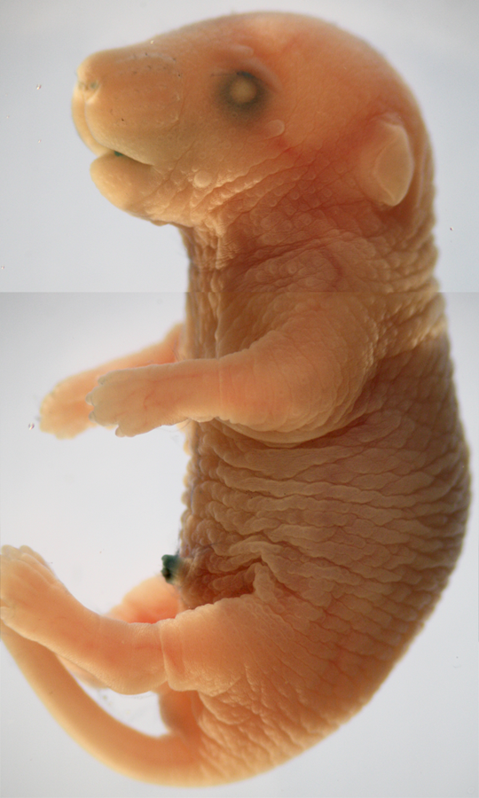
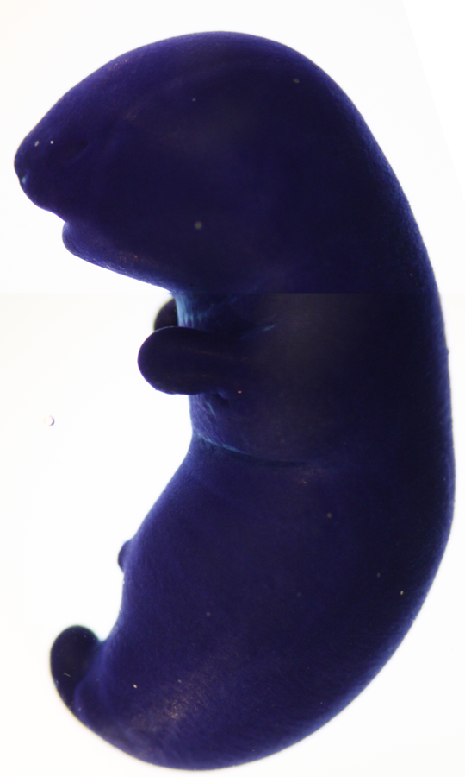
The epidermal barrier fails to form in shd mutants
control shd mutant
e18.5
Notes:
Toluidene Blue assay

Slide 30
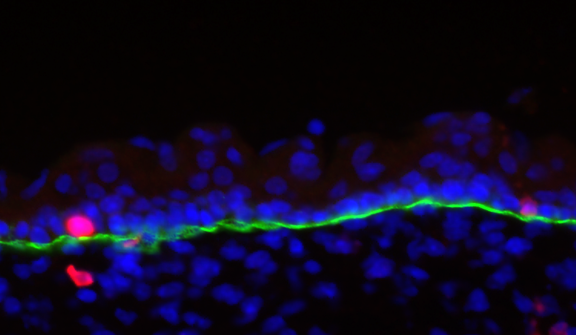
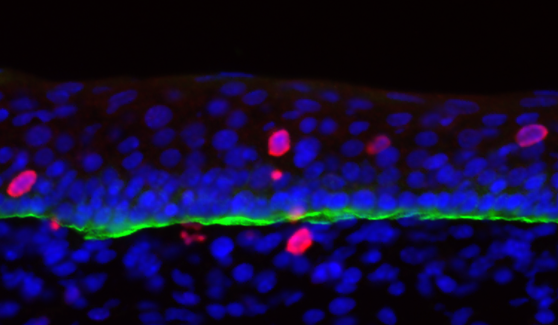
Proliferation is not halted in shd distal keratinocytes
wild type shd mutant
e16.5
pHH3, b4 integrin, DAPI

Slide 31
shd regulates the proliferation-differentiation switch
shd
Proliferate
Differentiate

Slide 32
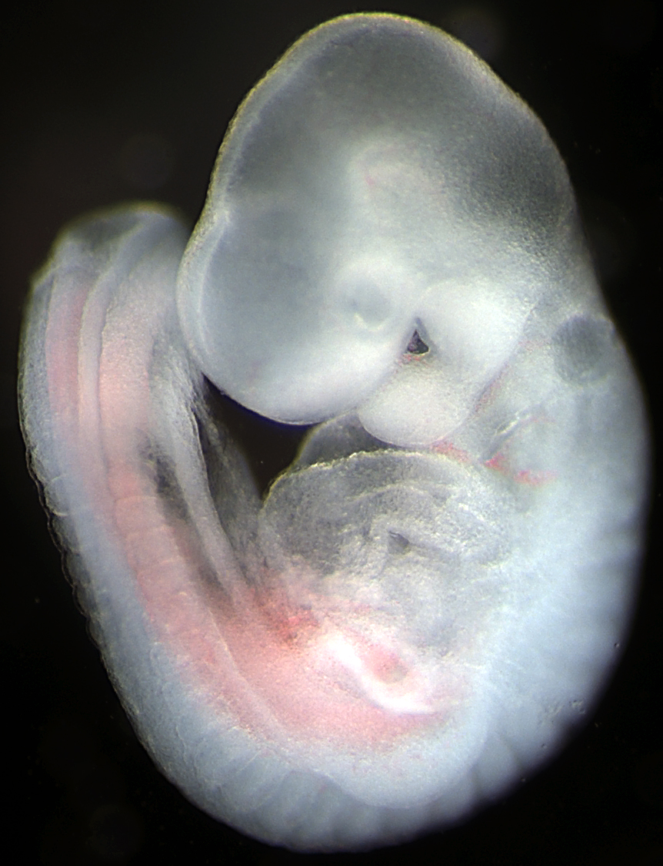
Epidermis begins as a single layer of cells
x
K14+, prolif.
x
e8.5-e9
x
x
Single-layered ectoderm

Slide 33
Epidermis forms a second layer at e14.5
x
K14+, prolif.
x
e8.5
x
x
x
K10/K14+, prolif.
x
x
intermediate
x
x
e14.5
K14+, prolif.
x
basal
x
x
Intermediate layer forms

Slide 34
Epidermis becomes stratified in late embryos
x
K14+, prolif.
x
e8.5
x
x
x
K10/K14+, prolif.
x
x
intermediate
x
x
e14.5
K14+, prolif.
x
basal
x
x
cornified
Loricrin+
granular
e17.5
K10+, non-prolif.
spinous
x
K14+, prolif.
x
basal
x
x
Terminal differentiation and restriction of stem cells

Slide 35
Is shd epidermis trapped in intermediate fate?
x
K14+, prolif.
x
e8.5
x
x
Single-layered ectoderm
x
K10/K14+, prolif.
x
x
intermediate
x
x
e14.5
K14+, prolif.
x
basal
x
x
Intermediate layer forms
K10/K14+, prolif.
x
x
intermediate
x
x
x
K10/K14+, prolif.
x
e17.5
x
intermediate
x
x
K10/K14+, prolif.
x
intermediate
x
x
x
K14+, prolif.
x
basal
x
x
Intermediate layer expands ??
Notes:
If this is true, you might expect
1 that proliferation of the stem cells and transit amplifying cells in the basal layer would not be altered in shd mutants
2 that epidermal development would proceed normally until e14, and then expansion would happen after the second layer was formed.

Slide 36
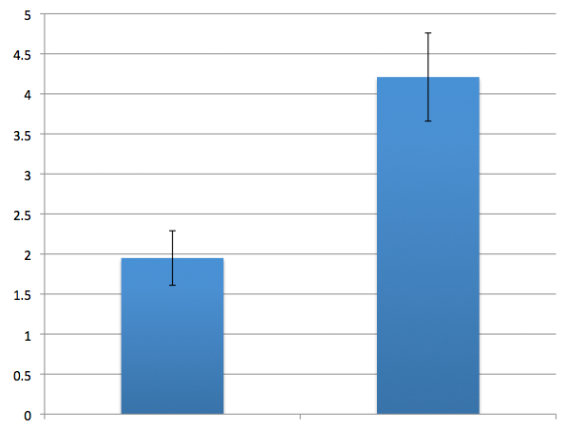
shd basal keratinocytes are hyperproliferative
***
Percentage of basal cells in mitosis
(phospho-histone H3+)
control shd mutant
e16.5
***P < 0.0005
Notes:
Two pieces of data that argue against this.
1. We see that basal cells have a higher mitotic index in shd mutants.

Slide 37
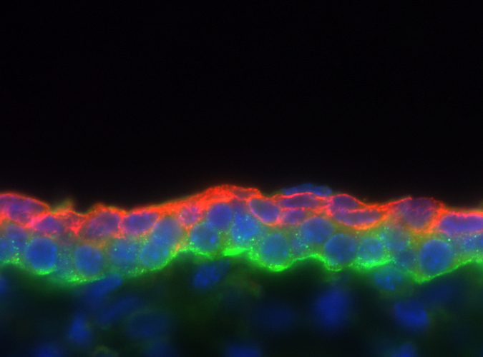
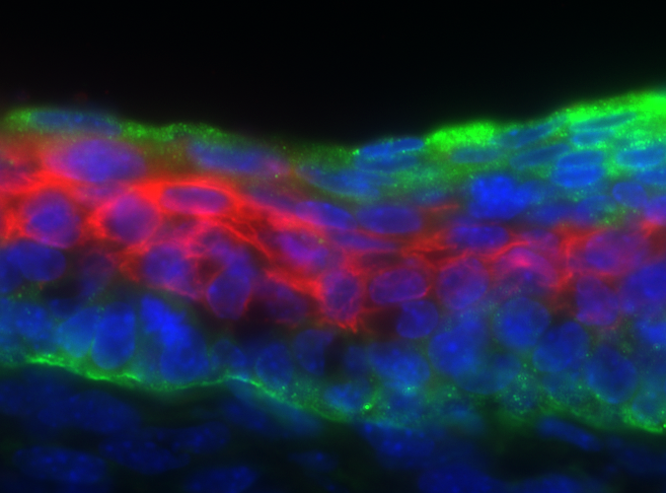
shd epidermal thickening occurs early
control shd mutant
e14.5
Keratin 10, b4 integrin, DAPI
Notes:
And, we observe that epidermal thickening precedes the stage of intermediate cell ID.

Slide 38
Shd curbs proliferation in epidermal stem cell layer and controls the proliferation-differentiation switch in progeny
Stem Cell
shd
Proliferating Stem
Cell Progeny
Differentiated
Progeny

Slide 39
OUTLINE
The shorthand mutant:
Identification & gross phenotype
Characterization of the skin
shd gene is essential for terminal differentiation
and a key brake on basal SC proliferation
Genetic interactions
Gene identity
Notes:
All processes involve multiple genes. We are also interested in genes that might act with shd in skin development.

Slide 40
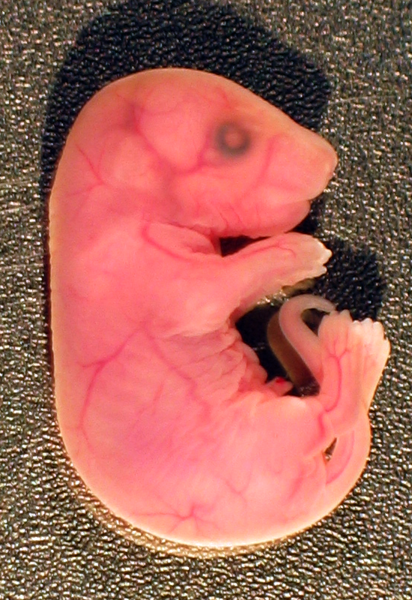
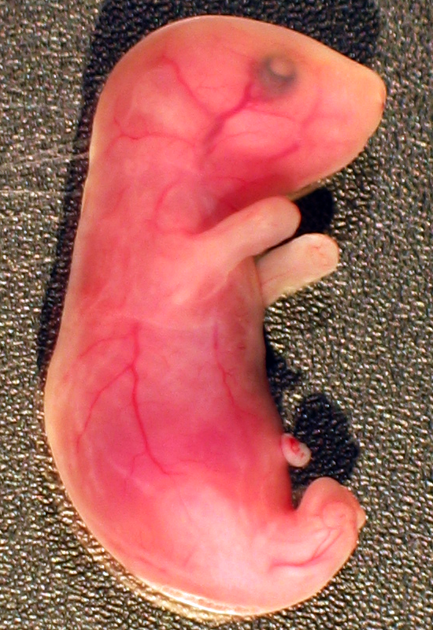
Stratifin (Sfn) mutants share the shd phenotype
Cleft Palate
Fused Esophagus
Taut Epidermis
Limbs Fused to Body
Control Sfn mutant
Notes:
Genes acting in the same pathway may have similar or opposite phenotypes

Slide 41
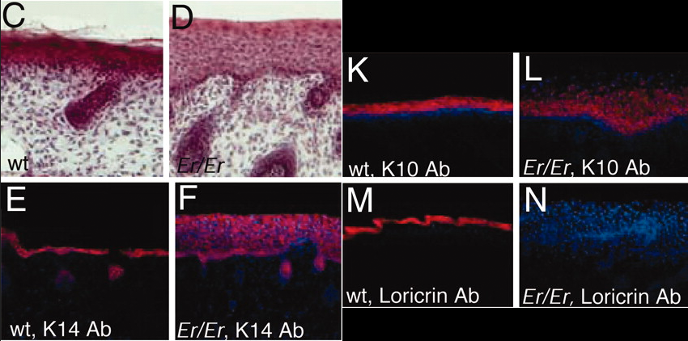
shd phenocopies Sfn differentiation defects
Control Sfn mutant
Control Sfn mutant
Li et al., PNAS 2005
Notes:
Inder Verma’s lab

Slide 42
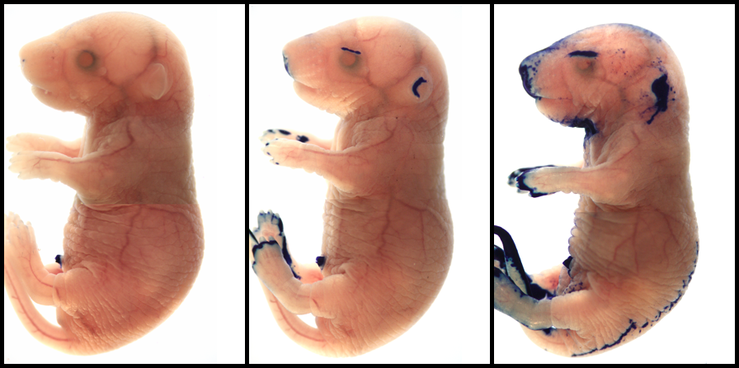
Together, shd and Sfn regulate barrier formation
Control Sfn heterozygote shd-Sfn double het
e18.5
Notes:
Shd het = control-like

Slide 43
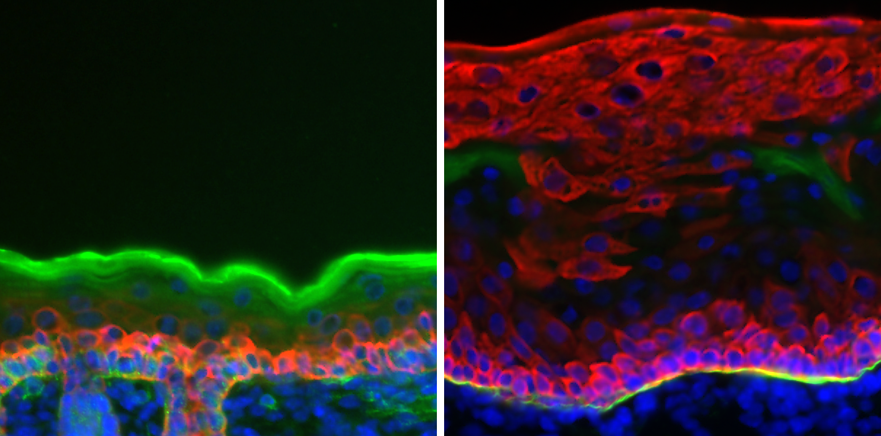
Basal markers expand in shd-Sfn double hets
Sfn heterozygote shd-Sfn double het
*
*
Keratin14, β4 integrin, DAPI
e18.5
Notes:
Columnar morphology
We also see Keratin 5 expand

Slide 44
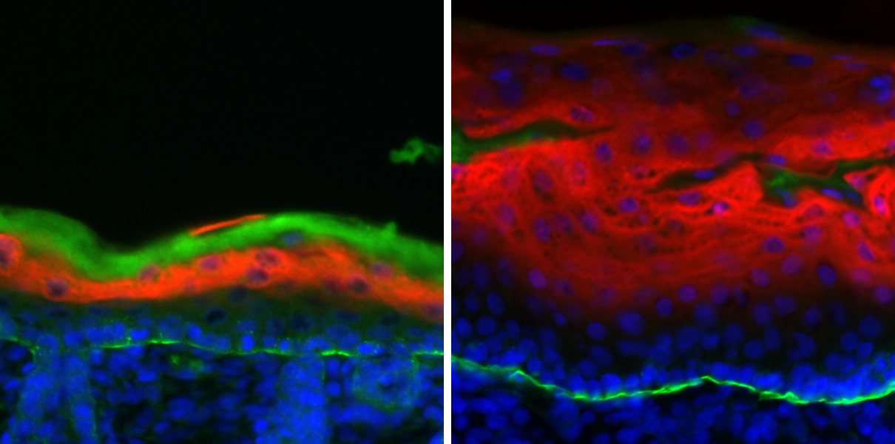
shd-Sfn double hets display differentiation defects
Sfn heterozygote shd-Sfn double het
*
*
Loricrin, β4 integrin, DAPI
e18.5
Notes:
Columnar morphology
We also see Keratin 5 expand

Slide 45
shd and Sfn act together to promote stepwise differentiation of the epidermis
Sfn shd
x
x
x
x
x
x
x
x
x
x
x
x
Intermediate cell fate
Loss of basal identity
Loss of distal proliferation
Terminal differentiation

Slide 46
p63 regulates Sfn, Irf6 and Ikkα
p63
Irf6 Sfn Ikkα
x
x
x
x
x
x
x
x
x
x
x
x
Intermediate cell fate
Loss of basal identity
Loss of distal proliferation
Terminal differentiation

Slide 47
p63 mutations underlie human epidermal syndromes
Ectrodactyly, Ectodermal Dysplasia, and Cleft Lip/Palate Syndrome 3 (EEC3)
Ankyloblepharon-Ectodermal Defects-Clefting
Syndrome (AEC)
Acro-Dermato-Ungual-Lacrimal-Tooth syndrome (ADULT)
Notes:
AEC = ectodermal dysplasia, including alopecia, scalp infections, dystrophic nails, hypodontia, ankyloblepharon (eyelid adhesdion defects), and cleft lip and/or cleft palate.

Slide 48
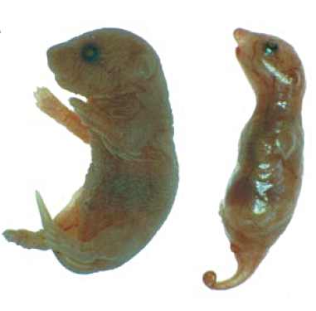
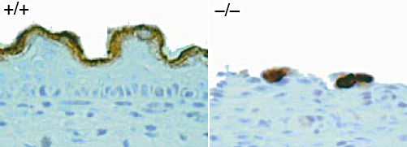
p63 mutants develop the opposite phenotype of shd
wild type p63 mutant wild type p63 mutant
Loricrin
Dermis
A thin, but differentiated
epidermis forms in p63 mutants.
Mills et al., Nature 1999 Yang et al., Nature 1999
Notes:
P63 is a transcription factor that has been shown to be involved in the maintenance of epidermal stem cells and in the stratification of the epidermis.

Slide 49
shd mutants show expanded p63 expression
wild type shd mutant
p63
Could too much p63 underlie the shd phenotype?
e18.5
Notes:
In our epidermis analysis, we observed an expansion of p63 expression in shd mutants. Could this expansion of p63 be a cause of the phenotype or a secondary effect?
Dosage…rescue?

Slide 50
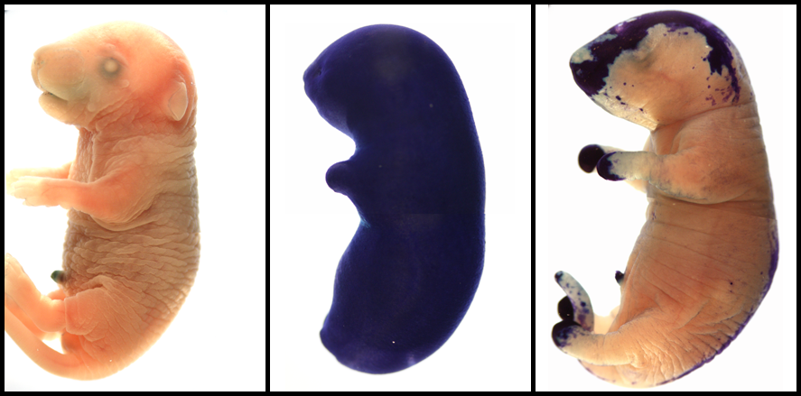
Reducing p63 dose rescues shd barrier defects
wild type shd/shd shd/shd; p63/+
e18.5

Slide 51
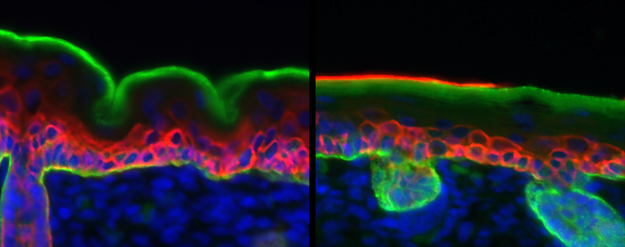
Reducing p63 dose rescues shd epidermis thickness and restriction of basal markers
Control shd/shd; p63/+
Keratin14, β4 integrin, DAPI
e18.5
Notes:
Columnar morphology
We also see Keratin 5 expand

Slide 52
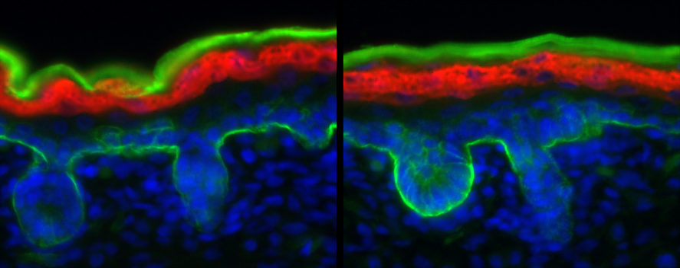
Reducing p63 dose rescues shd differentiation defects
Control shd/shd; p63/+
Keratin14, β4 integrin, DAPI
Loricrin, β4 integrin, DAPI
e18.5
Notes:
Columnar morphology
We also see Keratin 5 expand

Slide 53
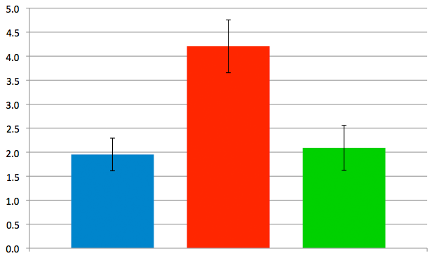
Lowering p63 dose rescues shd basal proliferation
***
***
Percentage of basal cells in mitosis
(phospho-histone H3+)
control shd/shd shd/shd
p63/+
***P < 0.0005
Notes:
Thickness has been restored to wild type levels. K14 is now restricted to the basal layer and Loricrin is expressed in more distal cells.

Slide 54
shd curbs stem cell proliferation and controls the proliferation-differentiation switch in progeny
Stem Cell
p63
shd & Sfn
Proliferating Stem
Cell Progeny
Differentiated
Progeny

Slide 55
OUTLINE
The shorthand mutant:
Identification & gross phenotype
Characterization of the skin
Genetic Interactions
shd acts with Sfn to regulate differentiation
and regulates p63 to curb proliferation
Gene Identity
Notes:
Everything so far has been focused on the phenotype. We had no idea which protein/gene was affected.
What sequence of DNA was affected?

Slide 56
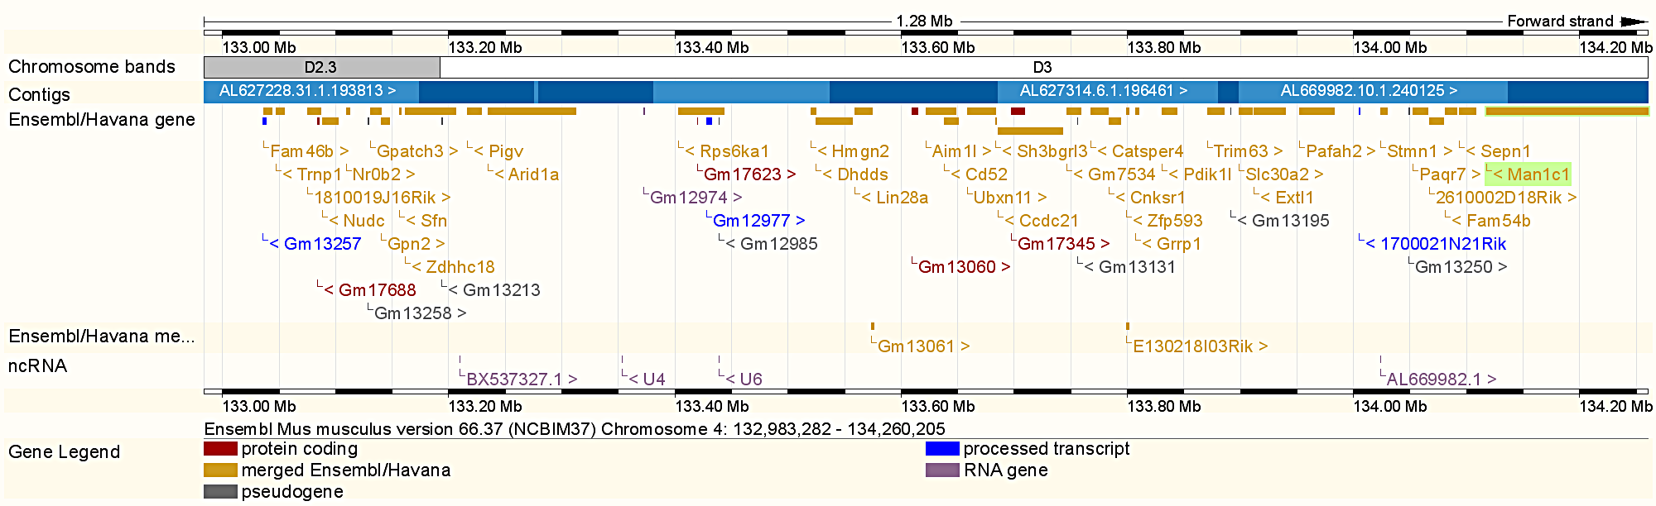
shd mapped to the distal region of mouse Chr4
Notes:
~1.2 Mb region on chromosome 4
~37 transcripts in this interval

Slide 57
We identified a mutation in the 1810019J16Rik gene
1810019J16Rik genomic region
1 Exon 2 3 4
1810019J16Rik mRNA
1810019J16Rik protein
Notes:
All genes in eukaryotes are in pieces
Intervening regions called introns. Careful splicing is important for making the right protein (eventually)

Slide 58
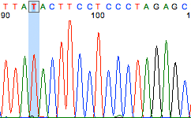
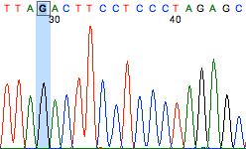
The shd mutation lies near the start of exon 3 in 1810019J16Rik
1810019J16Rik
T>G
1 Exon 2 3 4
wild type
exon3
T
shd mutant
G
Notes:
Thymine to Guanine transversion
14 bases upstream of exon 3

Slide 59

The shd mutation creates alters splicing of mRNA
1810019J16Rik
T>G
1 Exon 2 3 4
Wild type
shd mutant
1810019J16Rik mRNA
Notes:
Thymine to Guanine transversion
14 bases upstream of exon 3

Slide 60
The shd mutation causes multiple splice products
Wild type transcript
1 Exon 2 3 4
Mutant transcript 1 (frameshift)
T>G
T>G
Mutant transcript 2 (in-frame deletion)
Notes:
Sequencing the RNA confirmed that there were splicing problems. The nature of those is …

Slide 61
The shd mutation alters the C-terminus of the protein
Proline rich
WT
Cysteine rich
shd frameshift
shd
deletion

Slide 62
The shd mutation alters the C-terminus of the protein
Proline rich
WT
Cysteine rich
shd frameshift
shd
deletion
Renamed 1810019J16Rik =
Epidermal Differentiation Factor 1 (Edf1)

Slide 63

Edf1 is highly conserved across mammals
shd mutation
Notes:
Maybe it is really important

Slide 64


Edf1 RNA is expressed in keratinocytes
Skin Esophagus
1810019J16Rik RNA expression
e18.5
Notes:
Future directions involve determining where & when shd act. How it interacts with Er and how it regulates p63

Slide 65




Edf1 protein is found at cell borders
Edf1
DAPI
β4 integrin
e12.5 e16.5

Slide 66
Confirming the affected gene with a 2nd allele
Wild type gene
1 Exon 2 3 4
Welcome Trust Sanger Institute targeted allele
1 Exon 2 3 4
Genetrap
(same phenotype as shd mutant)
Notes:
European Conditional Mouse Mutagenesis Program
Welcome Trust Sanger Institute

Slide 67

gene
trap
shd
Figure 4.11
Notes:
Figure 4-11 Complementation analysis of alternative outcomes of two wingless mutations in Drosophila (mª and m^{b}). In Case 1, the mutations are not
alleles of the same gene, while in Case 2, the mutations are alleles of the same gene.
Mating of two organisms with similar mutant phenotypes can lead to wild type offspring, a phenomenon called genetic complementation
Complementation occurs when the mutations in the parents affect different genes

Slide 68
gene
trap
gene
trap
shd
shd
Notes:
Figure 4-11 Complementation analysis of alternative outcomes of two wingless mutations in Drosophila (mª and m^{b}). In Case 1, the mutations are not
alleles of the same gene, while in Case 2, the mutations are alleles of the same gene.

Slide 69




The genetrap allele fails to complement shd
Control Edf1^{shd/GT}

Slide 70

Edf1^{shd/GT} embryos fail to form a barrier
Control Edf1^{shd/GT}
e18.5

Slide 71


Thickening & basal markers expand in Edf1^{shd/GT}
Control Edf1^{shd/GT}
K5, β4 integrin, DAPI
e18.5

Slide 72


Loss of differentiation in Edf1^{shd/GT}
Control Edf1^{shd/GT}
Loricrin, β4 integrin, DAPI
e18.5

Slide 73
OUTLINE
The shorthand mutant:
Identification & gross phenotype
Characterization of the skin
Genetic interactions
Gene Identity
The shd mutation affects a novel, cytoplasmic
protein expressed in keratinocytes
Notes:
led us to a novel gene because of the great phenotype

Slide 74
Edf1 curbs stem cell proliferation and controls the proliferation-differentiation switch in progeny
Stem Cell
p63
Edf1 & Sfn
Proliferating Stem
Cell Progeny
Differentiated
Progeny

Slide 75


Current Lab Members:
Sunjin Lee
Kasey Basch
Emily Mis
Past Lab Members:
Will Horton
Stephanie Andrade
Valentina Greco & Lab
Sequence Capture:
Yale Center for
Genome Analysis
Bioinformatics:
Yong Kong
Sfn Mice:
Michael Karin UCSD
Yale Cancer Center
NIH
www.yale.edu/weatherbeelab

Slide 77




shd mutants have short digits
control shd mutant
Forelimbs
Hindlimbs

Slide 78

Irf6 and Ikkα mutants share the shd phenotype
Humans:
Irf6 heterozygotes:
Van der Woude Syndrome
Popliteal Pterygium Syndrome
Ikkα homozygotes:
Cocoon Syndrome
Mouse Homozygotes:
Cleft Palate
Fused Esophagus
Taut Epidermis
Limbs Fused to Body
Lahtela et al., 2010
Notes:
Similar to Stratifin mutants.
VWS, cleft palate and lip.
WE are interested to see if shd interacts with these proteins.

Slide 79


Edf1 is expressed in keratinocytes
genetrap
genetrap
e18.5
Notes:
Future directions involve determining where & when shd act. How it interacts with Er and how it regulates p63

Slide 80










ENU Screen
x
Recessive
Screen (autosomal)
mutagen
C57BL/6J
C3H/HeJ
x
F1
C3H
Mate @ 9 months
G2
Score embryos 1-2 weeks later
Notes:
After allowing the G2 females to grow up, you can now set up test crosses by mating G2 females with their fathers. You can begin scoring mutants within a week after mating the G2s, depending on the time of observation.

Slide 81

Sequence Capture idenitfied the shd gene
Isolate mutant DNA
Fragment
Hybridize to oligo array
Elute
Sequence
Nimblegen brochure
Notes:
At this point, still not cost-effective to sequence entire genome. But, by using Genome reduction strategies, can rapidly identify mutations in an interval.
Yong used BWA for mapping. (Burrows-Wheeler Alignment tool).
Yong used SamTools for SNV calling

Slide 82
Irf6 and Ikkα are also required for differentiation
Irf6 Ikkα
Sfn shd
x
x
x
x
x
x
x
x
x
x
x
x
Intermediate cell fate
Loss of basal identity
Loss of distal proliferation
Terminal differentiation

Slide 83
Normal Mouse Epidermal Development
x
K14+, prolif.
x
e8.5
x
x
Single-layered ectoderm
x
K10/K14+, prolif.
x
x
intermediate
x
x
e14.5
K14+, prolif.
x
basal
x
x
Intermediate layer forms
cornified
Loricrin+
granular
e17.5
K10+, non-prolif.
spinous
x
K14+, prolif.
x
basal
x
x
Terminal differentiation and restriction of stem cells

Slide 84


We study mouse limbs and skin
www.med.unc.edu

Slide 85

Confirming the affected gene with a 2nd allele
1810019J16Rik^{tm1a(EUCOMM)Wtsi}
1 Exon 2 3 4
Genetrap
Notes:
European Conditional Mouse Mutagenesis Program
Welcome Trust Sanger Institute

