Slide 1
Chapter 1 Introduction
LO1-1: Identify the elements of operations and supply chain management (OSCM).
LO1-2: Know the potential career opportunities in operations and supply chain management.
LO1-3: Recognize the major concepts that define the operations and supply chain management field.
LO1-4: Evaluate the efficiency of a firm.

Slide 2
Strategic Initiatives at Tesla to Address Major Obstacles for Battery-Powered Car
Built thousands of “supercharging” stations
Building a giant battery plant
Introduced “battery swap” technology

Slide 3
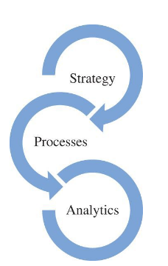
Success Depends On
Clever integration of a great operations-related strategy
Processes to deliver products and services
Analytics to support the decisions needed to manage the firm

Slide 4
What Is Operations and Supply Chain Management?
The design, operation, and improvement of the systems that create and delivery the firm’s primary products and services
Operations and supply chain management (OSCM) is
  A functional field of business
  Clear lines management responsibilities
  Concerned with the management of the entire production/delivery system

Slide 5
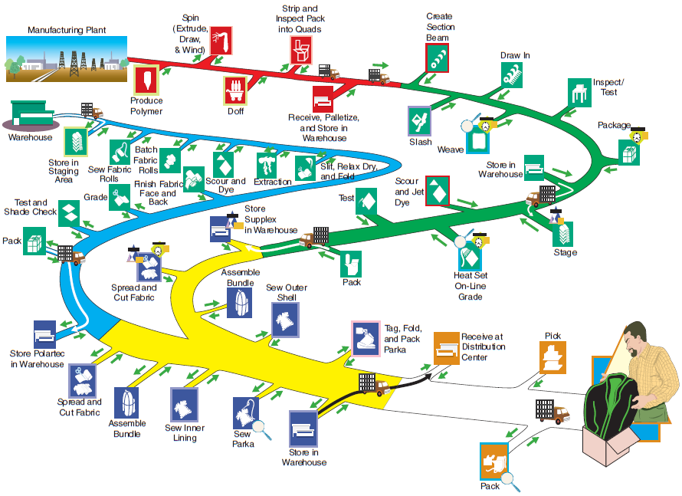
Process Steps for Men’s Nylon Supplex Parkas
Exhibit 1.1

Slide 6
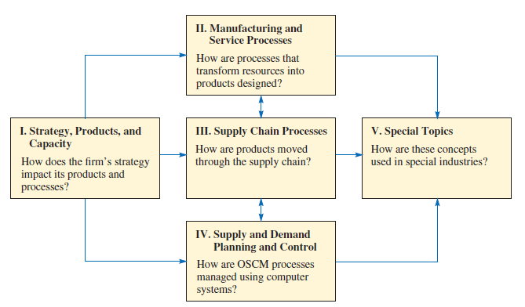
Questions Answered in Each Section of the OSCM
Exhibit 1.2

Slide 7
Operations and Supply Chain Terms
Operations
Supply Chain
Manufacturing and service processes used to transform resources into products
Processes that move information and material to and from the firm

Slide 8
Basic Principles that Guide the Design of Transformation Processes
How different types of processes are organized
How to determine the capacity of a process
How long it should take to make a unit
How the quality of a process is monitored
How information is used to make decisions

Slide 9
Process Activities
Planning – processes needed to operate an existing supply chain
Sourcing – selection of suppliers that will deliver the goods and services needed to create the firm’s product
Making – producing the major product or service
Delivering – logistics processes such as selecting carriers, coordinating the movement of goods and information, and collecting payments from customers
Returning – receiving worn-out, excess, and/or defective products back from customers

Slide 10
Supply Chain Processes
Exhibit 1.3

Slide 11
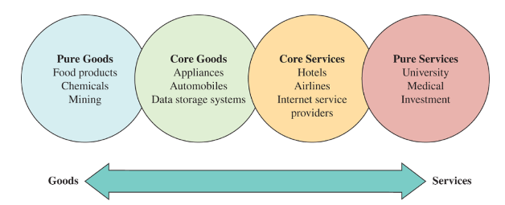
The Goods–Services Continuum
Exhibit 1.4

Slide 12
Careers in OSCM
OSCM careers specialize in managing the planning, production, and distribution of goods and services
Operations and supply chain manager works with people to figure out the best way to deliver the goods and services of the firm
OSCM jobs are hands-on, working with people and figuring out the best way to do things

Slide 13
OSCM Specialist Areas
Product design
Purchasing
Manufacturing
Service operations
Logistics
Distribution

Slide 14
Possible Careers in OSCM
Plant manager
Hospital administrator
Branch manager
Department store manager
Call center manager
Supply chain manager
Purchasing manager
Business process improvement analyst
Quality control manager
Lean improvement manager
Project manager
Production control analyst
Facilities manager
Chief operating officer

Slide 15
Chief Operating Officer (COO)
Works with CEO and president to determine the company’s competitive strategy
COO determines…
  Location
  Facilities
  Vendors to use
  Implementation of the hiring policy
Once key decisions are made, lower-level operations personnel carry them out

Slide 16
Time Line Depicting When Major OSCM Concepts Became Popular
Exhibit 1.5

Slide 17
The Major Concepts that Define the OSCM Field
Manufacturing strategy paradigm
Lean manufacturing, JIT, and TQC
Service quality and productivity
Total quality management and quality certification
Business process reengineering
Six sigma quality
Supply chain management
Electronic commerce
Sustainability and the triple bottom line
  Business strategy that includes social, economic and environmental criteria
Business analytics

Slide 18
Current Issues in Operations and Supply Chain Management
Coordinating the relationships between mutually supportive but separate organizations
Optimizing global supplier, production, and distribution networks
Managing customer touch points
Raising senior management awareness of OSCM as a significant competitive weapon
Sustainability and the triple bottom line

Slide 19
Efficiency, Effectiveness, and Value
Efficiency - doing something at the lowest possible cost
Effectiveness - doing the right things to create the most value for the company
Value - quality divided by price
  Quality - the attractiveness of the product, considering its features and durability

Slide 20
How Does Wall Street Evaluate Efficiency?
Earnings growth is largely a function of profitability
Profits can be increased through higher sales or lower cost
Highly efficient firms usually do well during recessions
Benchmarking - a process in which one company studies the processes of another company (or industry) to identify best practices

Slide 21
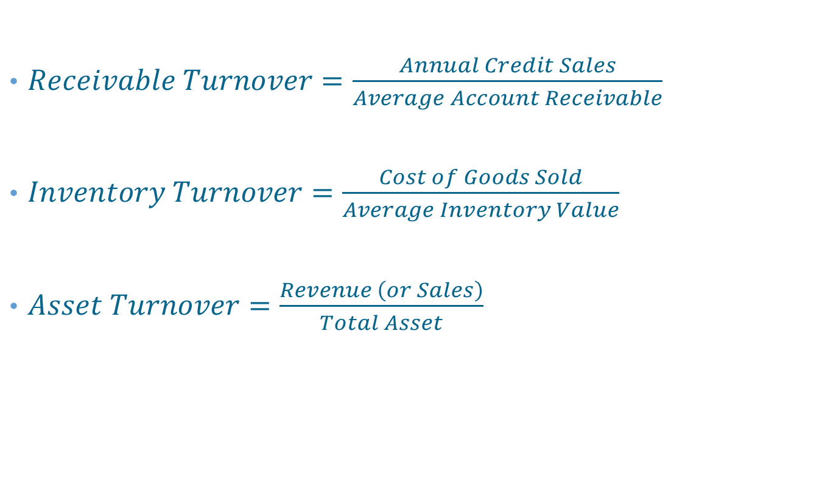
Management Efficiency Ratios
$Receivable Turnover=\frac{Annual Credit Sales}{Average Account Receivable}$
$Inventory Turnover=\frac{Cost of Goods Sold}{Average Inventory Value}$
$Asset Turnover=\frac{Revenue \left(or Sales\right)}{Total Asset}$

Slide 22
Summary
Processes are used to implement the strategy of the firm
Analytics are used to support the ongoing decisions needed to manage the firm
OSCM people specialize in managing the production of goods and services
OSCM jobs are hands-on and require working with others and figuring out the best way to do things
The chief operating officer (COO) works with the CEO and company president to determine the company’s competitive strategy
COOs determine an organization’s location, its facilities, which vendors to use, and how the hiring policy will be implemented
Many of the concepts that form the OSCM field have their origins in the Industrial Revolution in the 1800’s

Slide 23
Practice Exam
The pipeline-like movement of the materials and information needed to produce a good or service
A strategy that meets the needs of shareholders and employees and that preserves the environment
The processes needed to determine the set of future actions required to operate an existing supply chain
The selection of suppliers
A type of process where a major product is produced or a service provided
A type of process that moves products to warehouses or customers
Processes that involve the receiving of worn-out, defective, and excess products back from customers and support for customers who have problems
A type of business where the major product is intangible, meaning it cannot be weighed or measured

Slide 24
Practice Exam Continued
Refers to when a company builds service activities into its product offerings
Means doing something at the lowest possible cost
Means doing the right things to create the most value for the company.
Abstractly defined as quality divided by price
A philosophy that aggressively seeks to eliminate causes of production defects
An approach that seeks to make revolutionary changes as opposed to evolutionary changes (which is advocated by total quality management).
An approach that combines TQM and JIT
Tools that are taught to managers in “Green and Black Belt Programs.”
A program to apply the latest concepts in information technology to improve service productivity

