Slide 1
Chapter 2 Strategy
LO2–1: Know what a sustainable business strategy is and how it relates to operations and supply chain management.
LO2–2: Define operations and supply chain strategy.
LO2–3: Explain how operations and supply chain strategies are implemented.
LO2–4: Understand why strategies have implications relative to business risk.
LO2–5: Evaluate productivity in operations and supply chain management.
McGraw-Hill/Irwin
Copyright © 2014 by The McGraw-Hill Companies, Inc. All rights reserved.

Slide 2
Sustainable Strategy
The firm’s strategy describes how it will create and sustain value for its current shareholders
Shareholders – individuals or companies that legally own one or more shares of stock in the company
Stakeholders – individuals or organizations who are directly or indirectly influenced by the actions of the firm
Adding a sustainability requirement means meeting value goals without compromising the ability of future generations to meet their own needs
Triple bottom line – evaluating the firm against social, economic, and environmental criteria

Slide 3
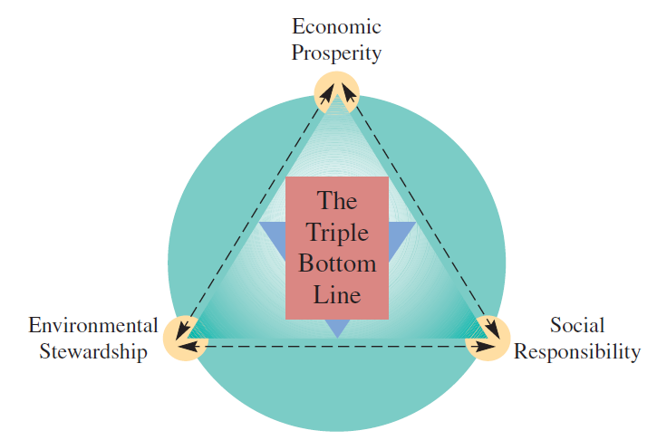
Triple Bottom Line
Exhibit 2.1

Slide 4
Triple Bottom Line Continued
Social responsibility: this pertains to fair and beneficial business practices toward labor, the community, and the region in which a firm conducts its business
Economic prosperity: the firm is obligated to compensate shareholders who provide capital
Environmental stewardship: this refers to the firm’s impact on the environment

Slide 5
What is Operations and Supply Chain Strategy?
Operations and supply chain strategy: setting broad policies and plans for using the resources of a firm – must be integrated with corporate strategy
Corporate strategy provides overall direction and coordinates operational goals with those of the larger organization
Can be viewed as part of a planning process that coordinates operational goals with those of the larger organization
Operations effectiveness: performing activities in a manner that best implements strategic priorities at a minimum cost

Slide 6
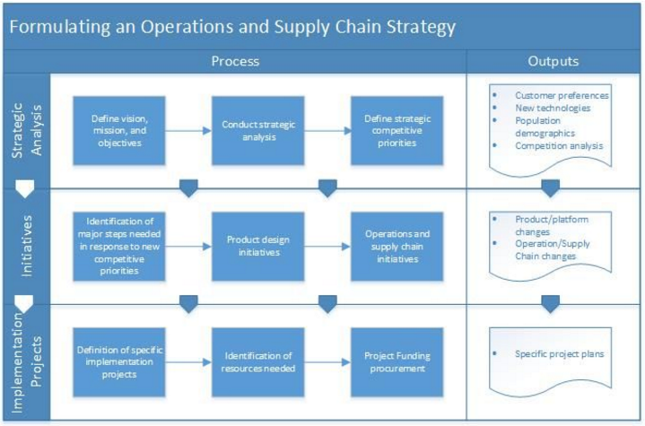
Formulating an Operations and Supply Chain Strategy
Exhibit 2.2

Slide 7
Competitive Dimensions
Price
Make the product or deliver the service cheap
Quality
Make a great product or delivery a great service
Delivery Speed
Make the product or deliver the service quickly
Delivery Reliability
Deliver it when promised
Coping with Changes in Demand
Change its volume
Flexibility and New-Product Introduction Speed
Change it

Slide 8
Other Product-Specific Criteria: “Support It”
Technical liaison and support
A supplier may be expected to provide technical assistance for product development
Meeting a launch date
A firm may be required to coordinate with other firms on a complex project
Supplier after-sale support
An important competitive dimension may be the ability of a firm to support its product after the sale
Environmental impact
This dimension is related to environmental/green criteria
Other dimensions
These typically include such factors as colors available, size, weight, location of the fabrication site, customization available, and product mix options

Slide 9
Trade-Offs
Management must decide which parameters of performance are critical and concentrate resources on those characteristics
For example, a firm that is focused on low-cost production may not be capable of quickly introducing new products
Straddling: seeking to match a successful competitor while maintaining its existing position
It adds features, services, or technology to existing activities
Often a risky strategy

Slide 10
Order Winners and Order Qualifiers
Order qualifiers: those dimensions that are necessary for a firm’s products to be considered for purchase by customers
Features customers will not forego
Order winners: criteria used by customers to differentiate the products and services of one firm from those of other firms
Features that customers use to determine which product to ultimately purchase

Slide 11
Strategies are Implemented Using Operations and Supply Chain Activities
All operations activities relate to one another
To be efficient, the firm must minimize total cost without compromising customers’ needs
Consider IKEA
Targets young, low cost buyers
Uses a self-service model showing furniture in familiar settings
Designs its own low-cost, modular, ready-to-assemble furniture
Stores stock the products in boxes
Customers pick their own boxes from inventory
Offers in-store child care and extended hours

Slide 12
Supply Chain Risk Examples
Japanese Tsunami (March 2011)
In 1996 General Motors experienced an 18-day labor strike at a brake supplier factory
This strike idled workers at 26 assembly plants and led to an estimated $900 million reduction in earnings
In 1997 a Boeing supplier’s failure to deliver two critical parts led to a loss of $2.6 billion
In 2000, a 10-minute fire at a Phillips plant that supplied integrated circuits led to a $400 million loss

Slide 13
Assessing Risk Associated with OSCM Strategy
All strategies have an inherent level of risk
Uncertainty in the environment causes supply chain planners to evaluate the relative riskiness of their strategies
Supply chain risk: the likelihood of a disruption that would impact the ability of a company to continuously supply products or services
Supply chain coordination risks are associated with the day-to-day management of the supply chain
Disruption risks are caused by natural or manmade disasters

Slide 14
Risk Mitigation Framework
Identify the sources of potential disruptions
Focus on highly unlikely events that would cause a significant disruption to normal operations
Assess the potential impact of the risk
Here the goal is to quantify the probability and the potential impact of the risk
Could be based on financial impact, environmental impact, ongoing business viability brand image/reputation, potential human lives, and so on
Develop plans to mitigate the risk
A detailed strategy for minimizing the impact of the risk could take many different forms, depending on the nature of the problem

Slide 15
Risk Mitigation Strategies
Risk | Risk Mitigation Strategy
Natural disaster | Contingency planning (alternate sites, etc.) insurance
Country risks | Hedge currency, produce/source locally
Supplier failure | Use multiple suppliers
Network provider failure | Support redundant digital networks
Regulatory risk | Up-front and continuing research; good legal advice, compliance
Commodity price risks | Multisource, commodity hedging

Slide 16
Risk Mitigation Strategies Continued
Risk | Risk Mitigation Strategy
Logistics failure | Safety stock, detailed tracking and alternate suppliers
Inventory risks | Pool inventory, safety stock
Major quality failure | Carefully select and monitor suppliers
Loss of customers | Service/product innovation
Theft and vandalism | Insurance, security precautions, knowledge of likely risks, patent protection, etc.

Slide 17
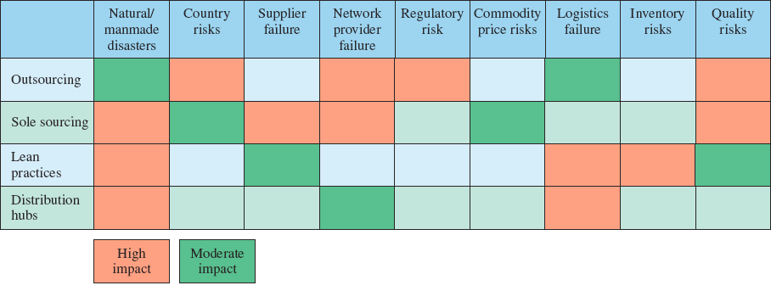
Risk Assessment Matrix
Exhibit 2.4 (Partial)

Slide 18
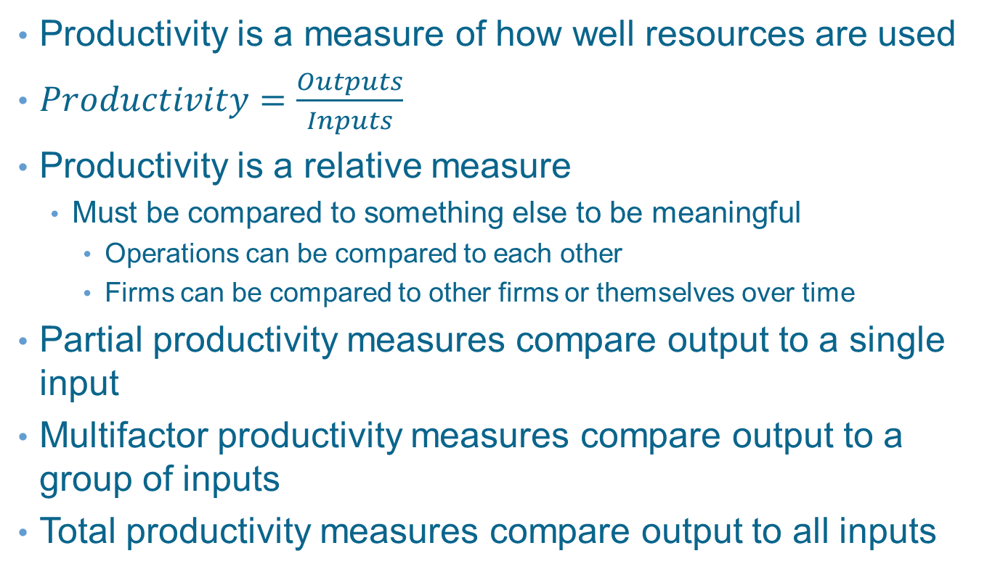
Productivity Measurement
Productivity is a measure of how well resources are used
$Productivity=\frac{Outputs}{Inputs}$
Productivity is a relative measure
Must be compared to something else to be meaningful
Operations can be compared to each other
Firms can be compared to other firms or themselves over time
Partial productivity measures compare output to a single input
Multifactor productivity measures compare output to a group of inputs
Total productivity measures compare output to all inputs

Slide 19
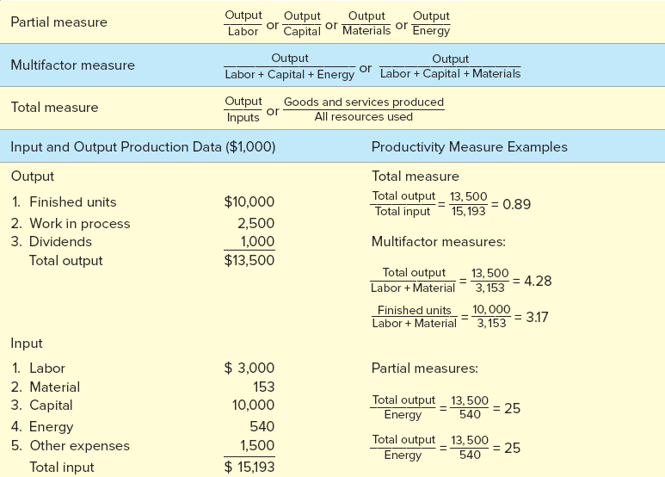
Productivity Calculation
Exhibit 2.5 (Partial)

Slide 20
Partial Measures of Productivity
Business | Productivity Measure
Restaurant | Customers (meals) per labor hour
Retail store | Sales per square foot
Chicken farm | Pounds of meat per pound of feed
Utility plant | Kilowatt hours per ton of coal
Paper mill | Tons of paper per cord of wood

Slide 21
Summary
A strategy that is sustainable needs to create value
Shareholders are equity owners in the company
Stakeholders are individuals and organizations that are influenced by the firm
Operations and supply chain strategy involves setting the broad policies for using a firm’s resources
Coordinates operational goals with those of the larger organization
Strategies are implemented through a set of activities designed to deliver products and services in a manner consistent with the firm's overall business strategy
Operations and supply chain strategies need to be evaluated relative to their riskiness
Supply chain disruptions are unplanned and unanticipated events that disrupt the normal flow of goods and materials
Supply chain coordination risks and disruption risks
Productivity measures are used to ensure that the firm makes the best use of its resources

Slide 22
Practice Exam
A strategy that is designed to meet current needs without compromising the ability of future generations to meet their needs
The three criteria included in a triple bottom line
The seven operations and supply chain competitive dimensions
It is probably most difficult to compete on this major competitive dimension
This occurs when a company seeks to match what a competitor is doing while maintaining its existing competitive position

Slide 23
Practice Exam Continued
A criterion that differentiates the products or services of one firm from those of another
A screening criterion that permits a firm’s products to be considered as possible candidates for purchase
A diagram showing the activities that support a company’s strategy
A measure calculated by taking the ratio of output to input

