Slide 1
Chapter 3: Design of Products and Services
LO3–1: Know the issues associated with product design and the typical processes used by companies
LO3–2: Illustrate how different criteria can impact the design of a product
LO3–3: Contrast how service products can have different design criteria compared to manufactured products
LO3–4: Evaluate the economic impact of a new product on a company
LO3–5: Illustrate how product development is measured in a company
McGraw-Hill/Irwin

Slide 2
The Product Design Process
Companies continuously bring new products to market
Product design is integral to success
Product design differs significantly depending on the industry
Companies often outsource major functions

Slide 3
Contract manufacturer
  Contract manufacturer: an organization capable of manufacturing and/or purchasing all the components needed to produce a finished product
Core competency: the one thing a company can do better than its competitors
A core competency has three characteristics:
  It provides potential access to a wide variety of markets
  It increases perceived customer benefits
  It is hard for competitors to imitate

Slide 4
Examples of Successful Companies
Apple Computer
  Designs the iPhone
  Subcontracts the fabrication
  Maintains ownership of the IP
Tesla Motors
  Developed all electric car with extended range
  Has batteries that a reduced fire risk
  Has supercharging technology
  Developing self-driving technology
A pharmaceutical company
  May purchase information on genetic targets from a genomics company
  Contract with a specialist for rapid synthesis and screening of compounds
  Utilize a contract research organization for clinical trials
  Retain the IP

Slide 5
Six Phases of the Generic Development Process (Formal Process)
Phase 0: Planning
Phase 1: Concept development
Phase 2: System-level design
Phase 3: Design detail
Phase 4: Testing and refinement
Phase 5: Production ramp-up

Slide 6
Phase 0: Planning
Precedes project approval
Begins with corporate strategy
Includes assessment of technology developments and market objectives
Output is the project mission statement

Slide 7
Phase 1: Concept Development
Needs of the target market are identified
Alternative product concepts are generated and evaluated
One or more concepts are selected for further development and testing
Concept: a description of the form, function, and features of a product

Slide 8
Phase 2: System-Level Design
Definition of the product architecture
Decomposition of the product into subsystems and components
Final assembly scheme for the production system is usually defined
Output:
Geometric layout of the product
Functional specifications for each subsystem
Preliminary process flow diagram

Slide 9
Phase 3: Design Detail
Complete specification of the geometry, materials, and tolerances for all parts
Identification of all the standard parts to be purchased from suppliers
Process plan is established
Tooling is designed
Output:
Drawings describing the geometry of each part and its tooling
Specifications of purchased parts
Process plan

Slide 10
Phase 4: Testing and Refinement
Construction and evaluation of multiple preproduction versions of product
Same geometry and material as production version
Not necessarily fabricated with the actual production processes
Prototypes tested to determine if the product will work as designed

Slide 11
Phase 5: Production Ramp-Up
Product is made using the intended production system
Need to train workers and resolve any remaining problems
Products may be supplied to preferred customers for evaluation
Transition to ongoing production is gradual

Slide 12
Generic Product Development Process
Technology-push products
Firm begins with new technology and looks for a market
Platform products
Built around a preexisting technological subsystem
Process-intensive products
Production process has an impact on the properties of the product
Product design cannot be separated from process design

Slide 13
Generic Product Development Process Continued
Customized products
New products are slight variations of existing configurations
High-risk products
Technical or market uncertainties create high risks of failure
Quick-build products
Rapid modeling and prototyping enables many design-build-test cycles
Complex systems
Systems must be decomposed into several subsystems and many components

Slide 14
Summary of Variants of Generic Product Development Process
Exhibit 3.2

Slide 15
Quality Function Deployment
Interfunctional teams from marketing, design engineering, and manufacturing
Begins with listening to the customer
  Uses market research
Converts the expectations and demands of customers into clear objectives
  These are then translated into specifications
Customer requirements forms the basis for the house of quality
Notes:
6

Slide 16
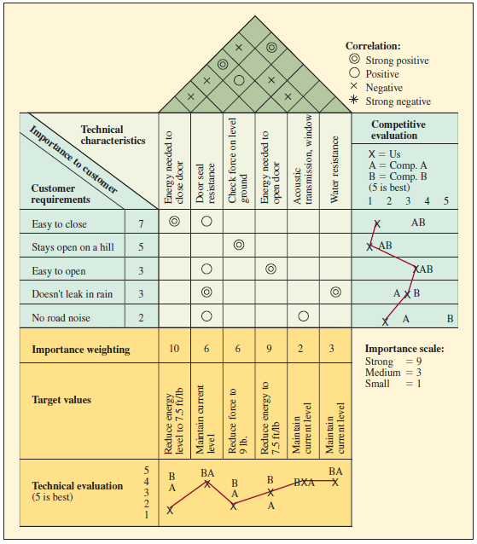
Completed House of Quality Matrix for a Car Door
Exhibit 3.3

Slide 17
Value Analysis/Value Engineering (VA/VE)
Purpose is to simplify products and processes
Objective is to achieve better performance at a lower cost while maintaining all functional requirements defined by the customer
Involves brainstorming such questions as:
  Does the item have any design features that are not necessary?
  Can two or more parts be combined into one?
  How can we cut down the weight?
  Are there nonstandard parts that can be eliminated?
Notes:
8

Slide 18
Designing Products for Manufacture and Assembly
Traditional approach
  “We design it, you build it” or “over the wall”
Concurrent engineering
  “Let’s work together simultaneously”
Notes:
9

Slide 19
Three Criteria Against Which Each Part Must be Examined
During the operation of the product, does the part move relative to all other parts already assembled?
Must the part be of a different material or be isolated from other parts already assembled?
Must the part be separate from all other parts to allow the disassembly of the product for adjustment or maintenance?
Notes:
10

Slide 20
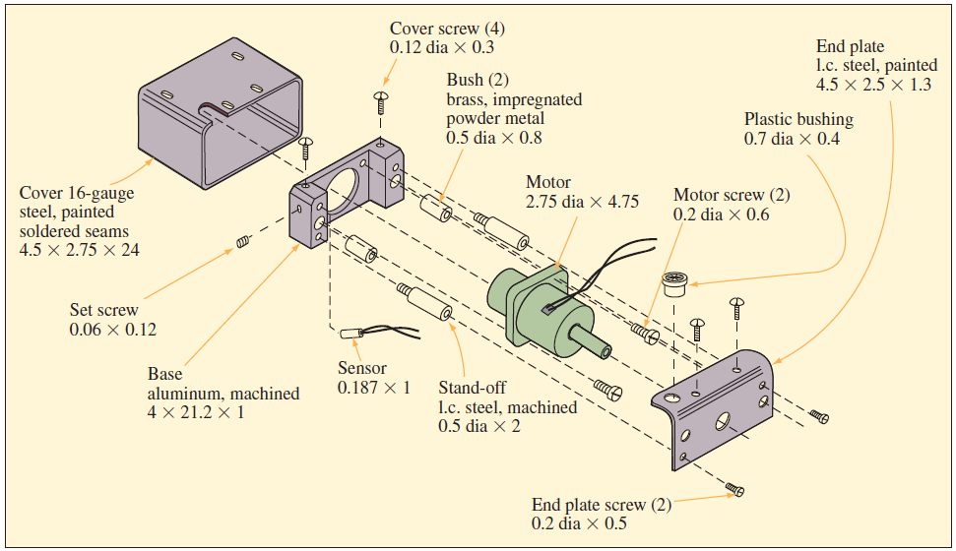
Proposed Motor Drive Design
Exhibit 3.5

Slide 21
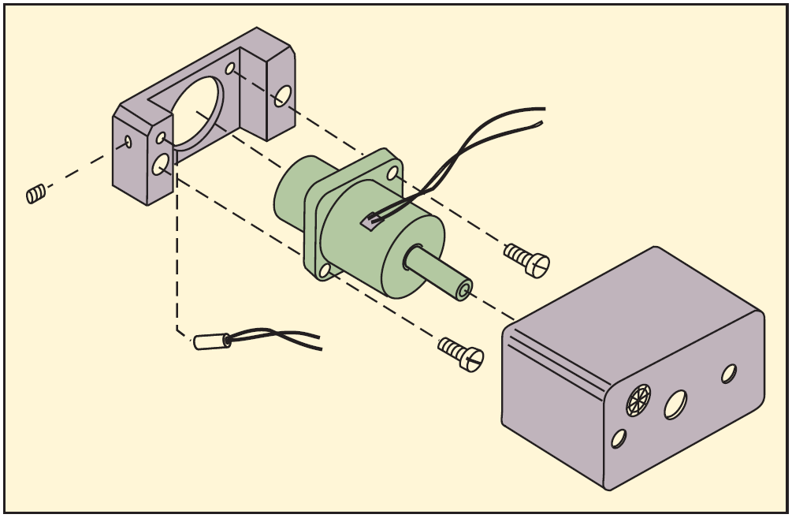
Redesign of Motor Drive Assembly Following Design for Assembly Analysis
Exhibit 3.6

Slide 22
Ecodesign
Ecodesign: the incorporation of environmental considerations in the design and development of products or services
  The whole life cycle is considered
  The product is considered as a system
  A multi-criteria approach is used
An extension of other important requirements such as quality, costs, manufacturability, functionality, and so on
Application of ecodesign can benefit business

Slide 23
Designing Service Products
Service products are very different
Direct customer involvement introduces significant variability in the process
Questions to address:
  How will this variability be addressed?
  What are the implications for operational cost and the customer service experience?

Slide 24
Three Factors when Determining how Different the New Service Is
Similarity to current services
New service should fit into the current service experience for the customer
Similarity to current process
Even the greatest service ideas require operational support to execute
The more similar they are to the current process, the more of that support is already in place
Financial justification
New services are costly and should be financially justified

Slide 25
Complexity and Divergence
Complexity: the number of steps involved in a service and the possible actions that can be taken at each step
Divergence: the number of ways a customer/service provider interaction can vary at each step according to the needs and abilities of each
The result may be a combination of higher complexity/divergence on some steps and lower complexity/divergence on others
This can be used to determine different resource requirements such as worker skills, layout, and process controls

Slide 26
Process Alternatives for a Family Restaurant
Exhibit 3.7

Slide 27
Economic Analysis of Project Development Costs
Economic analysis is useful in at least two different circumstances
  Go/no-go milestones
  Operational design and development decisions
Building a base-case financial model
  Compute net present value
  Good estimates of cash flows
Sensitivity analysis for “what if” questions
  Calculates change in NPV corresponding to a change in the factors included in the model
  Can be used to model different scenareos

Slide 28
Merging the Project Financials and Schedule into a Cash Flow Report
Exhibit 3.9

Slide 29
Possible Sensitivity Analysis Scenarios
Longer product development time
Higher/lower sales volume
Higher/lower sales price
Higher/lower development costs

Slide 30
Measuring Product Development Performance
A steady stream of new products is important to competitiveness
Firms must respond to changing customer needs and competitor moves
Ability to identify opportunities and bring new products to market is critical
  Must also be efficient

Slide 31
Generic Descriptions of Typical Measures of Product Development Success
Time to market
There are two aspects to this, the frequency of new product introductions and the time from initial concept to market introduction
Productivity
Such measures as the number of engineering hours, the cost of materials, and tooling costs are used in these measures
Quality
Measures that relate to the reliability of the product in use, the product's performance features compared to customer expectations, and the ability of a factory or service process to produce the product

Slide 32
Summary
Product development is a major challenge that directly impacts the long-range success of a firm
Many companies today outsource product design to companies that specialize in different industries
Product development is a multistep process that is unique to each organization
Different sets of criteria drive the design of a product
  Criteria that relate to customer wants are fundamental
  Criteria related to cost, manufacturability, and impact on the environment are also important
Service products are different because direct customer involvement in the process introduces variability

Slide 33
Summary Continued
Financial justification of service features ensure that customers can be retained while the company is making a profit
Economic analysis that consists of estimating the timing and magnitude of future cash flows is used to understand the financial implications of a product development project
  Sensitivity analysis can be used to answer “what if” questions that relate to project timing and costs
Generating a steady stream of new products to market is important to the competitiveness of the firm
Measures that relate to time to market, costs, and quality be used to evaluate product development success

Slide 34
Practice Exam
An organization capable of manufacturing or purchasing all the components needed to produce a finished product or device
The one thing that a company can do better than its competitors
The six phases of the product development process
A useful tool for the economic analysis of a product development project
An approach that uses interfunctional teams to get input from the customer in design specification
A matrix of information that helps a team translate customer requirements into operating or engineering goals
The greatest improvements from this arise from simplification of the product by reducing the number of separate parts
The incorporation of environmental considerations into the design and development of products or services

