Slide 1
Chapter 4: Project Management
LO4–1: Explain what projects are and how projects are organized.
LO4–2: Analyze projects using network-planning models.
LO4–3: Evaluate projects using earned value management.
LO4–4: Exemplify how network-planning models and earned value management are implemented in commercial software packages.
McGraw-Hill/Irwin

Slide 2
What is Project Management?
What is a project?
  A series of related jobs, usually directed toward some major output and requiring a significant period of time to perform
What is project management?
  Planning, directing, and controlling resources (people, equipment, material) to meet the technical, cost, and time constraints of the project
Why is project management important?
  At the highest levels of an organization, management often involves juggling a portfolio of projects

Slide 3
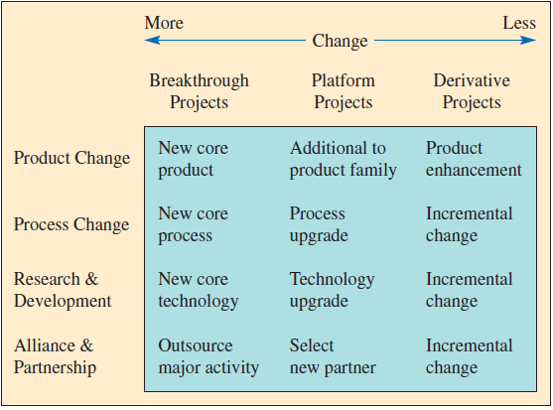
Types of Development Projects
Exhibit 4.1

Slide 4
Project Structure
Pure Project
A self-contained team works full-time on the project
Responsibility for the project lies within one functional area of the firm
Functional Project
Matrix Project
A blend of pure and functional project structures – people from different functional areas work on the project, possibly only part-time
Employees from that area work on the project, usually only part-time

Slide 5
Pure Project Structure
Advantages
The project manager has full authority
Disadvantages
Duplication of resources
Team members report to one boss
Shortened communication lines
Team pride, motivation, and commitment are high
Organizational goals and policies are ignored
Lack of technology transfer
Team members have no functional area "home"

Slide 6
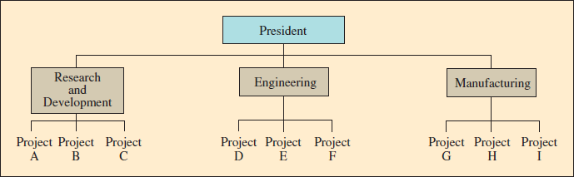
Functional Project Structure
Advantages
A team member can work on several projects
Disadvantages
Aspects of the project that are not directly related to the functional area get short-changed
Technical expertise maintained in functional area
Functional area is “home” after project completed
Critical mass of specialized knowledge
Motivation of team members is often weak
Needs of the client are secondary and are responded to slowly

Slide 7
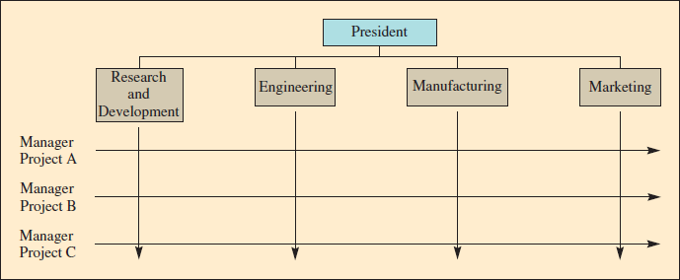
Matrix Project Structure
Advantages
Better communications between functional areas
Disadvantages
Too many bosses
Project manager held responsible for success
Duplication of resources is minimized
Functional “home” for team members
Policies of the parent organization are followed
Depends on project manager’s negotiating skills
Potential for sub-optimization

Slide 8
Defining the Project
Statement of Work
  A written description of the objectives to be achieved
Task
  A further subdivision of a project – usually shorter than several months and performed by a single group or organization
Work Package
  A group of activities combined to be assignable to a single organizational unit
Project Milestone
  Specific events in the life of the project
Work Breakdown Structure
  Defines the hierarchy of project tasks, subtasks, and work packages
Activities
  Pieces of work that consume time

Slide 9
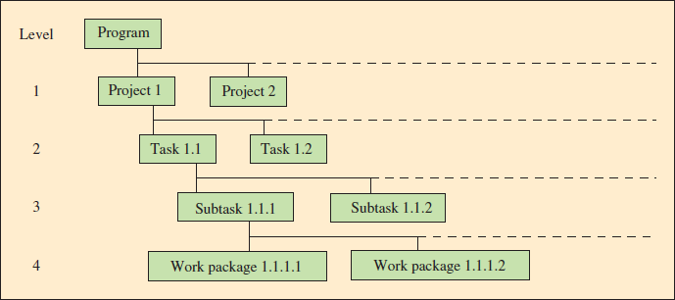
Work Breakdown Structure Example
Overview
Details
Exhibit 4.2

Slide 10
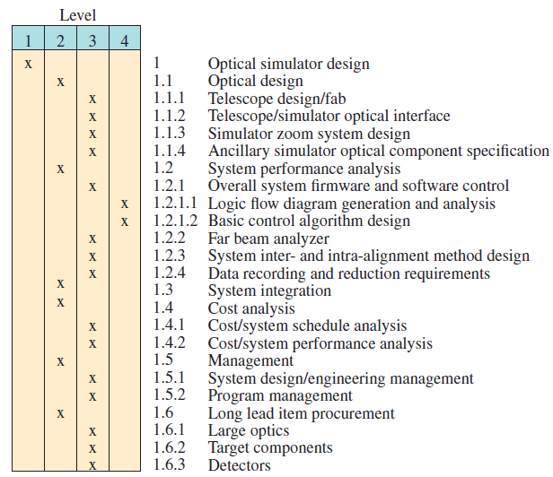
Work Breakdown Structure, Large Optical Scanner Design
Exhibit 4.3

Slide 11
Network-Planning Models
A project is made up of a sequence of activities that form a network representing a project
The path taking longest time through this network of activities is called the “critical path”
The critical path provides a wide range of scheduling information useful in managing a project
Critical path method (CPM) helps to identify the critical path(s) in the project networks

Slide 12
Critical Path Method (CPM)
Identify each activity to be done and estimate how long it will take
Determine the required sequence and construct a network diagram
Determine the critical path
Determine the early start/finish and late start/finish schedule

Slide 13
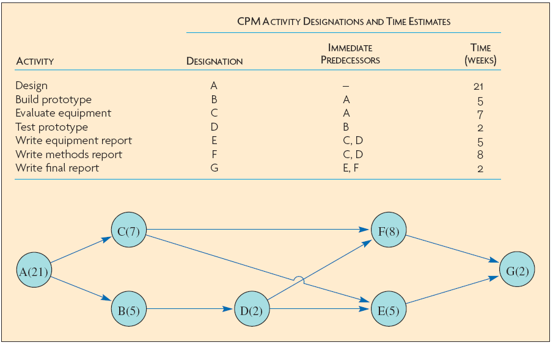
Example 4.1 – Identify Activities and Construct Network
Exhibit 4.4

Slide 14
Determine Early Start/Early Finish and Late Start/Late Finish Schedule
Exhibit 4.5

Slide 15
CPM with Three Activity Time Estimates
When activity times vary, a single time estimate may not be reliable
  Instead, estimate three values
    Minimum
    Maximum
    Most likely
This allows calculation of a probability estimate of completion time
This is the distinguishing characteristic of the PERT method

Slide 16
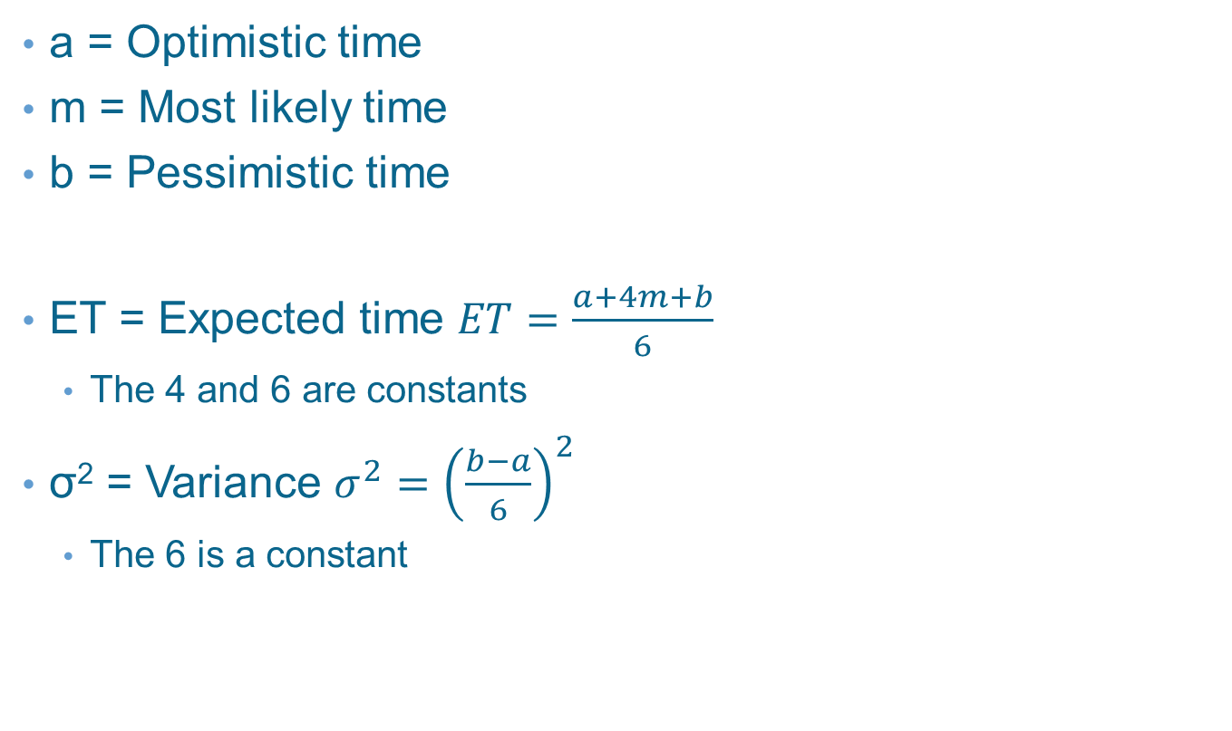
PERT Method Calculations
a = Optimistic time
m = Most likely time
b = Pessimistic time
ET = Expected time $ET=\frac{a+4m+b}{6}$
  The 4 and 6 are constants
σ² = Variance $σ^{2}={\left(\frac{b−a}{6}\right)}^{2}$
  The 6 is a constant

Slide 17
Example 4.2 - Three Time Estimates
Exhibit 4.6

Slide 18
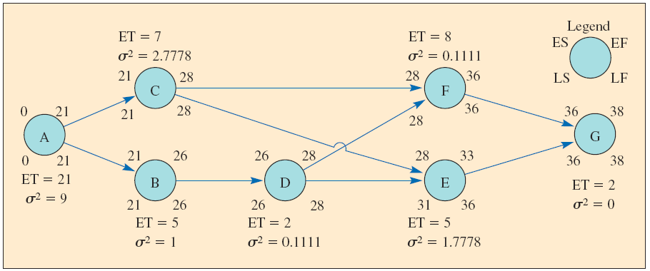
Example 4.2 - Network with Three Time Estimates
Exhibit 4.7

Slide 19
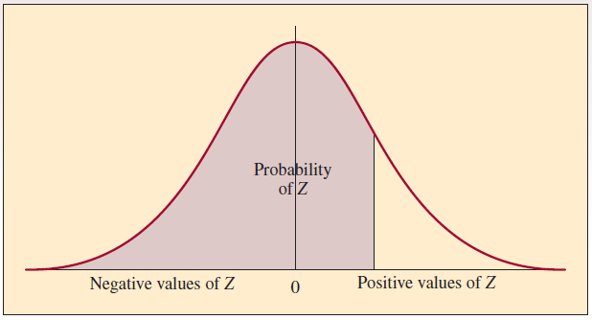

Example 4.2 – Three Time Estimates
Probability of finishing in 35 weeks (or less)
$z=\frac{D−T_{E}}{\sqrt{\sum{σ_{cp}^{2}}}}=\frac{35−38}{\sqrt{11.8889}}=−0.87$
Yields probability of 19 percent of being completed in 35 weeks

Slide 20
Time-Cost Models and Project Crashing
A time-cost model extends the CPM model to consider the trade-off between time required to complete an activity and total project cost
  Considers direct activity costs, indirect costs of project, and activity completion times
It is often referred to as “crashing” the project to reduce overall duration
On the one hand, it costs money to expedite an activity
On the other hand, it costs money to sustain (or lengthen) the project
Costs associated with expediting activities are termed activity direct costs
Costs associated with sustaining the project are termed project indirect costs

Slide 21
Project Crashing
Prepare a CPM-type network diagram
Determine the cost per unit of time to expedite each activity
Compute the critical path
Shorten the critical path at the point where costs are lowest
Plot project, indirect, and total cost curves to find the minimum-cost schedule

Slide 22
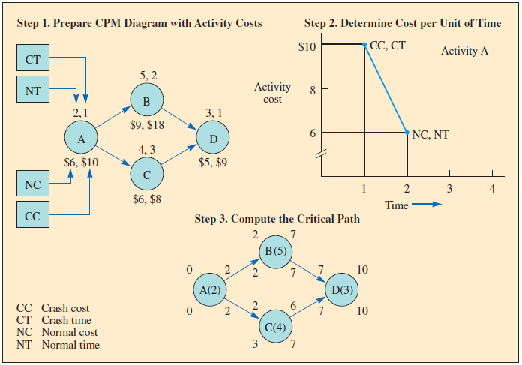
Example 4.3 – Project Crashing
Exhibit 4.8

Slide 23
Example 4.3 – Project Crashing
Exhibit 4.9

Slide 24
Managing Resources
Projects are not just planned, they must be managed
Charts and standard forms are useful
There are computer programs especially for this purpose

Slide 25
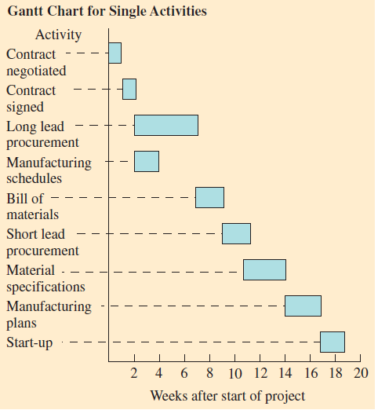
Project Control Charts
Charts provide an easily understood visual presentation
Software can be used to create the charts
Gantt charts show, in a graphic manner, the amount of time involved and the sequence of activities. Often referred to as a bar chart
Exhibit 4.11A

Slide 26
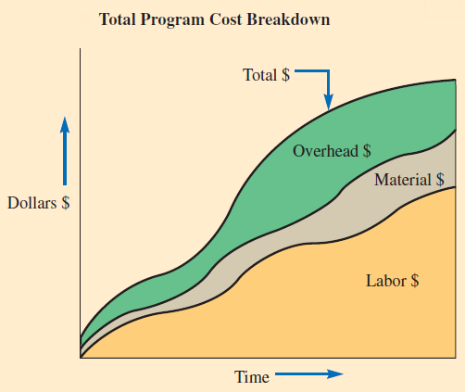
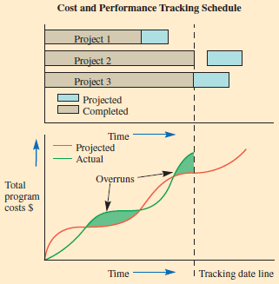
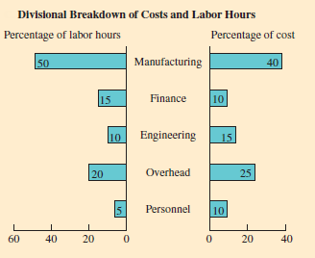
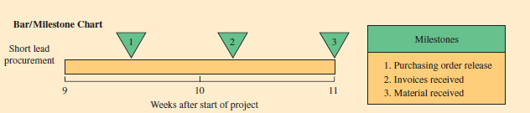
Project Report Samples
Exhibit 4.11B-E

Slide 27
Earned Value Management (EVM)
A technique for measuring project progress in an objective manner
Has the ability to combine measurements of scope, schedule, and cost in a project
Provides a method for evaluating the relative success of a project at a point in time
Can be applied to either revenue generation or cost projects

Slide 28
Earned Value Management – Essential Features
A project plan that identifies the activities to be accomplished
A valuation of each activity work
Predefined earning or costing rules to quantify the accomplishment of work

Slide 29
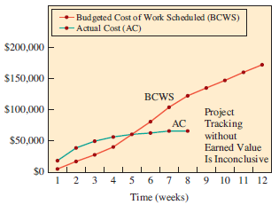
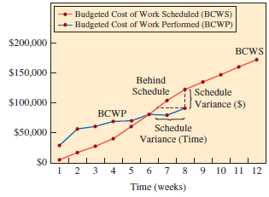
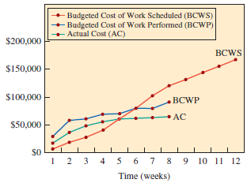
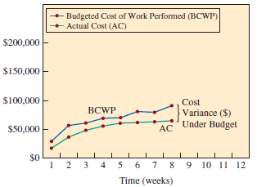
Earned Value Management Charts
Exhibit 4.12 A-D

Slide 30
Project Tracking
Without earned value management
A simple comparison of just costs versus budget does not tell the whole story
With earned value management
With predefined methods of quantifying the quantity of work accomplished, EVM provides much more information
A combined view gives an overview of project performance in terms of the original plan

Slide 31
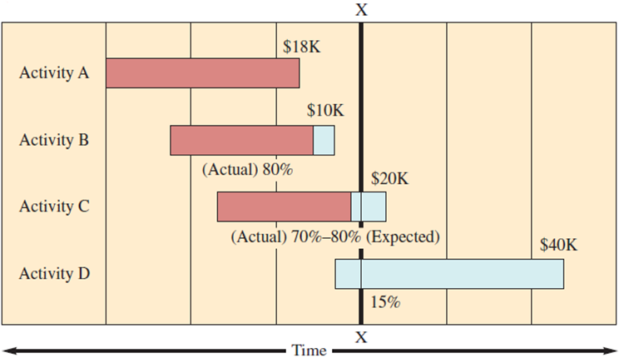
Example 4.4 – Budgeted Cost of Work Scheduled (BCWS)
At time “X”, Activity A is 100% complete (budgeted cost was $18K)
  Activity A – 100% of $18K = $18K
At time “X”, Activity B is 80% complete (budgeted cost was $10K)
  Activity B – 100% of $10K = $10K
At time “X”, Activity C is 70% complete (budgeted cost was $20K)
  80% of this activity should be complete by now
  Activity C – 80% of $20K = $16K
At time “X”, Activity D is 0% complete (budgeted cost was $40K)
  15% of this activity should be complete by now
  Activity D – 15% of $40K = $6K
BCWS = $18K + $10K + $16K + $6K = $50K

Slide 32
Example 4.4 – Budgeted Cost of Work Performed (BCWP)
Activity A – 100% of $18K = $18K
Activity B – 80% of $10K = $8K
Activity C – 70% of $20K = $14K
Activity D – 0% of $40K = $0K
BCWP = $18K + $8K + $14K + $0K = $40K

Slide 33
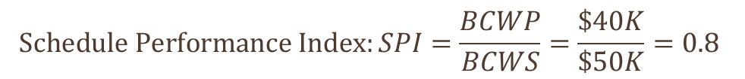
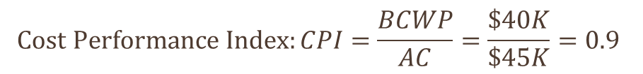
Example 4.4 – Performance Measures

Slide 34
Project Management: Information Systems
Two of the leading companies are Microsoft, with Microsoft Project, and Primavera, with Primavera Project Planner
The Microsoft Project program comes with an excellent online tutorial, which is one reason for its overwhelming popularity with project managers tracking midsized projects
For managing very large projects or programs having several projects, Primavera Project Planner is often the choice
Primavera was the first major vendor of this type of software and has possibly the most sophisticated capability

Slide 35
Other Capabilities of the Software
In addition to scheduling tasks, a major capability of all these software packages is assigning resources to competing tasks and projects
  For example, the systems can schedule back labor and equipment for a project
Mid- to high-level project management information systems (PMIS) software can also resolve over-allocations through a “leveling” feature
Several rules of thumb can be used such as:
  You can specify that low-priority tasks should be delayed until higher-priority ones are complete
  Or that the project should end before or after the original deadline

Slide 36
Summary
Projects can be categorized into four major types: product change, process change, research and development, and alliance and partnerships
The project team can be organized in different ways
  Pure project, functional project, and matrix project
The activities of the projects are organized according to the work breakdown structure
The critical path method (CPM) is the most widely used approach to scheduling projects
  The goal is to find the earliest time that the entire project can be completed
  Also identify what activities are critical

Slide 37
Summary Continued
A key aspect to managing a project is understanding the current status of its activities
Earned value management (EVM) is a technique commonly used for measuring project progress
The techniques and concepts described in this chapter are implemented in commercially available software packages

Slide 38
Practice Exam
A project structured where a self-contained team works full time on the project
Specific events that upon completion mark important progress toward completing a project
This defines the hierarchy of project tasks, subtasks, and work packages
Pieces of work in a project that consume time to complete
A chart that shows both the time and sequence for completing the activities in a project
Activities that in sequence form the longest chain in a project
The difference between the late and early start time for an activity
When activities are scheduled with probabilistic task times
The procedure used to reduce project completion time by trading off time versus cost
A key assumption related to the resources needed to complete activities when using the critical path method

