Slide 1
Chapter 5: Strategic Capacity Management
LO5–1: Explain what capacity management is and why it is strategically important.
LO5–2: Exemplify how to plan capacity.
LO5–3: Evaluate capacity alternatives using decision trees.
LO5–4: Compare capacity planning in services to capacity planning in manufacturing.
McGraw-Hill/Irwin

Slide 2
Economies of Scale Made of Steel
The Economics of Very Big Ships
Economy of Container Ships
  Allows a T-shirt made in China to be sent to the Netherlands for just 2.5 cents
  The Eleonora Maersk and the other seven ships in her class are among the largest ever built
  Almost 400 m long, or the length of four soccer fields, and another half-field across
  The ships can carry 7,500 or so 40-foot containers, each of which can hold 70,000 T-shirts
On this voyage, the Eleonora was carrying supplies for Europe’s New Year celebrations: 1,850 tons of fireworks, including 30 tons of gunpowder

Slide 3
Capacity Management in Operations and Supply Chain Management
Capacity: the ability to hold, receive, store, or accommodate
In business, viewed as the amount of output that a system is capable of achieving over a specific period of time
Capacity management needs to consider both inputs and outputs
Many industries measure and report capacity in terms of output
Industries whose product mix is very uncertain, like hospitals, often express capacity in terms of inputs

Slide 4
Capacity Planning Time Durations
Long range
Greater than one year
Intermediate range
Monthly or quarterly plans covering the next 6 to 18 months
Short range
Less than one month

Slide 5
Strategic Capacity Planning
Determining the overall level of capacity-intensive resources that best supports the company’s long-range competitive strategy
  Facilities
  Equipment
  Labor force size
Capacity level selected has a critical impact on response rate, it cost structure, is inventory policies, and management and staff support requirements
  Too low and the firm will lose customers and encourage competitors
  Too high and firm may have to cut costs or underutilize its capacity

Slide 6
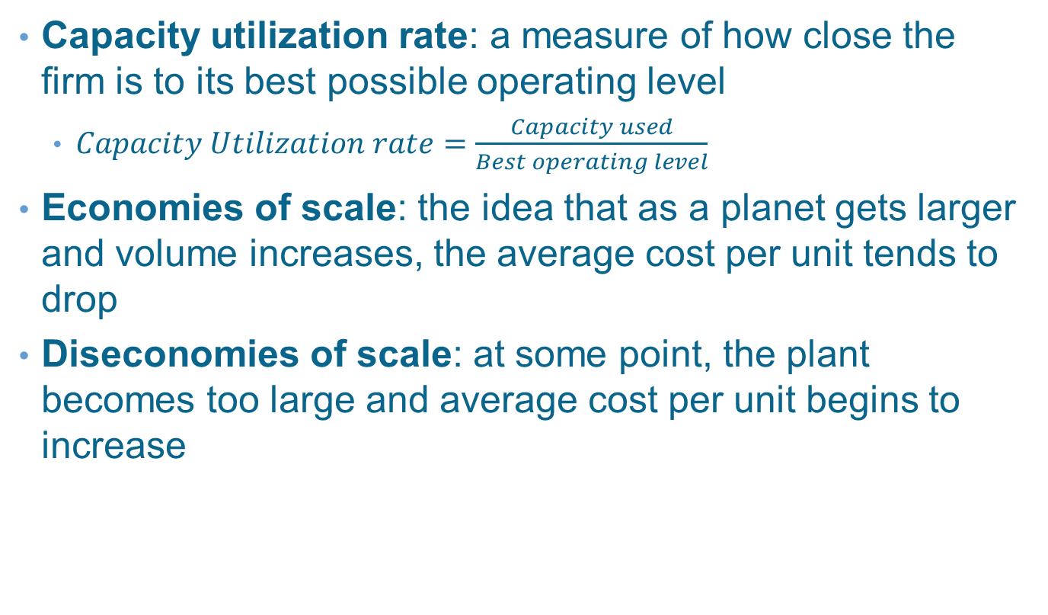
Capacity Planning Concepts
Capacity utilization rate: a measure of how close the firm is to its best possible operating level
  $Capacity Utilization rate=\frac{Capacity used}{Best operating level}$
Economies of scale: the idea that as a planet gets larger and volume increases, the average cost per unit tends to drop
Diseconomies of scale: at some point, the plant becomes too large and average cost per unit begins to increase

Slide 7
Capacity Planning Concepts
Capacity focus – the idea that a production facility works best when it is concentrated on a limited set of production objectives
  Focused factory or plant within a plant (PWP) concept
Capacity flexibility – the ability to rapidly increase or decrease product levels or the ability to shift rapidly from one product or service to another
  Comes from the plant, processes, and workers or from strategies that use the capacity of other organizations

Slide 8
Capacity Flexibility
Flexible Plants
Flexible Processes
Flexible manufacturing systems
Simple, easily set up equipment
Flexible Workers
Ability to switch from one kind of task to another quickly
Multiple skills (cross training)
Ability to quickly adapt to change
Zero-changeover time

Slide 9
Considerations in Changing Capacity
Maintaining System Balance
Similar capacities desired at each operation
Frequency of Capacity Additions
Cost of upgrading too frequently
Cost of upgrading too infrequently
External Sources of Capacity
Outsourcing
Sharing capacity
Decreasing Capacity
Temporary reductions
Permanent reductions
Manage bottleneck operations

Slide 10
Frequent versus Infrequent Capacity Expansions
Exhibit 5.2

Slide 11
Determining Capacity Requirements
Use forecasting to predict sales for individual products
Calculate labor and equipment requirements to meet forecasts
Project labor and equipment availability over the planning horizon

Slide 12
Example 5.1—Determining Capacity Requirements
Stewart Company produces two flavors of salad dressing
  Paul’s and Newman’s
Each is available in bottles and single-serving bags
Have three machines that can package 150,000 bottles each year
  Each machine requires two operators
Have five machines that can package 250,000 plastic bags per year
  Each machine requires three operators
What are the capacity and labor requirements for the next five years?

Slide 13
Step 1: Use Forecast to Predict Sales for Individual Products

Slide 14
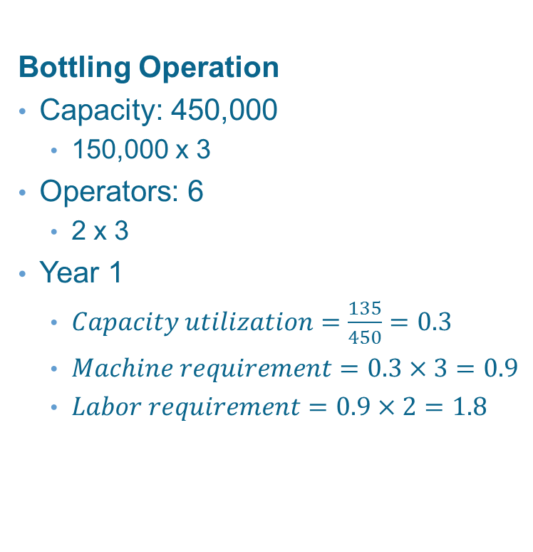
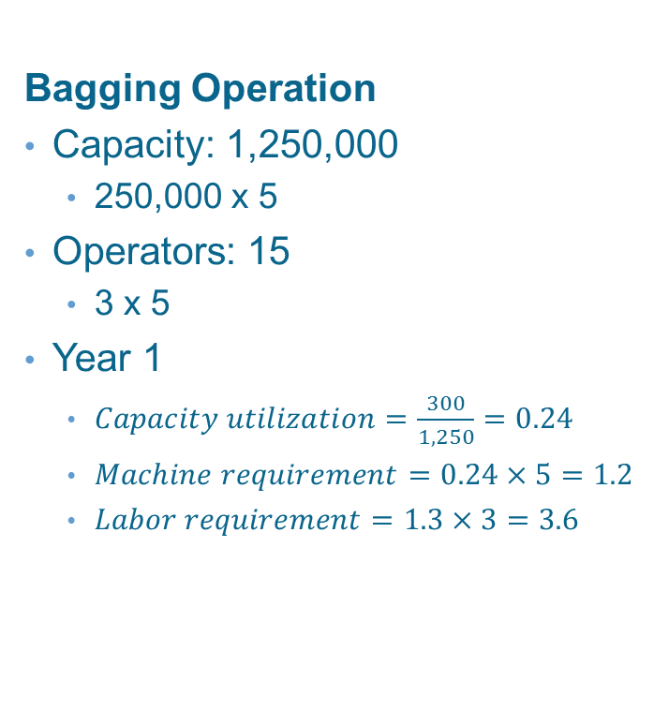
Step 2: Calculate Equipment and Labor Requirements
Bottling Operation
Capacity: 450,000
  150,000 x 3
Operators: 6
  2 x 3
Year 1
  $Capacity utilization=\frac{135}{450}=0.3$
  $Machine requirement=0.3×3=0.9$
  $Labor requirement=0.9×2=1.8$
Bagging Operation
Capacity: 1,250,000
  250,000 x 5
Operators: 15
  3 x 5
Year 1
  $Capacity utilization=\frac{300}{1,250}=0.24$
  $Machine requirement=0.24×5=1.2$
  $Labor requirement=1.3×3=3.6$

Slide 15
Step 3: Project Equipment and Labor Availabilities over the Planning Horizon

Slide 16
Using Decision Trees to Evaluate Capacity Alternatives
A decision tree is a schematic model of the sequence of steps in a problem – including the conditions and consequences of each step
Decision trees help analysts understand the problem and assist in identifying the best solution
Decision tree components include the following:
  Decision nodes – represented with squares
  Chance nodes – represented with circles
  Paths – links between nodes
Work from the end of the tree backwards to the start of the tree
Calculate expected values at each step

Slide 17
Example 5.2: Decision Trees
The owner of Hackers Computer Store is evaluating three options – expand at current site, expand to a new site, do nothing
The decision process includes the following assumptions and conditions
  Strong growth has a 55% probability
  New site cost is $210,000
    Payoffs: strong growth = $195,000; weak growth = $115,000
  Expanding current site cost is $87,000 (in either year 1 or 2)
    Payoffs: strong growth = $190,000; weak growth = $100,000
  Do nothing
    Payoffs: strong growth = $170,000; weak growth = $105,000

Slide 18
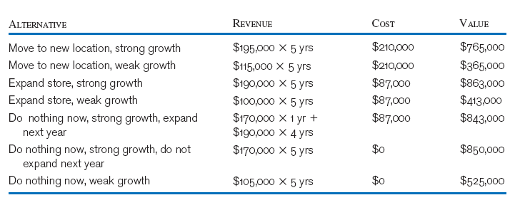
Calculate the value of each alternative

Slide 19
Diagram the Problem Chronologically
Exhibit 5.3

Slide 20
Calculate Value of Each Branch
Exhibit 5.4

Slide 21
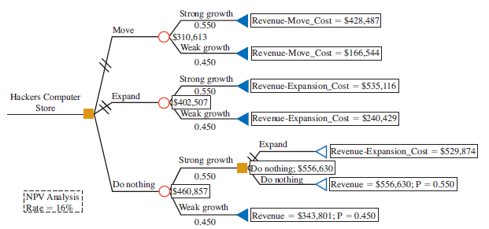
Decision Tree Analysis with Net Present Value Calculations
Exhibit 5.5

Slide 22
Planning Service Capacity
Manufacturing Capacity
Goods can be stored for later use
Goods can be shipped to other locations
Service Capacity
Capacity must be available when service is needed – cannot be stored
Service must be available at customer demand point
Volatility of demand is relatively low
Much higher volatility is typical

Slide 23
Capacity Utilization and Service Quality
The relationship between service capacity utilization and service quality is critical
  Arrival rate: the average number of customers that come to a facility during a specific period of time
  Service rate: the average number of customers that can be processed over the same period of time
  Best operating point is near 70 percent
Optimal levels of utilization are context specific
  Low rates are appropriate when the degree of uncertainty (in demand) is high and/or the stakes are high (e.g., emergency rooms, fire departments)
  Higher rates are possible for predictable services or those without extensive customer contact (e.g., commuter trains, postal sorting)

Slide 24
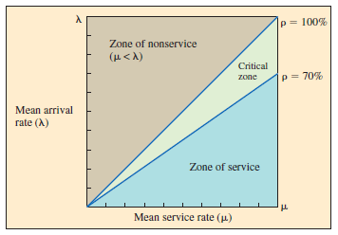
Relationship Between the Rate of Service Utilization and Service Quality
Exhibit 5.6

Slide 25
Summary
An operations and supply chain management view of capacity emphasizes the time dimension of capacity
  Long range, intermediate range, and short range
Best operating level is the rate that is sustainable by the system
With economies of scale, as volume increases, average cost per unit drops
Focused manufacturing plants are designed to produce multiple products using a concept called plant within a plant
From a strategic, long-term view, capacity additions or reductions come in chunks

Slide 26
Summary Continued
A useful technique for analyzing capacity problems is the decision tree
  With this format, the sequences of decisions are organized like branches in a tree
The potential consequences of the decisions are enumerated based on their probability of occurrence and corresponding expected value
Often, services require that capacity be available immediately and that it be near where the customer resides
  Firms that offer services often need to deal with dramatic changes in customer demand over time

Slide 27
Practice Exam
The level of capacity for which a process was designed and at which it operates at minimum cost
The concept that relates to gaining efficiency through the full utilization of dedicated resources, such as people and equipment
A facility that limits its production to a single product or a set of very similar products
When multiple (usually similar) products can be produced in a facility less expensively than a single product
The ability to serve more customers than expected
In a service process such as the checkout counter in a discount store, what is a good target percent for capacity utilization

