Slide 1
Chapter 7: Manufacturing Processes
LO7–1: Understand what a manufacturing process is.
LO7–2: Explain how manufacturing processes are organized.
LO7–3: Analyze simple manufacturing processes.
McGraw-Hill/Irwin

Slide 2
What Are Production Processes?
Production processes are used to make any manufactured item
High level view can be divided into three steps
  Step 1 – Source the parts needed
  Step 2 – Make the product
  Step 3 – Deliver the product
Exhibit 7.1

Slide 3
Production Process Terms
Lead time
The time needed to respond to a customer order
Customer order decoupling point
Where inventory is positioned to allow entities in the supply chain to operate independently
Lean manufacturing
A means of achieving high levels of customer service with minimal inventory investment

Slide 4
Types of Firms
Make-to-Stock
Assemble-to-Order
Make-to-Order
Engineer-to-Order
Serve customers from finished goods inventory
Combine a number of preassembled modules to meet a customer’s specifications
Make the customer’s product from raw materials, parts, and components
Work with the customer to design and then make the product

Slide 5
Make-to-Stock
Examples of products include the following:
  Televisions
  Clothing
  Packaged food products
Essential issue in satisfying customers is to balance the level of inventory against the level of customer service
  Easy with unlimited inventory, but inventory costs money
  Trade-off between the costs of inventory and level of customer service must be made
Use lean manufacturing to achieve higher service levels for a given inventory investment

Slide 6
Assemble-to-Order
A primary task is to define a customer’s order in terms of alternative components because these are carried in inventory
  An example is the way Dell Computer makes their desktop computers
One capability required is a design that enables as much flexibility as possible in combining components
There are significant advantages from moving the customer order decoupling point from finished goods to components

Slide 7
Make-to-Order/Engineer-to-Order
Boeing’s process for making commercial aircraft is an example
Customer order decoupling point could be in either raw materials at the manufacturing site or the supplier inventory
Depending on how similar the products are, it might not even be possible to preorder parts

Slide 8
How Production Processes Are Organized
Project
The product remains in a fixed location
Manufacturing equipment is moved to the product
Workcenter (job shop)
Similar equipment or functions are grouped together
Manufacturing cell
A dedicated area where products that are similar in processing requirements are produced
Assembly line
Work processes are arranged according to the progressive steps by which the product is made
Continuous process
Assembly line only the flow is continuous such as with liquids
Notes:
11

Slide 9
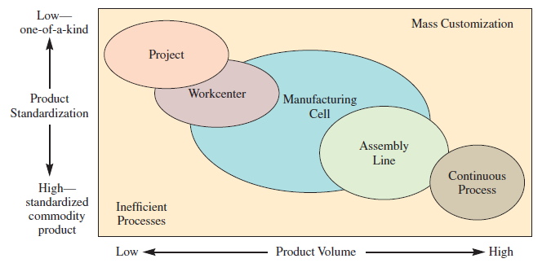
Product–Process Matrix: Framework Describing Layout Strategies
Exhibit 7.2

Slide 10
Production System Design
Project Layout
The product remains in a fixed location
Workcenter
A high degree of task ordering is common
A project layout may be developed by arranging materials according to their assembly priority
Most common approach to developing this type of layout is to arrange workcenters in a way that optimizes the movement of material
Sometimes is referred to as a department and is focused on a particular type of operation
Optimal placement often means placing workcenters with large interdepartmental traffic adjacent to each other

Slide 11
Production System Design
Manufacturing Cell
Formed by allocating dissimilar machines to cells that are designed to work on similar products (shape, processing, etc.)
Assembly Line and Continuous Layout
Designed for the special purpose of building a product by going through a series of progressive steps

Slide 12
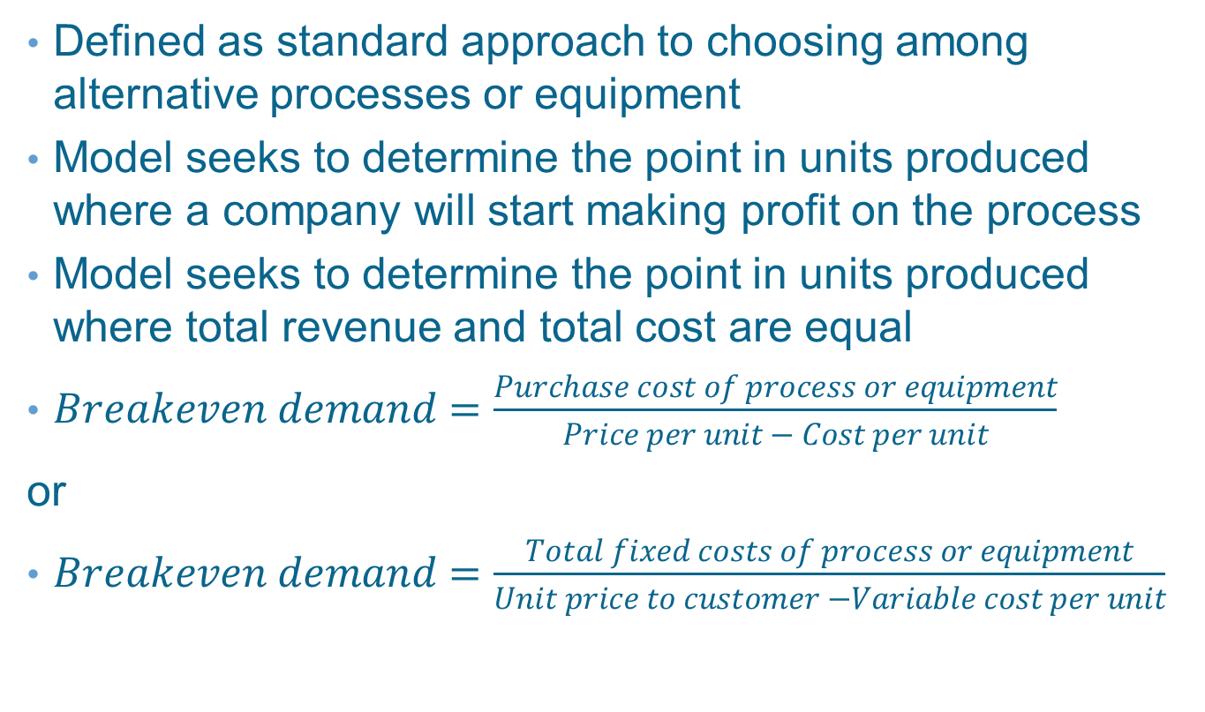
Break-Even Analysis
Defined as standard approach to choosing among alternative processes or equipment
Model seeks to determine the point in units produced where a company will start making profit on the process
Model seeks to determine the point in units produced where total revenue and total cost are equal
$Breakeven demand=\frac{Purchase cost of process or equipment}{Price per unit − Cost per unit}$
or
$Breakeven demand=\frac{Total fixed costs of process or equipment}{Unit price to customer −Variable cost per unit}$
Notes:
14

Slide 13
Example 7.1: Break-Even Analysis
Buy for $200
Make on lathe for $75
Make on machining center for $15
Buy has no fixed costs
Lathe has $80,000 fixed costs
Machining center has $200,000 fixed costs

Slide 14
Example 7.1: Total Cost for Each Option
Purchase
Cost = $200 x Demand
Produce Using Lathe
Cost = $80,000 + $75 x Demand
Produce Using Machining Center
Cost = $200,000 + $15 x Demand

Slide 15
Example 7.1: Costs Shown Graphically
Exhibit 7.3

Slide 16
Example 7.1:Finding Points A and B

Slide 17
Manufacturing Process Flow Design
Manufacturing process flow design: a method to evaluate the specific processes that material follow as they move through the plant
  Common tools are assembly drawings, assembly charts, route sheets, and flow process charts
Focus should be on the identification of activities that can be minimized or eliminated
  Movement and storage
  The fewer the moves, delays, and storage, the better the flow

Slide 18
The Charts
Assembly drawing
An exploded view of the product showing its component parts
Assembly chart
Defines how parts go together, their order of assembly, and overall flow pattern
Operation and route sheet
Specifies operations and process routing
Process flowchart
Denotes what happens to the product as it progresses through the production facility

Slide 19
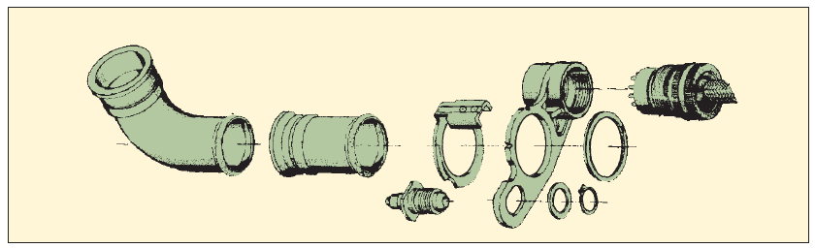
Sample Assembly Drawing
Exhibit 7.4

Slide 20
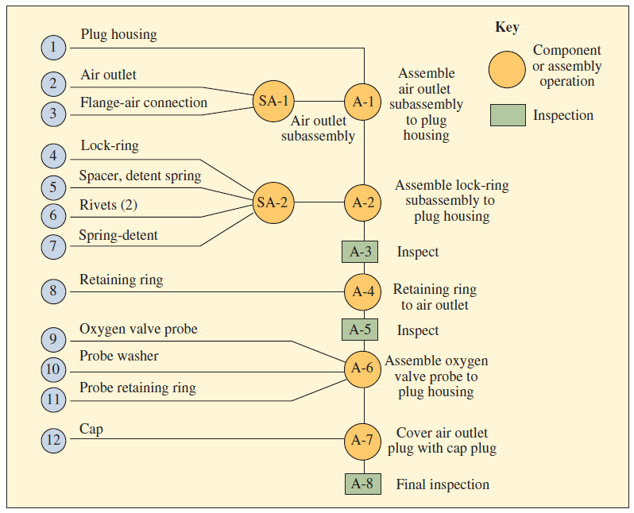
Sample Assembly Chart
Exhibit 7.5

Slide 21
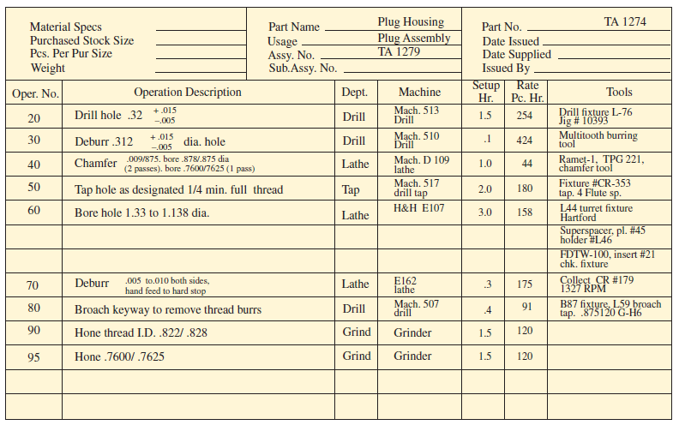
Sample Operation and Route Sheet
Exhibit 7.6

Slide 22
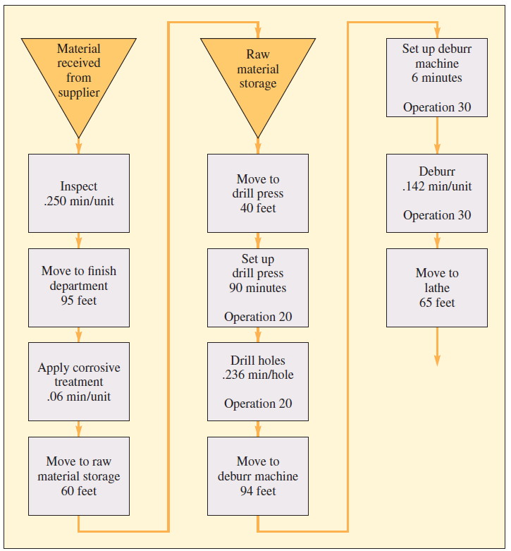
Sample Flowchart
Exhibit 7.7

Slide 23
Example 7.2: Manufacturing Process Analysis
15 workers, eight-hour shift
Assembly line moves at the rate of 150 components per hour
Incentive pay of 30¢ per good part
Can hire 15 more workers for second shift if needed
All but molding from outside vender

Slide 24
Example 7.2: Molding
11 Machines
  One usually down
  One operator per machine
25 parts per hour
Paid 20¢ per good part
Overtime is 30¢ per part
Employment is flexible
  Currently 6 employees
  4 more available

Slide 25
Example 7.2: Remaining Costs
Raw materials are 10¢ per part
Electricity is 2¢ per part
Purchased parts cost 30¢ per component
Other weekly expenses
  Rent is $100
  Other employees receive $1,000
  Accounting depreciation is $50

Slide 26
Example 7.2: Questions to Answer
Determine the capacity of the process
  Are the capacities balanced?
If the molding process were to use 10 machines instead of 6, what would be the capacity of the entire process?
If the company went to a second shift, what would be the new capacity?
Determine the cost per unit output when the capacity is 6,000 per week or 10,000 per week

Slide 27
Example 7.2: (a) Capacity of Entire Process
Molding Capacity
  6 machines x 25 parts per week x 8 hours x 5 days = 6,000
Assembly Capacity
  150 components per hour x 8 hours x 5 days = 6,000
The capacities are balanced

Slide 28
Example 7.2: (b) Increasing Molding to 10 Machines
Molding Capacity
  10 x 25 x 8 x 5 = 10,000
Assembly capacity has not changed from 6,000
The capacities are no longer balanced

Slide 29
Example 7.2: (c) Increasing Assembly Capacity
Molding Capacity
  10 x 25 x 8 x 5 = 10,000
Assembly Capacity
  150 x 16 x 5 = 12,000
New capacity is 10,000

Slide 30
Example 7.2: (d) Cost for 6,000 Parts per Week

Slide 31
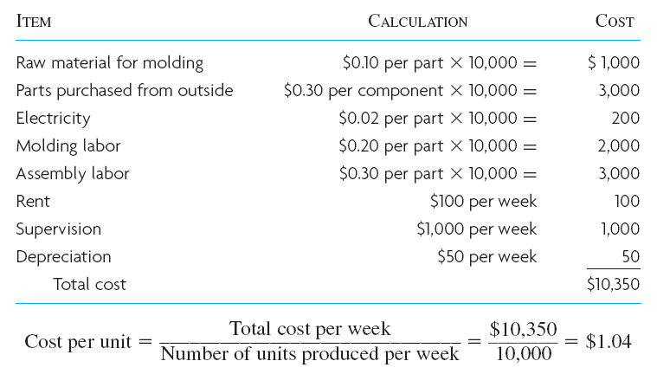
Example 7.2: (d) Cost for 10,000 Parts per Week

Slide 32
Summary
Manufacturing processes are used to make tangible items
  Sourcing parts, making the item, sending it to the customer
To allow parts of the process to operate independently, inventory is strategically positioned in the process
Positioning the decoupling points has an impact on speed, flexibility, and many other trade-offs
Manufacturing layouts are designed based on the nature of the product, the volume needed to meet demand, and the cost of equipment
Break-even analysis is useful for understanding the cost trade-offs between alternative equipment choices
Visual charts can be used to document manufacturing process flows
Flowcharts provide a simple but insightful analysis of capacity and variable cost

Slide 33
Practice Exam
A firm that makes predesigned products directly to fill customer orders has this type of production environment
A point where inventory is positioned to allow the production process to operate independently of the customer order delivery process
A firm that designs and builds products from scratch according to customer specifications would have this type of production environment
If a production process makes a unit every two hours and it takes 42 hours for the unit to go through the entire process, what is the expected work-in-process equal to
This is a production layout where similar products are made. Typically, it is scheduled on an as-needed basis in response to current customer demand
The relationship between how different layout structures are best suited depending on volume and product variety characteristics is depicted on this type of graph

