Slide 1
Chapter 9: Service Processes
LO9–1: Understand the characteristics of service processes.
LO9–2: Explain how service systems are organized.
LO9–3: Analyze simple service systems.
LO9–4: Contrast different service designs.
McGraw-Hill/Irwin

Slide 2
The Nature of Services
The customer is the focal point of all decisions and actions
The organization exists to serve the customer
Operations is responsible for service systems
Operations is also responsible for managing the work of the service workforce

Slide 3
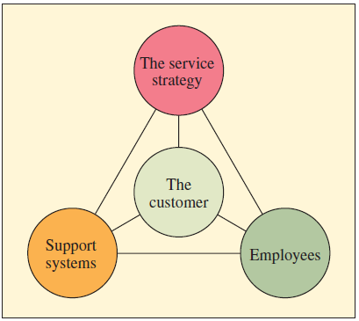
The Service Triangle
Exhibit 9.1

Slide 4
Service Package
Supporting facility
The physical resources that must be in place before a service can be offered
Facilitating goods
The material purchased by the buyer or the items provided to the customer
Information
Data provided by the customer
Explicit services
Benefits that are observable by the senses
Implicit services
Psychological benefits the customer may sense only vaguely

Slide 5
An Operational Classification of Services
Customer contact: the physical presence of the customer in the system
  Extent of contact: the percentage of time the customer must be in the system relative to service time
  Services with a high degree of customer contact are more difficult to control
Creation of the service: the work process involved in providing the service itself
The greater the percentage of contact time between the service system and the customer, the greater the degree of interaction between the two during the production process

Slide 6
Major Differences between High- and Low-Contact Systems in a Bank
Exhibit 9.2

Slide 7
Designing Service Organizations
Cannot inventory services
  Must meet demand as it arises
Service capacity is a dominant issue
  “What capacity should I aim for?”
Marketing can adjust demand
Cannot separate the operations management function from marketing in services
Waiting lines can also help with capacity

Slide 8
How Service Design Is Different from Product Design?
The process and the product must be developed simultaneously
  The process is the product
A service operation lacks the legal protection commonly available to products
The service package constitutes the major output of the development process
Many parts of the service package are defined by the training individuals receive
Many service organizations can change their service offerings virtually overnight

Slide 9
Structuring the Service Encounter: Service-System Design Matrix
Service encounters can be configured in a number of different ways
  Mail contact
  Internet and on-site technology
  Phone contact
  Face-to-face tight specs
  Face-to-face loose specs
  Face-to-face total customization
Production efficiency decreases with more customer contact
Low contact allows the system to work more efficiently

Slide 10
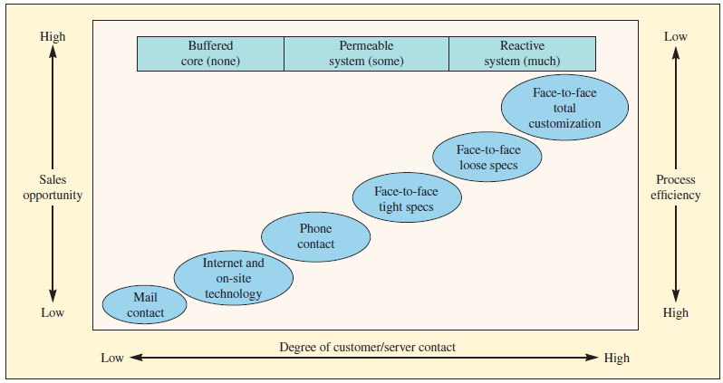
Service-System Design Matrix
Exhibit 9.3

Slide 11
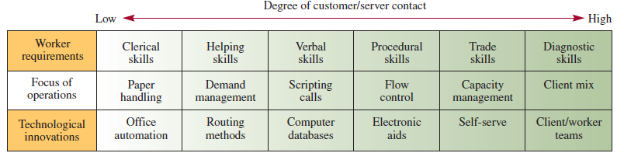
Characteristics Relative to the Degree of Customer/Service Contact

Slide 12
Strategic Uses of the Matrix
Enabling systematic integration of operations and marketing strategy
Clarifying exactly which combination of service delivery the firm is providing
Permitting comparison of how other firms deliver specific services
Indicating life cycle changes as the firm grows

Slide 13
Virtual Service: The New Role of the Customer
Customers no longer just interact with the business
Pure virtual customer contact: customers interact in an open environment
  eBay
  SecondLife
Mixed virtual and actual customer contact: customers interact with one another in a server-moderated environment
  YouTube
  Wikipedia

Slide 14
Managing Customer-Introduced Variability
How should services accommodate the variation introduced by the customer?
Standard approach is to treat this as a trade-off between cost and quality
  More accommodation → more cost
  Less accommodation → less satisfaction
Standard approach may overlook ways to accommodate customer

Slide 15
Five Types of Variability
Arrival variability
Customers arriving at times when there are not enough service providers
Request variability
Travelers requesting a room with a view
Capability variability
A patient being unable to explain symptoms to doctor
Effort variability
Shoppers not putting up carts
Subjective preference variability
Interpreting service action differently

Slide 16
Strategies for Managing Customer-Introduced Variability
Exhibit 9.4

Slide 17
Applying Behavioral Science to Service Encounters
The front-end and back-end of the encounter are not created equal
Segment the pleasure, combine the pain
Let the customer control the process
Pay attention to norms and rituals
People are easier to blame than systems
Let the punishment fit the crime in service recovery
Notes:
8

Slide 18
Service Guarantees as Design Drivers
Any guarantee is better than no guarantee
Involve the customer as well as employees in the design
Avoid complexity or legalistic language
Do not quibble or wriggle when a customer invokes a guarantee
Make it clear that you are happy for customers to invoke the guarantee

Slide 19
Service Blueprinting and Fail-Safing
The standard tool for service process design is the flowchart
  May be called a service blueprint
A unique feature is the distinction between high customer contact aspects of the service and those activities the customer does not see
  Made by a “line of visibility”

Slide 20
Service Fail-Safing Poka-Yokes (A Proactive Approach)
Poka-yokes: procedures that block a mistake from becoming a service defect
  Common in factories
Many applications in services
  Warning methods
  Physical or visual contact methods
  Three T’s
    Task to be done
    Treatment accorded to the customer
    Tangible features of the service
Must often fail-safe actions of the customer as well as the service workers

Slide 21
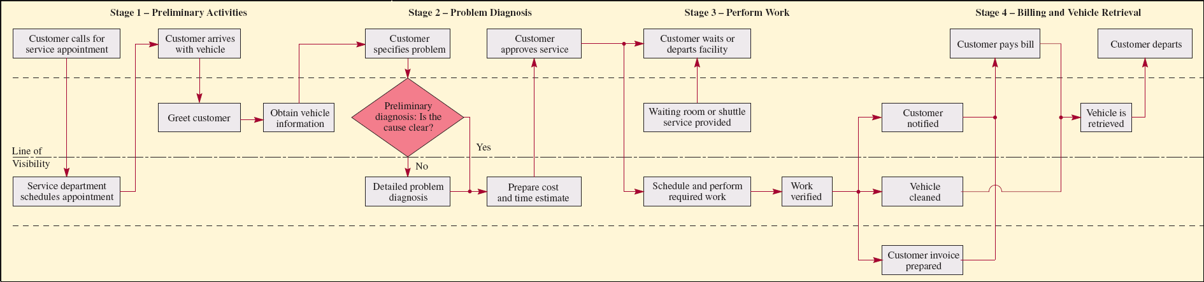
Fail-Safing an Automotive Service Operation
Exhibit 9.5

Slide 22
Three Contrasting Service Designs
The production line approach
McDonald’s
Service delivery is treated much like manufacturing
The self-service approach
ATM machines
Customer takes a greater role in the production of the service
The personal attention approach
Ritz-Carlton Hotel Company
Notes:
15

Slide 23
Seven Characteristics of a Well-Designed Service System
Each element of the service system is consistent with the operating focus of the firm
It is user-friendly
It is robust
It is structured so that consistent performance by its people and systems is easily maintained
It provides effective links between the back office and the front office
It manages evidence of service quality so that customers see the value of service provided
It is cost-effective
Notes:
17

Slide 24
Summary
A service package is the bundle of goods and services that is provided to the customer in some environment
Services can be classified according to the degree of “contact” of the customer in the system
  In some cases, the customer need not be present at all
Service systems differ from manufacturing systems in a number of significant ways
The service-system design matrix explores the trade-offs between sales opportunity, efficiency, and characteristics of workers
A challenge in managing service systems is the great variability introduced by a customer
Service guarantees are designed to provide a customer with a clear idea of what to expect from a service
Service blueprints are a flowchart tool that places special emphasis on identifying the high/low customer contact

Slide 25
Practice Exam
Service systems can generally be categorized according to this characteristic that relates to the customer
A service triangle consists of these four features
This framework relates to the customer service system encounter
This is the key feature that distinguishes a service blueprint from a normal flowchart
Having your luggage arrive on time when you land at an airport is what type of service in the service package

Slide 26
Practice Exam Continued
SecondLife would be this type of virtual service
These procedures are done to make a system mistake-proof
These are the three steps of service at Nordstrom
What are the four strategies for managing customer-induced variability
The front end and the back end of a service encounter are referred to as what

