Slide 1
Chapter 11: Process Design and Analysis
LO11–1: Exemplify a typical business process and how it can be analyzed.
LO11–2: Compare different types of processes.
LO11–3: Explain how jobs are designed.
LO11–4: Analyze manufacturing, service, and logistics processes to ensure the competitiveness of a firm.
McGraw-Hill/Irwin

Slide 2
Process Analysis
Process: any part of an organization that takes inputs and transforms them into outputs
  A process that does not match the needs of the firm will punish the firm every minute that the firm operates
The output of many processes are services
Cycle time: the average successive time between completions of successive units
Utilization: the ratio of the time that a resource is actually activated relative to the time that it is available for use
Notes:
4

Slide 3
Analyzing a Las Vegas Slot Machine
Analyzing the mechanical slot machine
Analyzing the new electronic slot machine
Comparison
The slot machine is one of many casino processes

Slide 4
Process Flowcharting
Process flowcharting: the use of a diagram to present the major elements of a process
The basic elements can include tasks or operations, flows of materials or customers, decision points, and storage areas or queues
Separating a diagram into different horizontal or vertical bands sometimes is useful
It is an ideal methodology by which to begin analyzing a process
Notes:
4

Slide 5
Process Flowchart Example (Slot Machine)
Exhibit 11.1

Slide 6
Types of Processes
One way to categorize a process is single-stage or multiple-stage
Single-stage: all of the activities could be collapsed and analyzed using a single cycle time to represent the speed of the process
Multiple-stage: has multiple groups of activities that are linked through flows
Stage: multiple activities that have been pulled together for analysis purposes
Notes:
4

Slide 7
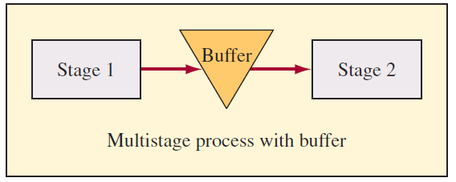
Buffering, Blocking, and Starving
Buffer: a storage area between stages where the output of a stage is placed prior to being used in a downstream stage
Blocking: occurs when the activities in a stage must stop because there is no place to deposit the item
Starving: occurs when the activities in a stage must stop because there is no work
Bottleneck: stage that limits the capacity of the process

Slide 8
Make-to-Stock versus Make-to-Order
Make-to-order
Only activated in response to an actual order
Both work-in-process and finished goods inventory kept to a minimum
Response time is slow
Make-to-stock
Process activated to meet expected or forecast demand
Customer orders are served from target stocking level
Hybrid
Combines the features of both make-to-order and make-to-stock
Notes:
4

Slide 9
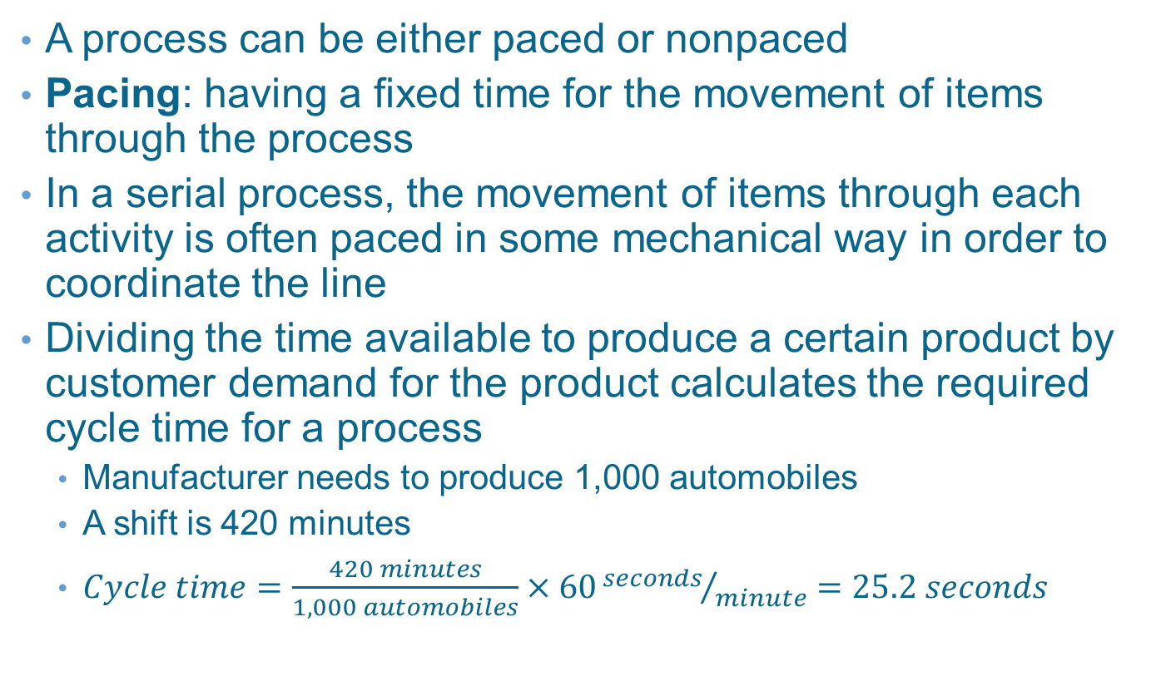
Pacing
A process can be either paced or nonpaced
Pacing: having a fixed time for the movement of items through the process
In a serial process, the movement of items through each activity is often paced in some mechanical way in order to coordinate the line
Dividing the time available to produce a certain product by customer demand for the product calculates the required cycle time for a process
  Manufacturer needs to produce 1,000 automobiles
  A shift is 420 minutes
  $Cycle time=\frac{420 minutes}{1,000 automobiles}×60{seconds}/{minute}=25.2 seconds$

Slide 10
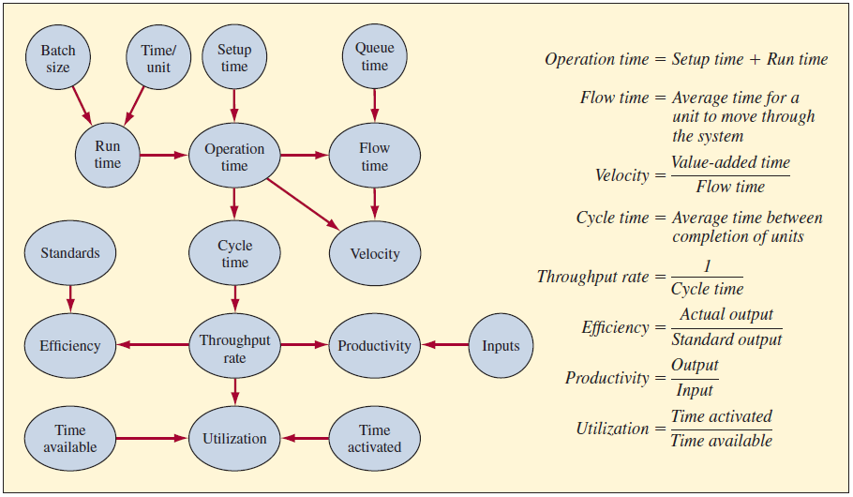
Measuring Process Performance
Exhibit 11.3
Notes:
17

Slide 11
Measuring Process Performance Terms
Benchmarking: comparing the metrics of one company to another
Productivity: the ratio of output to input
  Total factor productivity usually measured in dollars
  Partial factor productivity measured based on an individual input
    Labor is the most common
Efficiency: a ratio of the actual output of a process relative to some standard
  An alternative way that the term efficiency is used is to measure the loss or gain in a process

Slide 12
Measuring Process Performance Terms Continued
Run time: is the time required to produce a batch of parts
Setup time: the time required to prepare a machine to make a particular item
  In practice, setup time is often not included in the utilization of the process
Operation time: the sum of the setup time and run time for a batch of parts that are run on a machine
Flow time: includes the time the unit spends actually being worked on, together with the time spent waiting in a queue
  In practice, the term cycle time is often used to mean flow time
Value-added time: the time in which useful work is actually being done on the unit
Process velocity: the ratio of the value-added time to the flow time
  Also known as throughput ratio

Slide 13
Production Process Mapping and
Little’s Law
Total average value of inventory
Sum of the value of raw materials, work-in-process, and finished goods inventory
Inventory turns
Cost of goods sold divided by the average inventory value
Days-of-supply
Inverse of inventory turns scaled to days
Little’s law
There is a long-term relationship among inventory, throughput, and flow time
Inventory = Throughput rate x Flow time

Slide 14
Example 11.1: Car Batteries
Average cost $45
12 hours to make a car
Assembles 200 cars per 8-hour shift
  Currently one shift
Holds on average 8,000 batteries in raw material inventory

Slide 15
Example 11.1: Average Inventory
WIP = Throughput x Flow time
WIP = 25 batteries x 12 hours
WIP = 300 batteries
Total = 8,000 + 300 = 8,300 batteries

Slide 16
Example 11.1: Value and Flow Time
Value = 8,300 x $45 = $373,500
Flow time = Inventory/Throughput
Flow time = 8,000/200 = 40 days

Slide 17
Job Design Decisions
Job design: the function of specifying the work activities of an individual or group in an organizational setting
Objective is to develop job structures that meet the requirements of the organization and its technology
  Also that satisfy the jobholders’ personal and individual requirements
Work measurement methods are used to determine the most efficient means of performing a given task, as well as to set reasonable standards for performing it

Slide 18
Behavioral Considerations in
Job Design
Specialization of labor
Made high-speed, low-cost production possible
Greatly enhanced standard of living
Adverse effects on workers
Job enrichment
Making job more interesting to the worker
Horizontal enrichment: worker performs a greater number of variety of tasks
Vertical enrichment: worker is involved in planning, organizing, and inspecting work

Slide 19
Work Measurement and Standards
Work measurement: a process of analyzing jobs for the purpose of setting time standards
Why use it?
  Schedule work and allocate capacity
  Motivate and measure work performance
  Evaluate performance
  Provide benchmarks
Work measurement and its resulting work standards have been controversial
  Management may set the rate too high
  Workers who find a better way get penalized by having a revised rate set

Slide 20
Four Basic Work Measurement Techniques
Direct methods
  Time study: uses a stopwatch to time the work
  Work sampling: entails recording random observations of a person or teams at work
Indirect methods
  Predetermined motion-time data system: sums data from tables of generic movement times developed in the laboratory to arrive at a time for the job
  Elemental data: sums times from a database of similar combinations of movements to arrive at job time

Slide 21
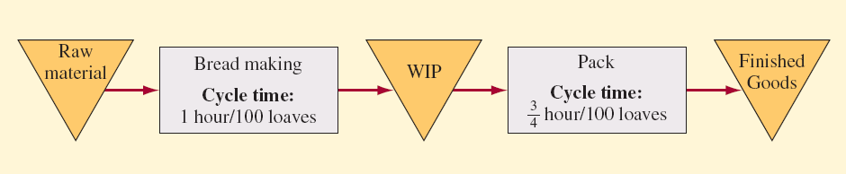
Example 11.2: Bread Making
Two steps are required
  Prepare the dough and bake the loaves (bread making)
  Packaging the loaves
Bread is made in batches of 100 loaves
  Completes a batch every hour, which is the cycle time
  Slower process so is the bottleneck
Packaging needs only 0.75 hour to place the 100 loaves in bags
  Has 75 percent utilization
Exhibit 11.5A

Slide 22
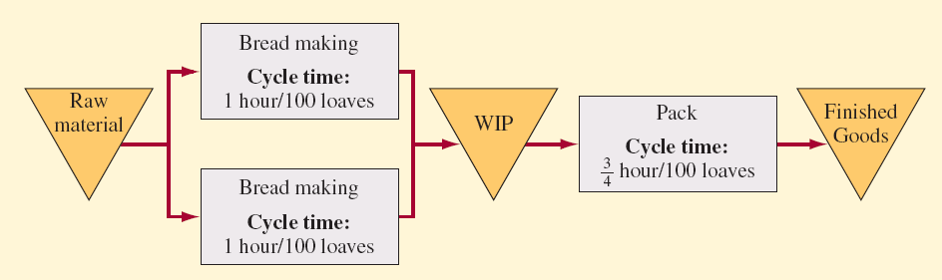
Example 11.2: Bread Making
Suppose we have two bread making lines
  Cycle time on each is still one hour to make 100 loaves
Bread making runs two shifts
  Produces 200 x 8 x 2 = 3,200
Packaging runs three shifts
  Produces 133.3 x 8 x 3 = 3,200
Capacities are roughly equal
Exhibit 11.5B

Slide 23
Example 11.3: A Restaurant
Consider the restaurant in the casino
Managers have set up a buffet arrangement where customers serve themselves
Buffet is continually replenished to keep items fresh
To further speed service a fixed amount is charged for the meal
Customers take an average of 30 minutes to get their food and eat
They typically eat in groups (or customer parties) of two or three to a table
The restaurant has 40 tables
  Each table can accommodate four people
What is the maximum capacity of this restaurant?

Slide 24
Example 11.3: Solution Approach
Utilization
  The restaurant can accommodate 160 people at a time
  It might be more convenient to measure the capacity in terms of customer parties because this is how the capacity will be used
    If the average customer party is 2.5 individuals, then the average seat utilization is 62.5 percent when the restaurant is operating at capacity
Cycle time
  When operating at capacity, 0.75 minute
    30 minutes/40 tables
  On average, a table would become available every 0.75 minute or 45 seconds
Capacity
  The restaurant could handle 80 customer parties per hour
    60 minutes/0.75 minute/party

Slide 25
Example 11.3: Challenges in Restaurant Problem
The problem with this restaurant is that everyone wants to eat at the same time
Management has collected data and expects the profile below for customer parties arriving during lunch, which runs from 11:30 am until 1:30 pm
Customers are seated only until 1:00 pm

Slide 26
Example 11.3: Restaurant Continued
Restaurant operates for two hours for lunch
The capacity is 80 customer parties per hour
A simple way to analyze the situation is to calculate how the system looks at the end of each 15-minute interval
The key is to look at the cumulative numbers
  The difference between cumulative arrivals and cumulative departures gives the number of customer parties in the restaurant
Because there are only 40 tables, when the cumulative difference through is greater than 40, a waiting line forms
Cycle time for the entire restaurant is 45 seconds per customer party at this time
The last party will need to wait for all of the earlier parties to get a table, so the expected waiting time is the number of parties in line multiplied by the cycle time

Slide 27
Example 11.3: Restaurant Continued
In the table below, when the cumulative number of parties is 50, there are 10 parties waiting to be seated
The average wait time is 10 x 45 seconds = 7.5 minutes
During 12:00 to 12:15
  Parties that arrived during 11:30 to 11:45 would have left
  The cumulative number of parties at the end of 12:15 = 50
    Number at the end of 12:00 + 30 (arrivals during 12:00 to 12:15) – 15 (departures during 12:00 to 12:15) = 65

Slide 28
Example 11.3: Customers in the Restaurant

Slide 29
Example 11.4: The Balabus (“Tourist Bus”) in Paris
Two hours for the route during peak traffic
Route has 60 stops
Each bus has seating capacity of 50
  Another 30 passengers can stand
Busy much of the day

Slide 30
Example 11.4: Initial Analysis
With one bus, maximum wait is two hours
If bus is halfway through cycle, wait is one hour
Average wait is one hour
  In general, average wait is ½ cycle time
If two buses used…
  Cycle time is one hour
  Average wait is 30 minutes
For a two-minute wait…
  Need four-minute cycle time
  Need 30 buses (120 minutes/4 minute cycle time)

Slide 31
Example 11.4: Capacity
Each bus has total capacity of 80 passengers
  50 seated
  30 standing
30 buses can accommodate…
  1,500 seated
  2,400 total

Slide 32
Example 11.4: Detailed Analysis

Slide 33
Example 11.4: Conclusion
With 30 buses, many will stand
During morning and afternoon rush, not all customers can be accommodated
  Need at least 40 buses during rush hours
With 40 buses all the time…
  24,000 seat-hours available
    40 buses x 12 hours x 50 seats per bus
  25,875 seat-hours needed
    107.8 percent utilization
    7.8 percent of customers must stand

Slide 34
Process Flow Time Reductions
Perform activities in parallel
Change the sequence of activities
Reduce interruptions

Slide 35
What Goes Into a Process Must Come out of the Process
Exhibit 11.6

Slide 36
Summary
A process takes inputs and transforms them into outputs that create value for the organization
  A company may have literally thousands of different processes
Understanding a process usually starts with a flowchart
With multistage process, it is useful to buffer the activities by placing inventory between the activities
The bottleneck is the activity or stage that limits the capacity of the process
A process that is only activated after an actual order arrives is called make-to-order
Make-to-stock processes supply inventory from which actual customer orders are filled

Slide 37
Summary Continued
Little’s law is a mathematical formula that captures the relationship between the amount of inventory of all types in the process
Job design is the study of how work activities are designed for workers
A key design decision is the amount of specialization that a job entails
Trade-offs exist between the quality and relative productivity of a process
A fundamental concept is that what goes into a process must come out of the process in some form
Coordinating the inputs and outputs is important to having a good process

Slide 38
Practice Exam
This is a part of an organization that takes inputs and transforms them into outputs
This is the ratio of the time that a resource is activated relative to the time it is available for use
This is a step in a process that is the slowest compared to the other steps
  This step limits the capacity of the process
This refers to the fixed timing of the movement of items through a process
This is when one company compares itself to another relative to operations performance
The relationship between time and units in a process is called this
What is the major assumption about how a process is operating for Little’s law to be valid
What is the two-edged sword of job design
This is when a job is increased vertically or horizontally
What are the four basic work measurement techniques

