Slide 1
Chapter 12: Six Sigma Quality
LO12–1: Explain the scope of total quality management in a firm.
LO12–2: Understand the Six Sigma approach to improving quality and productivity.
LO12–3: Illustrate globally recognized quality benchmarks.
McGraw-Hill/Irwin

Slide 2
Total Quality Management (TQM)
Total quality management: managing the entire organization so that it excels on all dimensions of products and services that are important to the customer
Two fundamental operational goals
  Careful design of the product or service
  Ensuring that the organization’s systems can consistently produce the design
Can only be achieved if the entire organization is oriented toward them
  Hence, the term total quality management

Slide 3
Malcolm Baldrige National Quality Award
An award established by the U.S. Department of Commerce given annually to companies that excel in quality
The Baldrige Quality Award is given to organizations that have demonstrated outstanding quality in their products and processes
The award program is administered by the National Institute of Standards and Technology, an agency of the U.S. Department of Commerce
A total of up to 18 awards may be given annually in these categories: manufacturing, service, small business, education and health care, and not-for-profit

Slide 4
Categories
Leadership
Strategic Planning
Customer and Market Focus
Information and Analysis
Human Resource Focus
Process Management
Business Results

Slide 5
Baldrige – Scoring
Applications are scored on total points out of 1,000
Those scoring over 650 get selected for site visits, which decide the final winner
Other benefits:
  Feedback from the Baldrige examiners
  “An audit report of the firm’s practices”
Many states use Baldrige Criteria as the basis for their own awards

Slide 6
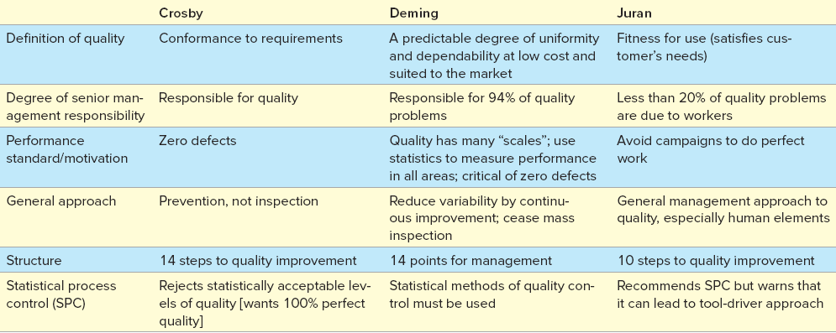
The Quality Gurus Compared
Exhibit 12.1

Slide 7
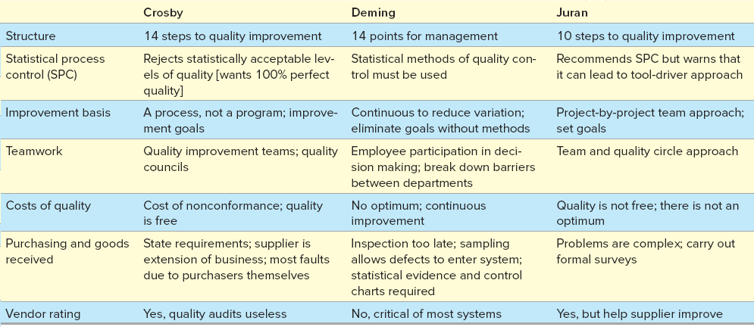
The Quality Gurus Compared Continued
Exhibit 12.1

Slide 8
Quality Costs
Design quality: inherent value of the product in the marketplace
Conformance quality: degree to which the product or service design specifications are met
Appraisal costs: costs of the inspection and testing to ensure that the product or process is acceptable
Prevention costs: sum of all the costs to prevent defects
Internal failure costs: costs for defects incurred within the system
External failure costs: costs for defects that pass through the system

Slide 9
Dimensions of Design Quality
Exhibit 12.2

Slide 10
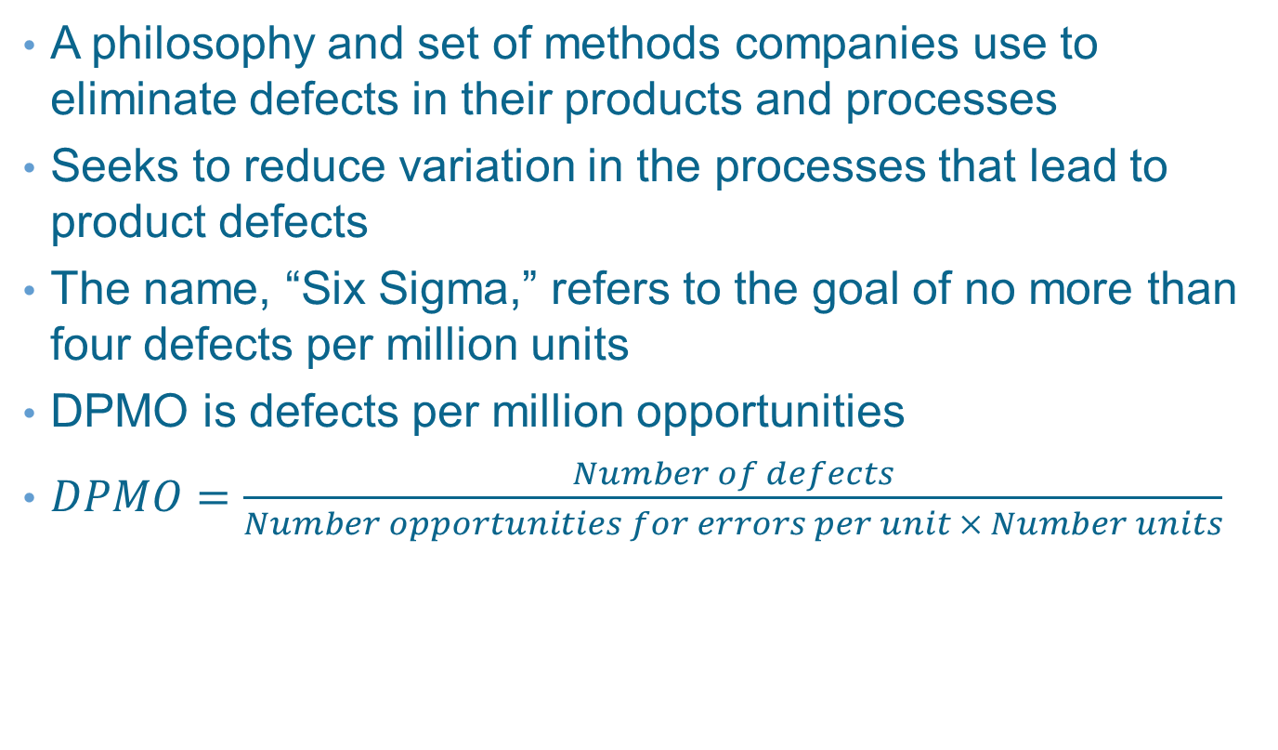
Six Sigma
A philosophy and set of methods companies use to eliminate defects in their products and processes
Seeks to reduce variation in the processes that lead to product defects
The name, “Six Sigma,” refers to the goal of no more than four defects per million units
DPMO is defects per million opportunities
$DPMO=\frac{Number of defects}{Number opportunities for errors per unit × Number units}$

Slide 11
DMAIC Cycle
Define - identify customers and their priorities
Measure - determine how to measure the process and how it is performing
Analyze - determine the most likely causes of defects
Improve - identify means to remove the causes of defects
Control - determine how to maintain the improvements

Slide 12
Six Sigma Analytical Tools
Flowchart - a diagram of the sequence of operations
Run chart - depict trends in data over time
Pareto chart - help to break down a problem into components
Checksheet - basic form to standardize data collection
Cause-and-effect diagram - show relationships between causes and problems
Opportunity flow diagram - used to separate value-added from non-value-added
Process control chart - used to assure that processes are in statistical control

Slide 13
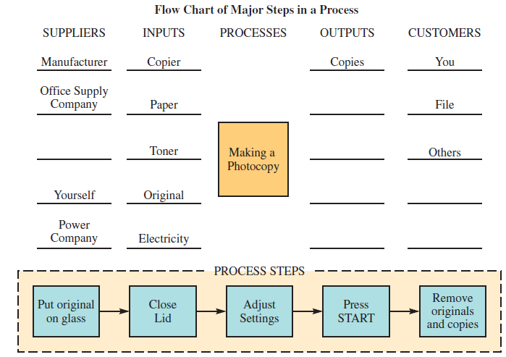
Flowchart
Exhibit 12.5

Slide 14
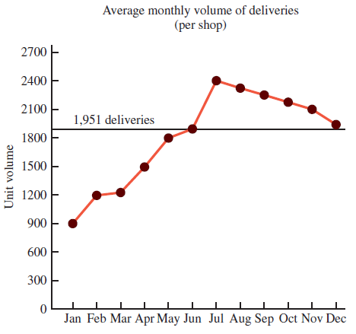
Run Chart
Exhibit 12.5

Slide 15
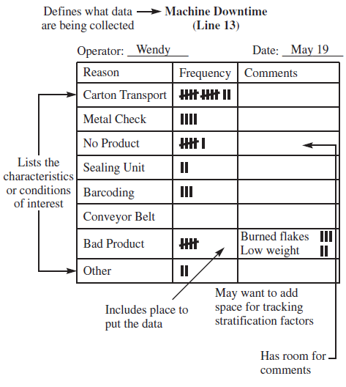
Checksheet
Exhibit 12.5

Slide 16
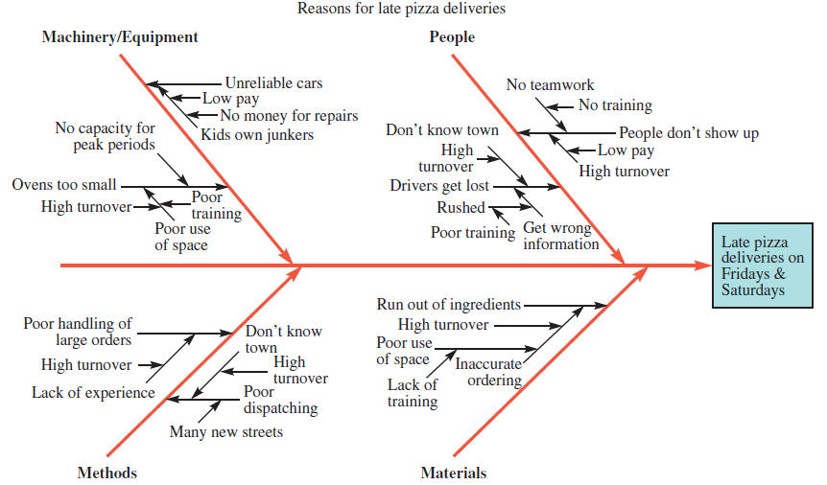
Cause-and-Effect Diagram (Fishbone Diagram)
Exhibit 12.5

Slide 17
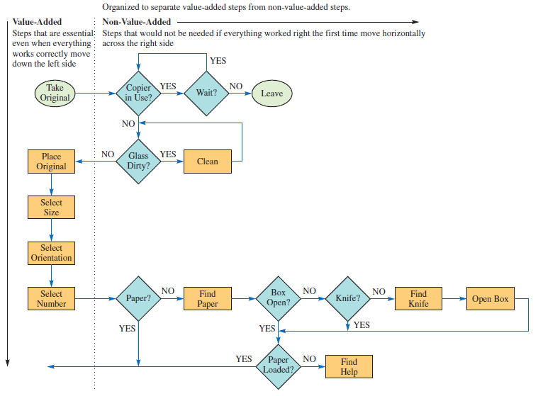
Opportunity Flow Diagram
Exhibit 12.5

Slide 18
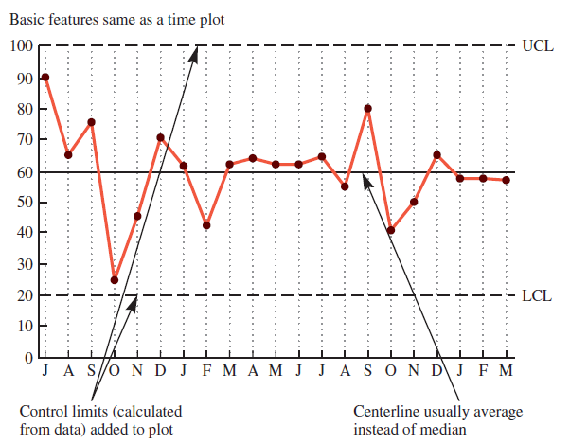
Process Control Chart
Exhibit 12.5

Slide 19
Additional Six Sigma Tools
Failure mode and effect analysis (FMEA): a structured approach to identify, estimate, prioritize, and evaluate risk of possible failures at each stage in the process
Design of experiments (DOE): a statistical methodology to determine cause-and-effect relationships between process variables and output
  Permits experimentation with many variables simultaneously
Lean Six Sigma combines the implementation and quality control tools of Six Sigma and the inventory management concept of lean manufacturing
Lean manufacturing achieves high-volume production and minimal waste through the use of just-in-time inventory methods

Slide 20
Six Sigma Roles and Responsibilities
Executive leaders must champion the process of improvement
Corporation-wide training in Six Sigma concepts and tools
Set stretch objectives for improvement
Continuous reinforcement and rewards

Slide 21
The Shingo System: Fail-Safe Design
Shingo’s argument:
  SQC methods do not prevent defects
  Defects arise when people make errors
  Defects can be prevented by providing workers with feedback on errors
    Successive check
    Self-check
    Source inspection
Poka-yoke includes:
  Checklists
  Special tooling that prevents workers from making errors
Notes:
21

Slide 22
ISO 9000 and ISO 14000
Series of international standards agreed upon by the International Organization for Standardization (ISO)
  Adopted in 1987
  Used in more than 160 countries
A prerequisite for global competition?
ISO 9000 an international reference for quality; ISO 14000 primarily concerned with environmental management
Notes:
24

Slide 23
Seven Quality Management Principles ISO 9000 Based On
Customer focus
Leadership
Involvement of people
Process approach
Continual improvement
Factual approach to decision making
Mutually beneficial supplier relationships

Slide 24
Three Forms of ISO Certification
First party: a firm audits itself against ISO 9000 standards
Second party: a customer audits its supplier
Third party: a "qualified" national or international standards or certifying agency serves as auditor
Notes:
27

Slide 25
Summary
TQM is a comprehensive approach to quality
  Two goals: design of the produce/service and ensuring consistency
Quality specifications are fundamental to a sound quality program
Processes are designed so design specifications are met when the product is produced or the service delivered
Costs related to quality may be difficult to measure
Six Sigma projects follow five steps: (1) define, (2) measure, (3) analyze, (4) improve, and (5) control
Often, fail-safe procedures can be included in a process that guarantees a very high level of quality
The International Organization for Standardization (ISO) has developed specifications that define best-quality practices
  The two most accepted specifications are ISO 9000 and ISO 14000

Slide 26
Practice Exam
This refers to the inherent value of the product in the marketplace and is a strategic decision for the firm
Relates to how well a product or service meets design specifications
Relates to how the customer views the ability of the product to meet his/her objectives
The series of international quality standards
What is the enemy of good quality
A Six Sigma process that is running at the center of its control limits would expect this defect rate
The standard quality improvement methodology developed by General Electric

