Slide 1
Chapter 15: Logistics, distribution, and transportation
LO15–1: Explain what logistics is.
LO15–2: Contrast logistics and warehouse alternatives.
LO15–3: Analyze logistics-driven location decisions.
McGraw-Hill/Irwin

Slide 2
Logistics
Logistics: the art and science of obtaining, producing, and distributing material and product in the proper place and in the proper quantities
  Accounts for eight to nine percent of US GDP
International logistics: managing these functions when the movement is on a global scale
Third-party logistics company: an outside company used to manage all or part of another company’s logistics functions

Slide 3
Transportation Modes
Truck: great flexibility
Ship: high capacity and low cost but slow
Plane: fast but expensive
Train: low cost but slow and variable
Pipeline: highly specialized and limited to liquids, gases, and solids in slurry form
  No packaging is needed and the costs per mile are low
Hand delivery: last step in many supply chains
Multimodial solutions are the norm

Slide 4
Logistics-System Design Matrix: Framework Describing Logistics Processes
Exhibit 15.1

Slide 5
Cross-Docking
Cross-docking: large shipments are broken down into small shipments for local delivery in an area
  Minimizes inventory in the warehouse
Hub-and-spoke systems: the sole purpose of the warehouse (the hub) is sorting goods to consolidation areas, where each area is designed for shipment to a specific location
  Hubs are located near the geographic center of the region they are to serve to minimize the distance a good must travel

Slide 6
Issues in Facility Location
Proximity to customers: makes rapid delivery easier
Business climate: can include presence of similar-sized businesses, businesses in the same industry, and other foreign companies
Total costs: object is to minimize overall cost
Infrastructure: adequate road, rail, air, and sea transportation along with energy and telecommunications
Quality of labor: educational and skill levels must match needs
Notes:
4

Slide 7
Issues in Facility Location Continued
Suppliers: proximity of important suppliers supports lean production
Other facilities: location of other facilities can influence a location decision
Free trade zones: a closed facility into which foreign goods can be brought without being subject to the normal customers requirements
Political risk: risks in both the country of location and the host country influence the decision
Government barriers: barriers in many countries are being removed
Notes:
4

Slide 8
Issues in Facility Location Continued
Trading blocs: firms locate within a block to take advantage of new markets or lower total cost
Environmental regulation: these impact a certain industry in a given location and must be included in the decision
Host community: host community’s interest is part of the evaluation process
Competitive advantage: the location should provide the company with a competitive advantage
Notes:
8

Slide 9
Boeing Adds South Carolina to Its Dreamliner Assembly Location
Boeing assembled all commercial planes in Seattle until the Dreamliner 787 came along
First Dreamliner came out of SC plant on April 27, 2012
By the end of 2013, 3.5 planes per month are expected
Boeing chose SC over the vigorous objection of its union
The union finally relented, and signed a contract, when the firm agreed to add an advanced version to the Dreamliner line-up in Seattle

Slide 10
Plant Location Methods
Factor-rating system
Transportation method of linear programming
Centroid method

Slide 11
Factor-Rating System
Is the most widely used
List of factors is developed
Range of possible points is assigned to each factor
Each site is rated against each factor
The sums of assigned points for each site are computed
The site with the most points is selected

Slide 12
Transportation Method of Linear Programming
Transportation method is a special linear programming method
Two common objectives…
  Minimize costs of shipping n units to m destinations
  Maximize profit of shipping n units to m destinations
Notes:
10

Slide 13
Example 15.1
U.S. Pharmaceutical Company has four factories supplying the warehouses of four major customers
Its management wants to determine the minimum-cost shipping schedule for its monthly output to these customers
Factory supply, warehouse demands, and shipping costs per case for these drugs are given in the table in the next slide

Slide 14
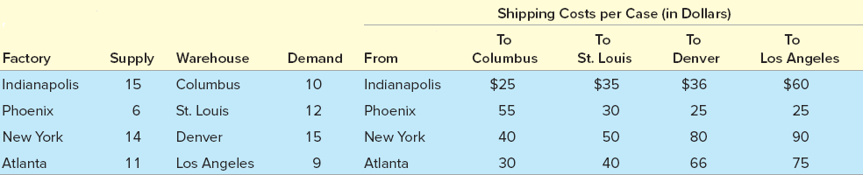
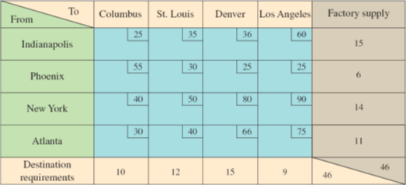
Example: U.S. Pharmaceutical Company
Exhibit 15.2

Slide 15
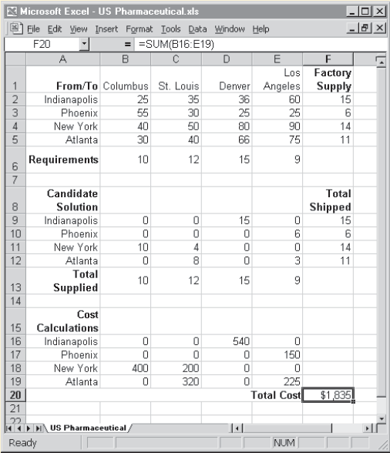
Example: Excel Screen Showing the U. S. Pharmaceutical Problem
Exhibit 15.3

Slide 16
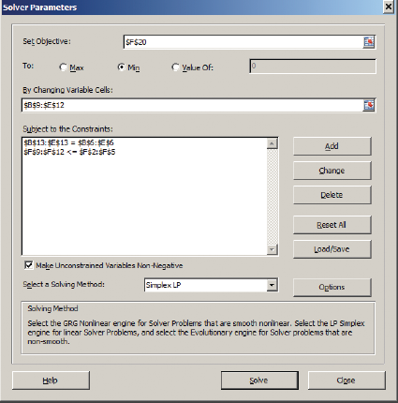
Example: Solver Parameters

Slide 17
Centroid Method
Used for locating single facilities that considers existing facilities, the distances between them, and the volumes of goods to be shipped between them
  Assumes inbound and outbound transportation costs are equal
  Does not include special shipping costs for less than a full load
This methodology involves formulas used to compute the coordinates of the two-dimensional point that meets the distance and volume criteria stated above
Notes:
10

Slide 18
Centroid Method Formulas
Notes:
12

Slide 19
Example 15.2: HiOctane Refining Company
The HiOctane Refining Company needs to locate an intermediate holding facility between its refining plant in Long Beach and its major distributors
Next slide shows the coordinate map and the amount of gasoline shipped to or from the plant and distributors
In this example, for the Long Beach location (the first location), d_{ix} = 325, d_{iy} = 75, and V_{i} = 1,500

Slide 20
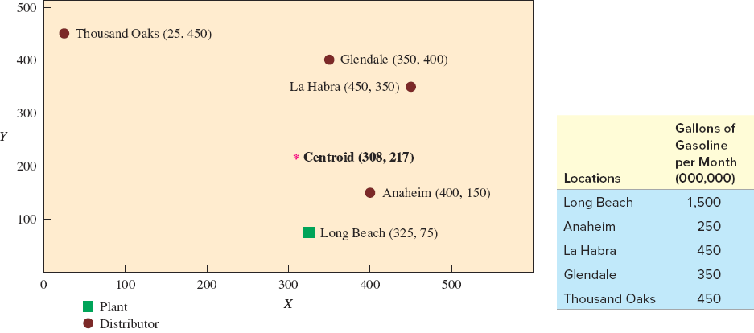
Example 15.2: Grid Map for Centroid Example
Exhibit 15.4

Slide 21
Example 15.2: Calculations
C_{x} = X coordinate of centroid
C_{y} = Y coordinate of centroid
d_{ix} = X coordinate of the i^{th} location
d_{iy} = Y coordinate of the i^{th} location
V_{i} = volume of goods moved to or from the i^{th} location

Slide 22
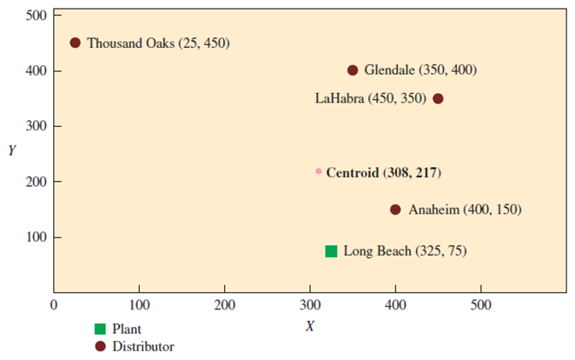
Example 15.2: Grid Map for Centroid Example with Centroid
Start search for new location here
Exhibit 15.4 (Partial)

Slide 23
Locating Service Facilities
New service facilities are far more common than new factories and warehouses
  Much less expensive
Multiple sites close to customers
Location decision closely tied to the market selection decision
Decision more about maximizing profits than minimizing costs

Slide 24
Example 15.3: Linear Regression as a Model for Service Location
Develop a model for locating a motel
The goal is to locate so as to maximize long-term profitability
What category of variables and individual items in the category are important?
  Competitive
    Room rate
    Competitor’s rate, etc.
  Demand generators
    Nearness to military base, hospitals
    Nearness to college
    Nearness to malls, etc.

Slide 25
Example 15.3: Independent Variables Collected for the Initial Model-Building Stage
Exhibit 15.5

Slide 26
Example 15.3: Choosing Variables That Matter
Look at the correlation of profitability (operating margin over the last few years) with all the potential parameters
Pick the ones that are highly correlated (in a positive or negative fashion)
Run a regression line with the chosen parameters as the independent variables and profitability as the dependent variable
Profitability = 39.05 - 5.41 x State pop. per inn (1,000)
+ 5.86 x Room rate for the inn
- 3.91 x Square root income of area (1,000)
+ 1.75 x College enrollment within 4 miles

Slide 27
Example 15.3: How the Result Is Used
The hotel chain implemented the model on a spreadsheet and routinely uses the spreadsheet to screen potential real estate acquisitions
The founder and president of the hotel chain has accepted the model’s validity and no longer feels obligated to personally select the sites
This example shows that a specific model can be obtained from the requirements of service organizations and used to identify the most important features in site selection

Slide 28
Summary
Logistics covers the entire scope of obtaining, producing, and distributing material and product to the proper place and in the correct quantities
  The focus is on the movement of material and the location of warehouses and manufacturing plants
  Third-party logistics companies provide services to many companies
Decision related to how material will be transported and where plants and warehouses are located have an impact on the cost of the product
Transportation alternatives include water, rail, highways, air, pipelines, and hand delivery
Finding the optimal logistics-system design is a complex task
The factor-rating system is an analytical tool that allows consideration of many different types of criteria
Locating service type businesses is often very dependent on how close the contact needs to be to customers

Slide 29
Practice Exam
This is the art and science of obtaining, producing, and distributing material and product in the proper place and in the proper quantities
A company that is hired to handle logistics functions
A mode of transportation that is the most flexible relative to cost, volume, and speed of delivery
When large shipments are broken down directly into smaller shipments for local delivery
Sorting goods is the main purpose of this type of warehouse
A place where foreign goods can be brought into the United States without being subject to normal customs requirements

Slide 30
Practice Exam Continued
The main cost criterion employed when a transportation model is used for analyzing a logistics network
The Microsoft Excel function used to solve the transportation model
For the transportation model to be able to find a feasible solution, this must always be greater than or equal to total demand
The “changing cells” in a transportation model represent this
This is a method that locates facilities relative to an X, Y grid
A technique that is useful for screening potential locations for services

