Slide 1
Chapter 16: Global Sourcing and Procurement
LO16–1: Explain what strategic sourcing is.
LO16–2: Explain why companies outsource processes.
LO16–3: Analyze the total cost of ownership.
LO16–4: Evaluate sourcing performance.
McGraw-Hill/Irwin

Slide 2
Strategic Sourcing
Strategic sourcing: the development and management of supplier relationships to acquire goods and services in a way that aids in achieving the immediate needs of the business
In the past, sourcing was another name for purchasing
As a result of globalization, sourcing implies a more complex process suitable for products that are strategically important

Slide 3
Strategic Sourcing Continued
Specificity: refers to how common the item is and, in a relative sense, how many substitutes might be available
  Commonly available products can be purchased using a relatively simple process
Request for proposal (RFP): used for purchasing items that are more complex or expensive and where there may be a number of potential vendors
Vendor-managed inventory: when a customer actually allows the supplier to manage an item or group of items for them

Slide 4
Sourcing/Purchasing Design Matrix
Exhibit 16.1

Slide 5
The Bullwhip Effect
Forward buying: retailers responding to a temporary price cut by stocking up
Bullwhip effect: phenomenon of variability magnification as we move from the customer to the producer in the supply chain
  A slight change in consumer sales ripples backward as magnified oscillations upstream, like the result of a flick of a bullwhip handle
Continuous replenishment: inventory is replaced frequently, as part of an ongoing process

Slide 6
Increasing Variability of Orders Up the Supply Chain
Exhibit 16.2

Slide 7
Functional Products
Functional products: the staples that people buy in a wide range of retail outlets, such as grocery stores and gas stations
Product life cycle of more than two years
Contribution margin of 5 to 20 percent
Only 10 to 20 product variations
An average forecast error of only 10 percent
Lead time for make-to-order products of from six months to one year

Slide 8
Innovative Products
Innovation can enable a company to achieve higher profit margins
Newness of the innovative products makes demand
for them unpredictable
Typically have a life cycle of just a few months
  Imitators quickly erode the competitive advantage that innovative products enjoy
  Companies are forced to introduce a steady stream of newer innovations
The short life cycles and the great variety typical of these products further increase unpredictability

Slide 9
Product and Process Uncertainty Characteristics
Exhibit 16.3

Slide 10
Supply Chain Uncertainty Framework
Supply Uncertainty
Exhibit 16.4

Slide 11
Four Types of Supply Chain Strategies
Efficient supply chains: utilize strategies aimed at creating the highest cost efficiency
Risk-hedging supply chains: utilize strategies aimed at pooling and sharing resources in a supply chain to share risk
Responsive supply chains: utilize strategies aimed at being responsive and flexible
Agile supply chains: utilize strategies aimed at being responsive and flexible to customer needs

Slide 12
Outsourcing
Outsourcing: moving some of a firm’s internal activities and decision responsibility to outside providers
Allows a company to create a competitive advantage while reducing cost
An entire function may be outsourced, or some elements of an activity may be outsourced, with the rest kept in-house

Slide 13
Reasons to Outsource and the Resulting Benefits
Exhibit 16.5

Slide 14
Logistics Outsourcing
Logistics: the management functions that support the complete cycle of material flow
  Purchase and internal control of materials
  Planning and control of WIP
  Purchasing, shipping, and distribution of finished product
Emphasis on lean inventory means there is less room for delivery errors
Logistics companies have complex computer tracking technology that reduces the risk in transportation and allows the logistics company to add more value to the firm
Third-party logistics providers track freight to tell customers exactly where its drivers are and when deliveries will be made

Slide 15
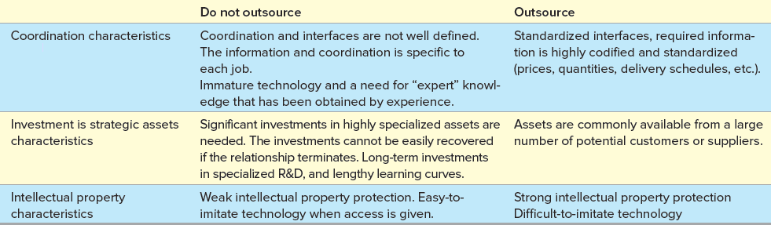
A Framework for Structuring Supplier Relationships
Exhibit 16.6

Slide 16
Green Sourcing
Being environmentally responsible has become a business imperative
Many firms are looking to their supply chains to deliver “green” results
Financial results can often be improved through going green
A comprehensive green sourcing effort should assess how a company uses items that are purchased internally
It is also important to reduce waste

Slide 17
Green Sourcing Process
Exhibit 16.7

Slide 18
Total Cost of Ownership
Total cost of ownership (TCO): an estimate of the cost of an item
Includes all the costs related to the procurement and use of an item, including any related costs in disposing of the item
Can be applied to internal costs or more broadly to costs throughout the supply chain
Exhibit 16.8

Slide 19
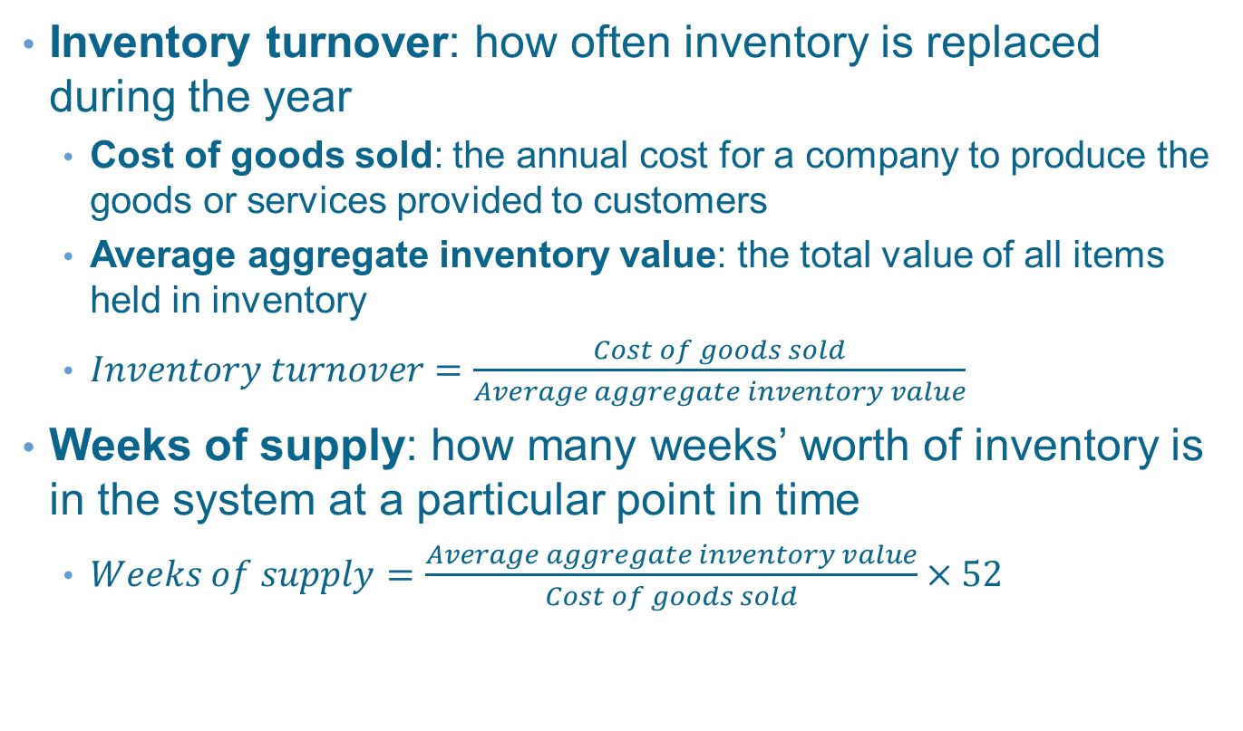
Measuring Sourcing Performance
Inventory turnover: how often inventory is replaced during the year
  Cost of goods sold: the annual cost for a company to produce the goods or services provided to customers
  Average aggregate inventory value: the total value of all items held in inventory
  $Inventory turnover=\frac{Cost of goods sold}{Average aggregate inventory value}$
Weeks of supply: how many weeks’ worth of inventory is in the system at a particular point in time
  $Weeks of supply=\frac{Average aggregate inventory value}{Cost of goods sold}×52$

Slide 20
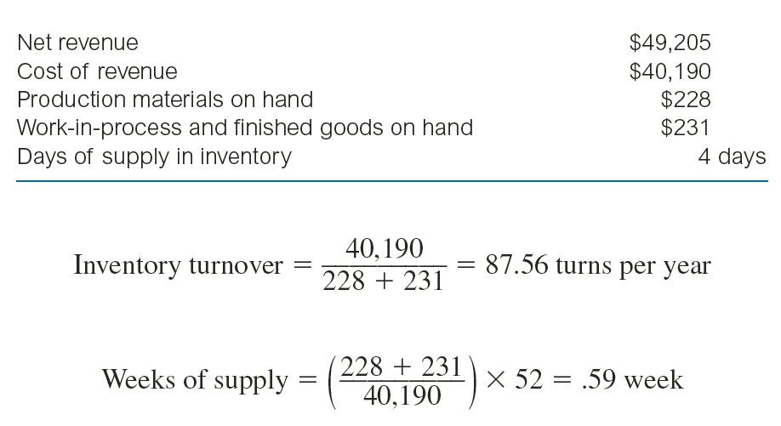
Example 16.2: Inventory Turnover Calculation

Slide 21
Summary
Sourcing is a term that captures the strategic nature of purchasing in today's global and Internet-connected marketplace
The bullwhip effect is when changes in demand are magnified as they move from the customer to the manufacturer
Supply chains can be categorized based on demand and supply uncertainty characteristics
  Four types of supply chains are identified: (1) efficient, (2) risk-hedging, (3) responsive, and (4) agile
Costs can generally be categorized into three areas
  (1) acquisition costs, (2) ownership costs, and (3) post-ownership costs
Inventory turn and weeks of supply are the most common measures to evaluate supply chain efficiency

Slide 22
Practice Exam
Refers to how common an item is or how many substitutes might be available
When a customer allows the supplier to manage inventory policy for an item or group of items
A phenomenon characterized by increased variation in ordering as we move from the customer to the manufacturer in the supply chain
Products that satisfy basic needs and do not change much over time
Products with short life cycles and typically high profit margins
A supply chain that must deal with high levels of both supply and demand uncertainty

Slide 23
Practice Exam Continued
In order to cope with high levels of supply uncertainty, a firm would use this strategy to reduce risk
Used to describe functions related to the flow of material in a supply chain
When a firm works with suppliers to look for opportunities to save money and benefit the environment
Refers to an estimate of the cost of an item that includes all costs related to the procurement and use of an item, including the costs of disposing after its useful life

