Slide 1
Enterprise resource planning systems
LO17–1: Understand what an enterprise resource planning (ERP) system is.
LO17–2: Explain how ERP integrates business units through information sharing.
LO17–3: Illustrate how supply chain planning and control fits within ERP.
LO17–4: Evaluate supply chain performance using data from the ERP system.
McGraw-Hill/Irwin

Slide 2
What is ERP?
Managers
  ERP is a comprehensive software approach to support decisions concurrent with planning and controlling the business
IT Community
  ERP is a term describing a software system that integrates application programs in finance, manufacturing, logistics, sales and marketing, human resources, and other functions in a firm
  Accomplished through a database shared by all the functions and data-processing applications

Slide 3
ERP
ERP requires consistent numbers across all applications
There are four aspects of ERP software that determine the quality of an ERP system
  The software should be multifunctional in scope
  The software should be integrated
  The software needs to be modular in structure
  The software must facilitate basic planning and control activities
Transaction processing: the posting and tracking of the activities that document the business
  Efficient handling of the transactions as goods move through each step of the process is the primary goal of an ERP system
Decision support: the system helps the user make intelligent judgments about how to run the business
  This is a second objective of an ERP system

Slide 4
How ERP Connects the Functional Units
A typical ERP system is made up of functionally oriented and tightly integrated modules
All the modules of the system use a common database that is updated in real time
ERP vendors are constantly looking for ways to improve the functionality of their software, so new features are often added

Slide 5
The Scope of ERP Applications
Exhibit 17.2

Slide 6
Typical ERP Modules
Finance
  Automatic capture of basic accounting transactions at the source
Manufacturing and Logistics
  Largest and most complex of the module categories
  Typical components include:
    Sales and operations planning
    Materials management
    Plant maintenance
    Quality management
    Production planning and control
    Project management
Sales and Marketing
  Customer and sales management, forecasting, and so on
Human Resources
  Supports the need to manage, schedule, pay, hire, and train people

Slide 7
Customized Software
In addition to the standard application modules, many companies utilize special add-on modules
  These link to the standard modules
  They tailor applications to specific needs
These modules may be tailored to specific industries
They may also provide special decision support functions
Even with standard ERP packages, additional software will usually be required
  Each company has a unique mix of products and services

Slide 8
Data Integration
ERP works from a single database
Transactions are processed in real time
Data entered by one functional area updates all other functional areas and the data are processed in real time
  Eliminates reposting of data (errors)
  Ensures a common vision instantly displayed
Data warehouse: a special program that is designed to automatically archive and process data for uses that are outside the basic ERP system applications

Slide 9
How Supply Chain Planning and Control Fits Within ERP
ERP is concerned with all aspects of a supply chain
  managing materials
  Scheduling machines and people
  Coordinating suppliers and key customers
The coordination required for success runs across all functional units in the firm
  An ERP system is designed to provide the information and decision support needed to coordinate this

Slide 10
SAP Supply Chain Management
SAP divides its supply chain software into four main functions
  Supply chain planning
  Supply chain execution
  Supply chain collaboration
  Supply chain coordination
Supply chain design module provides a centralized overview of the entire supply chain and key performance indicators
Collaborative demand and supply planning helps match demand to supply
Materials management shares inventory and procurement order information

Slide 11
SAP Supply Chain Management Continued
Collaborative manufacturing shares information with partners
Collaborative fulfillment supports partnerships that can intelligently commit to delivery dates in real time
The inventory collaboration hub uses the Internet to gain visibility to suppliers and manage the replenishment process
Collaborative replenishment planning allow manufacturers to collaborate with their strategic retail customers
Vendor managed inventory (VMI) enables vendor-driven inventory replenishment

Slide 12
SAP Supply Chain Management Continued
Enterprise portal gives users personalized access to a range of information, applications, and services supported by the system
Mobile supply chain management allows people to plan, execute, and monitor activity using mobile and remote devices
Supply chain event management monitors the execution of supply chain events
Supply chain performance management allows the firm to monitor key performance indicators

Slide 13
Performance Metrics to Evaluate Integrated System Effectiveness
An ERP system can provide the data needed for a comprehensive set of performance measures
  This allows the firm to evaluate strategic alignment of the various functions with the firm’s strategy
Three major functional areas make up the internal supply chain of a manufacturing enterprise
  Purchasing
  Manufacturing
  Sales and distribution
Tight cooperation is required between these three functions for effective manufacturing planning and control
Exhibit 17.2

Slide 14
The “Functional Silo” Approach
Purchasing
  Responsible for buying all material to support manufacturing operations
  Wishes to know what quantities are going to be needed over the long term
  Solicits bids for the best price for each material
  The main criterion is simply the cost of the material
Manufacturing
  Making the product at the lowest possible cost is classic metric
  Long production runs lead to lower unit costs and high inventories
Distribution
  Job is moving product from the manufacturing site to the customer at lowest possible cost

Slide 15
Implications if all Three Areas are Allowed to Work Independently
Purchasing will buy the largest quantities possible
  This results in large amounts of raw material inventory
Manufacturing group desires to maximize production volumes
  Spread the fixed costs of production over as many units as possible
  Results in high WIP
  Time between batches increases
  Response time to unexpected demand increases
Distribution will try to fully load every truck
  Minimize transportation cost
  Result in larges amount of inventory in distribution centers
Sales group might sell product that cannot possibly be delivered on time
A more coordinated approach is facilitated by the use of an ERP system

Slide 16
Integrated Supply Chain Metrics
Developed by the APICS Supply Chain Council
Designed to measure the impact of decisions on the entire supply chain
Avoids development of functional silos by developing metrics that reflect the entire supply chain

Slide 17
Supply Chain Metrics
Exhibit 17.4

Slide 18
Cash-to-Cash Cycle Time
Cash-to-cash cycle time: integrates the purchasing, manufacturing, and sales/distribution cycles
  Calculating the measure requires the use of data related to purchasing, accounting, manufacturing, and sales
Is a measure of cash flow
  Where cash comes from
  Where cash is spent
  Net change in cash
Cash-to-cash cycle time = Inventory days of supply
+ Days of sales outstanding
- Average payment period for material

Slide 19
Integrated ERP Data for Cash-to-Cash Cycle Time Calculation
Exhibit 17.5

Slide 20
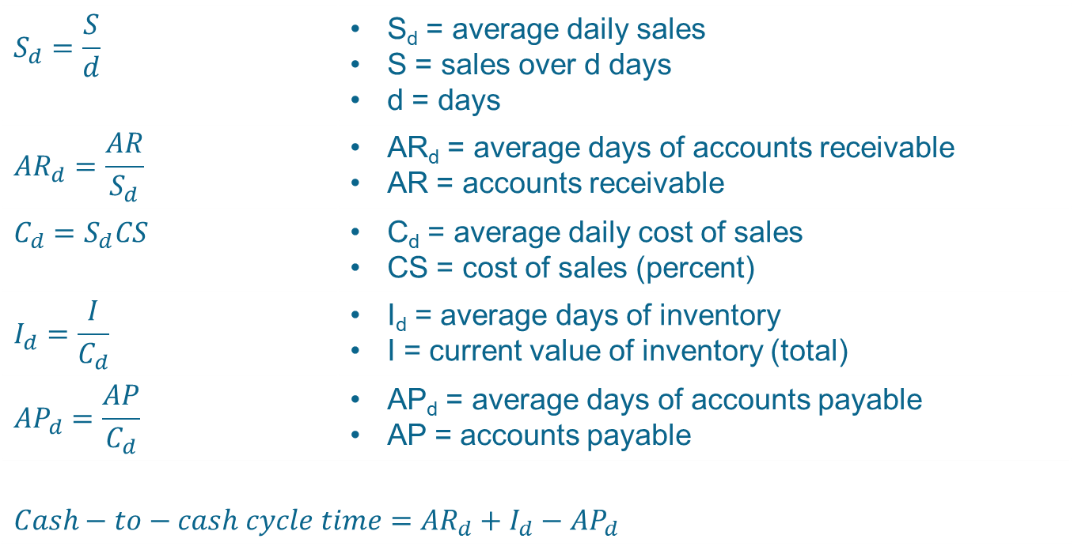
Calculating the Cash-to-Cash Cycle Time
$$S_{d}=\frac{S}{d}$$ | S_{d} = average daily sales S = sales over d days d = days
$${AR}_{d}=\frac{AR}{S_{d}}$$ | AR_{d} = average days of accounts receivable AR = accounts receivable
$$C_{d}=S_{d}CS$$ | C_{d} = average daily cost of sales CS = cost of sales (percent)
$$I_{d}=\frac{I}{C_{d}}$$ | I_{d} = average days of inventory I = current value of inventory (total)
$${AP}_{d}=\frac{AP}{C_{d}}$$ | AP_{d} = average days of accounts payable AP = accounts payable
$$Cash−to−cash cycle time={AR}_{d}+I_{d}−{AP}_{d}$$

Slide 21
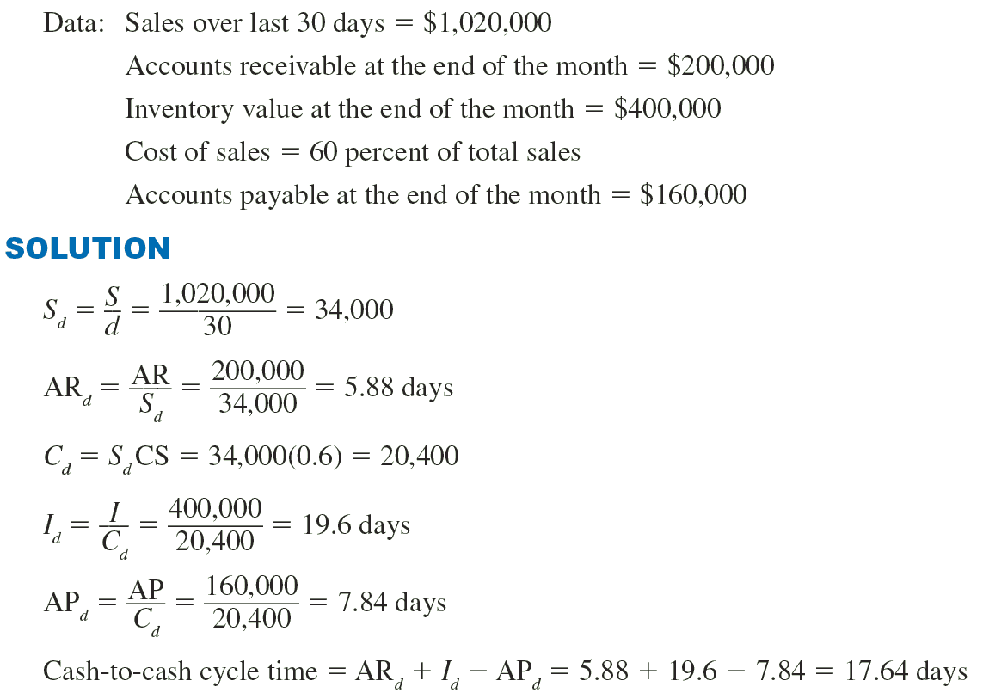
Example 17.1: Cash-to-Cash Cycle Time Calculation

Slide 22
Summary
ERP is a comprehensive software system that integrates data from all functional areas of a business
  Benefits gained are better processes, information accuracy, and responsiveness through the real-time information provided by the system
Typical ERP systems have application modules in finance, manufacturing and logistics, sales and marketing, and human resources
  The software modules connect to a common database that is updated in real time
Applications for supply chain activities are all included
Performance measures that span functional areas are most useful to ensure that each area is not optimizing their own processes at the expense of the other areas

Slide 23
Practice Exam
A computer system that links all areas of a company using an integrated set of application programs and a common database
The application programs are designed in accordance with industry norms or _____
Implementing an ERP system is a simple exercise that involves loading software on a computer
A term used for delivering ERP services on demand over the Internet
The name of Microsoft’s ERP offering
Part of an ERP system that manages the activities within a certain functional area
A set of processes to enable vendor-driven replenishment
A metric that measures the percentage of orders shipped according to schedule

