Slide 1
Chapter 18: Forecasting
LO18–1: Understand how forecasting is essential to supply chain planning.
LO18–2: Evaluate demand using quantitative forecasting models.
LO18–3: Apply qualitative techniques to forecast demand.
LO18–4: Apply collaborative techniques to forecast demand.
McGraw-Hill/Irwin

Slide 2
Forecasting in Operations and Supply Chain Management
Forecasting is a vital function and affects every significant management decision
  Finance and accounting use forecasts as the basis for budgeting and cost control
  Marketing relies on forecasts to make key decisions such as new product planning and personnel compensation
  Production uses forecasts to select suppliers; determine capacity requirements; and drive decisions about purchasing, staffing, and inventory
Different roles require different forecasting approaches
  Decisions about overall directions require strategic forecasts
  Tactical forecasts are used to guide day-to-day decisions

Slide 3
Forecasting and Decoupling Point
Decoupling point: Point at which inventory is stored, which allows SC to operate independently
The choice of the decoupling point in a supply chain is strategic
Forecasting helps determine the level of inventory needed at the decoupling points
The decision will be affected by the error produced in the forecast and the type of product (easily inventoried or easily perishable)

Slide 4
Types of Forecasting
There are four basic types of forecasts
  Qualitative
  Time series analysis
  Causal relationships
  Simulation
Time series analysis is based on the idea that data relating to past demand can be used to predict future demand
Chapter focuses on qualitative and time series techniques

Slide 5
Components of Demand
Average demand for a period of time
Trend
Seasonal element
Cyclical elements
Random variation
Autocorrelation
Notes:
7

Slide 6
Historical Product Demand Consisting of a Growth Trend and Seasonal Demand
Exhibit 18.1

Slide 7
Remaining Components
Cyclical factors are more difficult to determine because the time span may be unknown or the cause of the cycle may not be considered
  Political elections, war, economic conditions, or sociological pressures
Random variations are caused by chance events
  If we cannot identify the cause of variation, it is assumed to be purely random chance
Autocorrelation denotes that the value expected at any point is highly correlated with its own past values

Slide 8
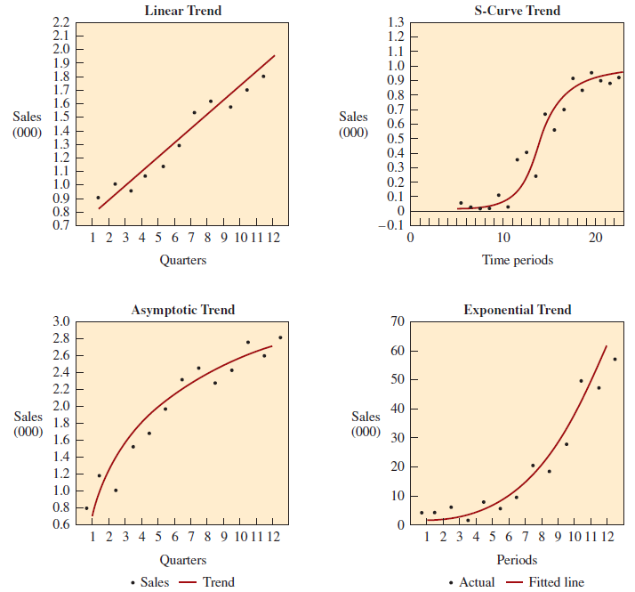
Trend Lines
Identification of trend lines is a common starting point when developing a forecast
Common trend types include linear, S-curve, asymptotic, and exponential
Exhibit 18.2

Slide 9
Time Series Analysis
Short term: forecast under three months
  Tactical decisions
Medium term: three months to two years
  Capturing seasonal effects
Long term: forecast longer than two years
  Detecting general trends
  Identifying major turning points

Slide 10
Factors Affecting Forecasting Model Selection
Time horizon to be forecast
Data availability
Accuracy required
Size of forecasting budget
Availability of qualified personnel

Slide 11
A Guide to Selecting an Appropriate Forecasting Method
Exhibit 18.3

Slide 12
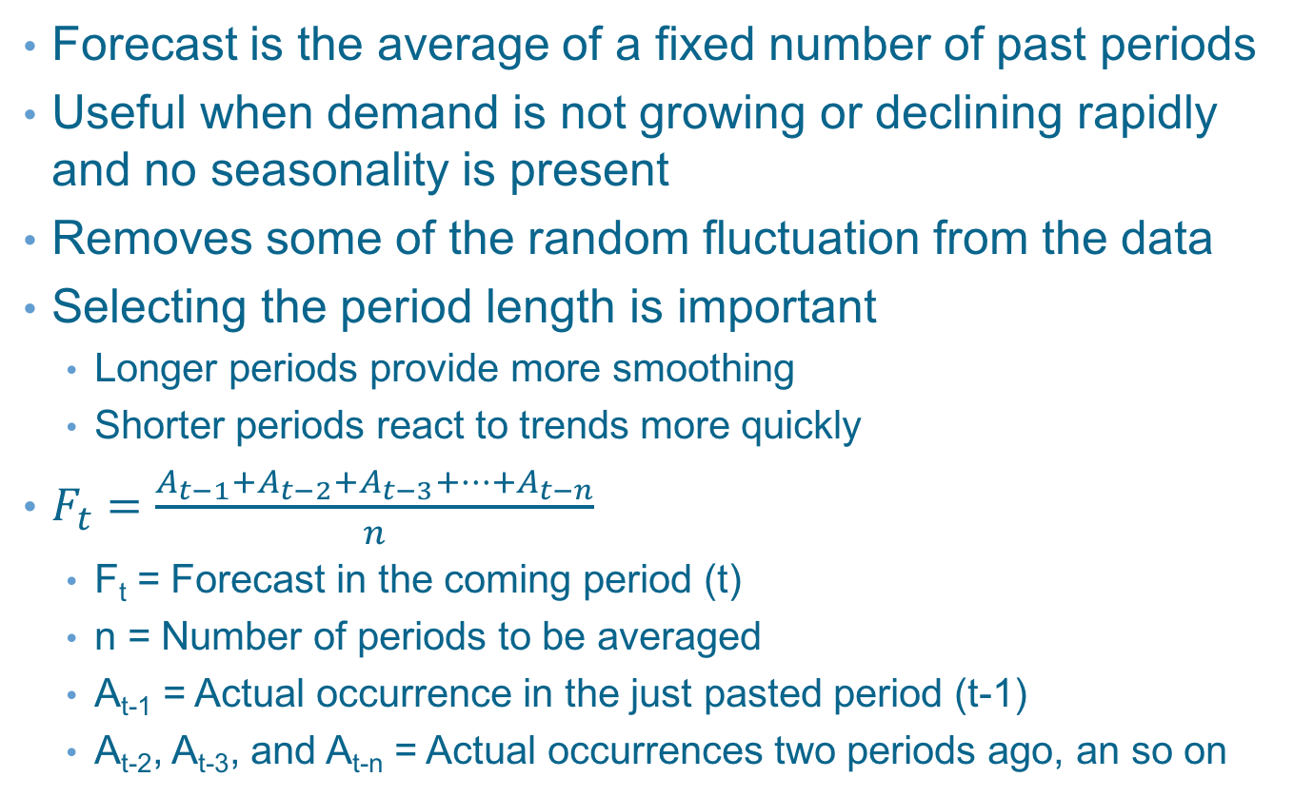
Simple Moving Average
Forecast is the average of a fixed number of past periods
Useful when demand is not growing or declining rapidly and no seasonality is present
Removes some of the random fluctuation from the data
Selecting the period length is important
  Longer periods provide more smoothing
  Shorter periods react to trends more quickly
$F_{t}=\frac{A_{t−1}+A_{t−2}+A_{t−3}+⋯+A_{t−n}}{n}$
  F_{t} = Forecast in the coming period (t)
  n = Number of periods to be averaged
  A_{t-1} = Actual occurrence in the just pasted period (t-1)
  A_{t-2}, A_{t-3}, and A_{t-n} = Actual occurrences two periods ago, an so on

Slide 13
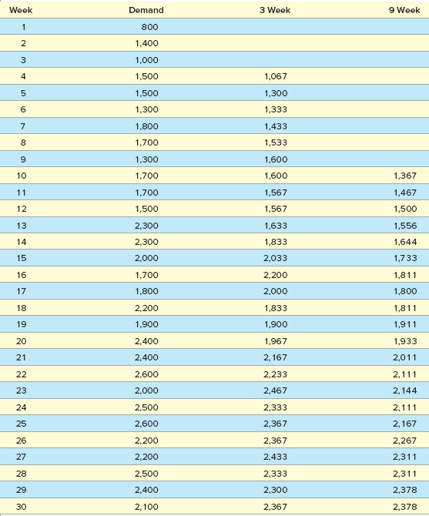
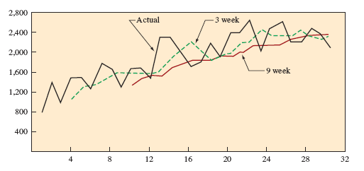
Simple Moving Average – Example
Exhibit 18.4

Slide 14
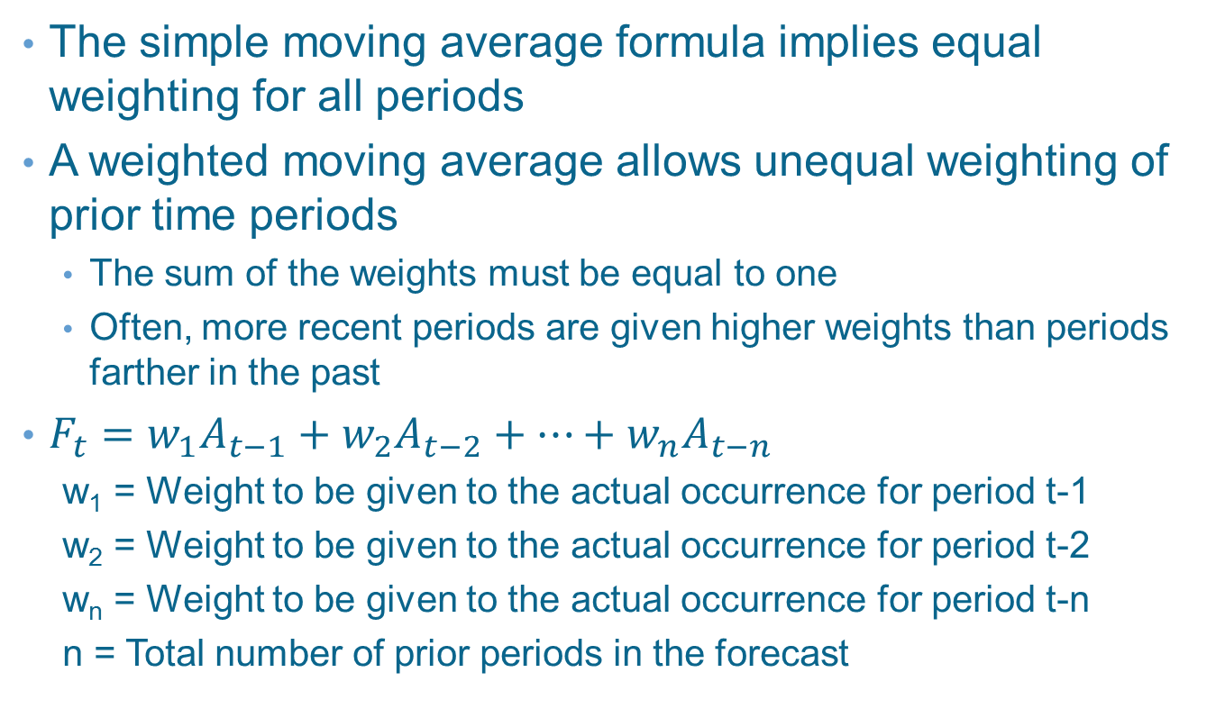
Weighted Moving Average
The simple moving average formula implies equal weighting for all periods
A weighted moving average allows unequal weighting of prior time periods
  The sum of the weights must be equal to one
  Often, more recent periods are given higher weights than periods farther in the past
$F_{t}=w_{1}A_{t−1}+w_{2}A_{t−2}+⋯+w_{n}A_{t−n}$
  w₁ = Weight to be given to the actual occurrence for period t-1
  w₂ = Weight to be given to the actual occurrence for period t-2
  w_{n} = Weight to be given to the actual occurrence for period t-n
  n = Total number of prior periods in the forecast

Slide 15
Selecting Weights
Experience and/or trial-and-error are the simplest approaches
The recent past is often the best indicator of the future, so weights are generally higher for more recent data
If the data are seasonal, weights should reflect this appropriately
  That is, the sales from the same period last time should be weighted the heaviest

Slide 16
Exponential Smoothing
A weighted average method that includes all past data in the forecasting calculation
More recent results weighted more heavily
The most used of all forecasting techniques
An integral part of computerized forecasting
Well accepted for six reasons
  Exponential models are surprisingly accurate
  Formulating an exponential model is relatively easy
  The user can understand how the model works
  Little computation is required to use the model
  Computer storage requirements are small
  Tests for accuracy are easy to compute

Slide 17
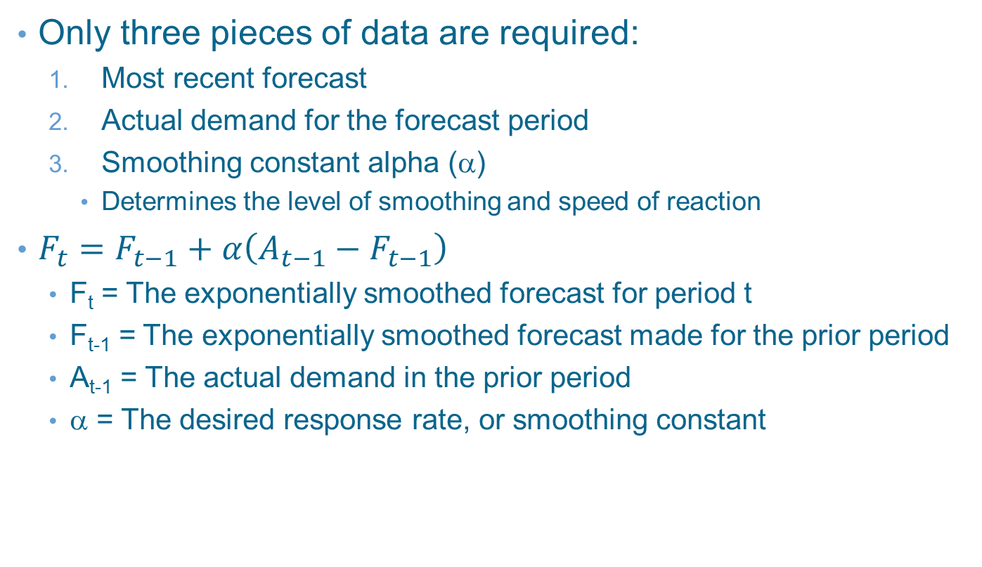
Exponential Smoothing Model
Only three pieces of data are required:
  Most recent forecast
  Actual demand for the forecast period
  Smoothing constant alpha (α)
    Determines the level of smoothing and speed of reaction
$F_{t}=F_{t−1}+α\left(A_{t−1}−F_{t−1}\right)$
  F_{t} = The exponentially smoothed forecast for period t
  F_{t-1} = The exponentially smoothed forecast made for the prior period
  A_{t-1} = The actual demand in the prior period
  α = The desired response rate, or smoothing constant

Slide 18





Exponential Smoothing Example (α=0.20)
Week | Demand | Forecast
1 | 820 | 820
2 | 775 | 820
3 | 680 | 811
4 | 655 | 785
5 | 750 | 759
6 | 802 | 757
7 | 798 | 766
8 | 689 | 772
9 | 775 | 756
10 |  | 760

Slide 19
First Forecast
No way to find F₁ since F_{t} is a function of F_{t-1}
When exponential smoothing is first used for an item, an initial forecast may be obtained by using a simple estimate
  Like the first period’s demand
  Or by using an average of preceding periods, such as the average of the first two or three periods
For working homework, assume F₁ = A₁

Slide 20
Exponential Forecasts vs. Actual Demand for Product over Time Showing Forecast Lag
Exhibit 18.5

Slide 21
Exponential Smoothing with Trend
An trend in data causes the exponential forecast to always lag the actual data
Can be corrected somewhat by adding in a trend adjustment
To correct the trend, we need two smoothing constants
  Smoothing constant alpha (α)
  Trend smoothing constant delta (δ)

Slide 22
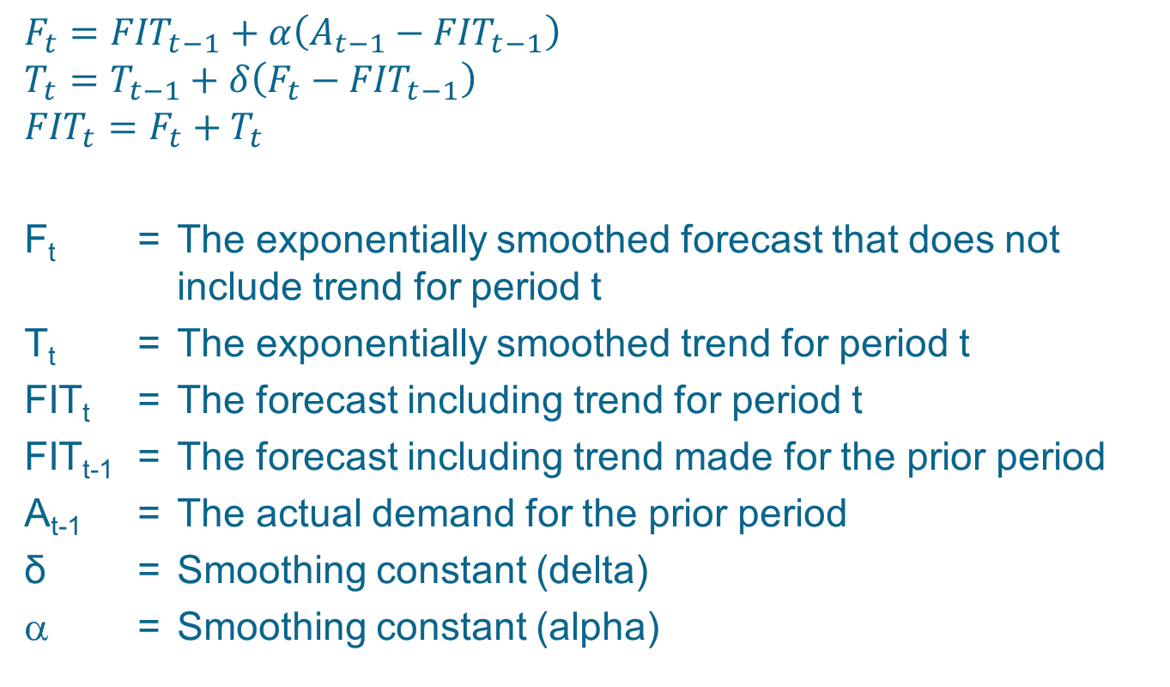
Trend Effects Equations
$$F_{t}={FIT}_{t−1}+α\left(A_{t−1}−{FIT}_{t−1}\right)$$
$$T_{t}=T_{t−1}+δ\left(F_{t}−{FIT}_{t−1}\right)$$
$${FIT}_{t}=F_{t}+T_{t}$$
F_{t} = The exponentially smoothed forecast that does not include trend for period t
T_{t} = The exponentially smoothed trend for period t
FIT_{t} = The forecast including trend for period t
FIT_{t-1} = The forecast including trend made for the prior period
A_{t-1} = The actual demand for the prior period
δ = Smoothing constant (delta)
α = Smoothing constant (alpha)

Slide 23
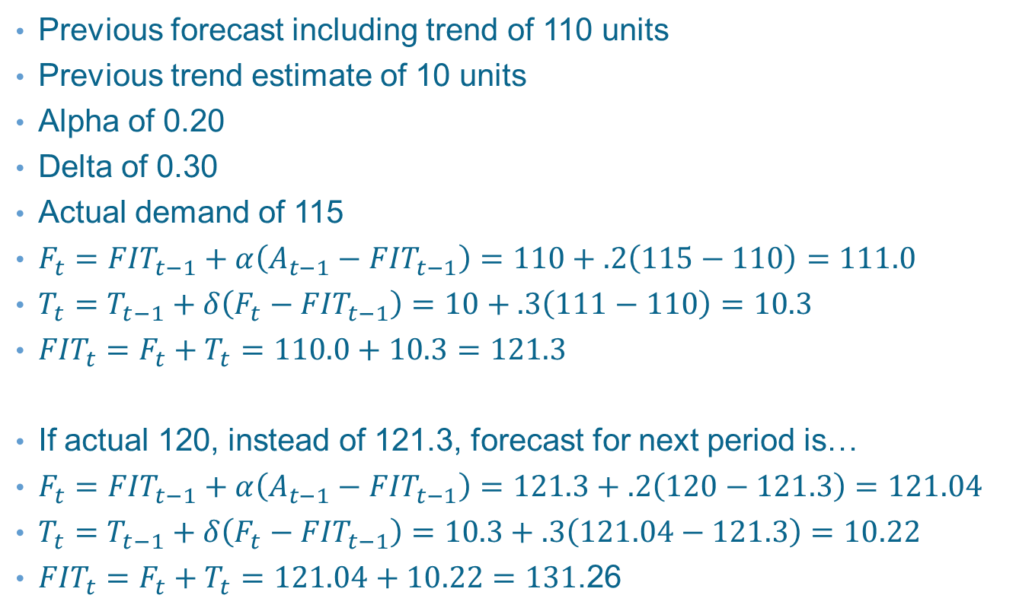
Example 18.1: Forecast Including Trend
Previous forecast including trend of 110 units
Previous trend estimate of 10 units
Alpha of 0.20
Delta of 0.30
Actual demand of 115
$F_{t}={FIT}_{t−1}+α\left(A_{t−1}−{FIT}_{t−1}\right)=110+.2\left(115−110\right)=111.0$
$T_{t}=T_{t−1}+δ\left(F_{t}−{FIT}_{t−1}\right)=10+.3\left(111−110\right)=10.3$
${FIT}_{t}=F_{t}+T_{t}=110.0+10.3=121.3$
If actual 120, instead of 121.3, forecast for next period is…
$F_{t}={FIT}_{t−1}+α\left(A_{t−1}−{FIT}_{t−1}\right)=121.3+.2\left(120−121.3\right)=121.04$
$T_{t}=T_{t−1}+δ\left(F_{t}−{FIT}_{t−1}\right)=10.3+.3\left(121.04−121.3\right)=10.22$
${FIT}_{t}=F_{t}+T_{t}=121.04+10.22=131$.26

Slide 24
Choosing Alpha and Delta
Exponential smoothing requires that the smoothing constants be given a value between 0 and 1
Typically fairly small values are used for alpha and delta in the range of .1 to .3
The values depend on how much random variation there is in demand and how steady the trend factor is

Slide 25
Linear Regression Analysis
Regression is used to identify the functional relationship between two or more correlated variables, usually from observed data
Dependent variable is predicted for given values of the independent variable
Linear regression is special case that assumes the relationship between the variables can be explained with a straight line
Useful for long-term forecasting
Y = a + bt
  Y = Dependent variable computed by the equation
  y = The actual dependent variable data point
  a = Y intercept
  b = Slope of the line
  t = Time period

Slide 26
Example 18.2: Least Squares Method
Quarter | Sales |  | Quarter | Sales
1 | 600 |  | 7 | 2,600
2 | 1,550 |  | 8 | 2,900
3 | 1,500 |  | 9 | 3,800
4 | 1,500 |  | 10 | 4,500
5 | 2,400 |  | 11 | 4,000
6 | 3,100 |  | 12 | 4,900
Exhibit 18.6

Slide 27
Example 18.1: Calculating Totals
Exhibit 18.7

Slide 28
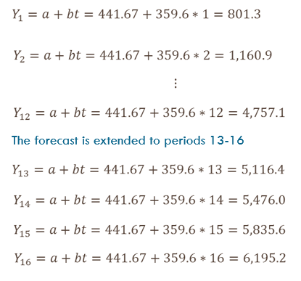
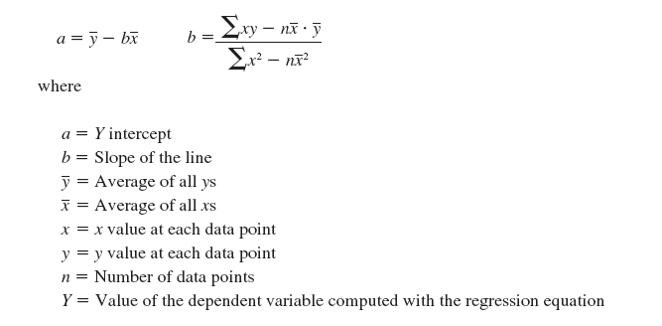
Example 18.1: Other Calculations

Slide 29
Regression with Excel
Exhibit 18.8

Slide 30
Time Series Decomposition
Chronologically ordered data are referred to as a time series
A time series may contain one or many elements
  Trend, seasonal, cyclical, autocorrelation, and random
Identifying these elements and separating the time series data into these components is known as decomposition
Seasonal variation may be either additive or multiplicative
  Additive: Forecast including trend and seasonal = Trend + Seasonal
  Multiplicative: Forecast including trend and seasonal = Trend × Seasonal factor
Exhibit 18.9

Slide 31
Example 18.3: Simple Proportion
In past years, firm sold an average of 1,000 units each year
  200 in spring
  350 in summer
  300 in fall
  150 in winter
Find the seasonal factors
Using those factors, if we expected demand for next year to be 1,100 units, compute demand per period

Slide 32
Example 18.3: Finding Seasonal Factors

Slide 33
Example 18.3: Forecast for Next Year

Slide 34
Decomposition Using Least Squares Regression
Decompose the time series into its components
  Find seasonal component
  Deseasonalize the demand
  Find trend component
Forecast future values of each component
  Project trend component into the future
  Multiply trend component by seasonal component

Slide 35
Example: Deseasonalized Demand
Exhibit 18.11

Slide 36
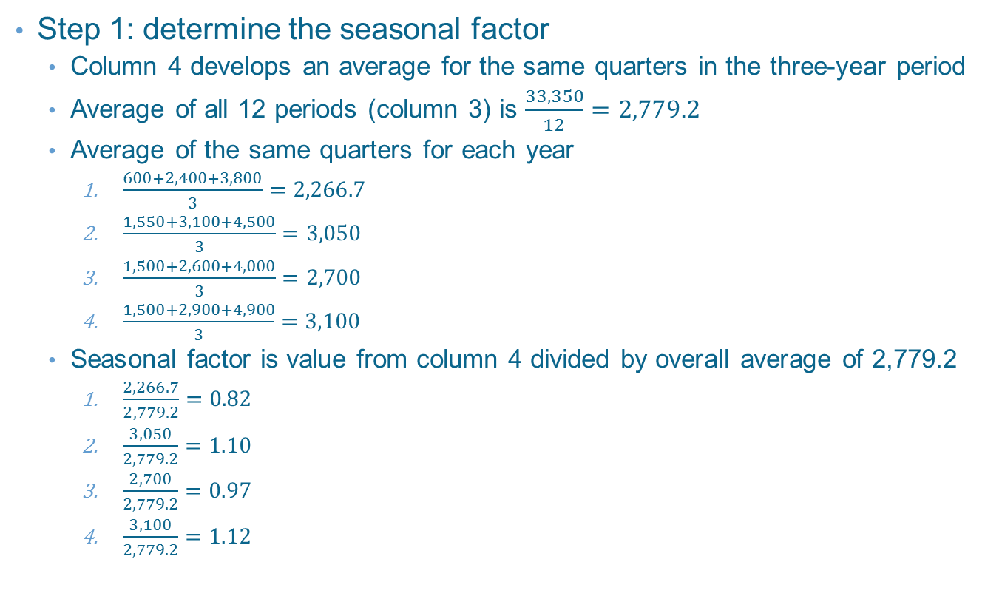
Example Continued
Step 1: determine the seasonal factor
  Column 4 develops an average for the same quarters in the three-year period
  Average of all 12 periods (column 3) is $\frac{33,350}{12}=2,779.2$
  Average of the same quarters for each year
    $\frac{600+2,400+3,800}{3}=2,266.7$
    $\frac{1,550+3,100+4,500}{3}=3,050$
    $\frac{1,500+2,600+4,000}{3}=2,700$
    $\frac{1,500+2,900+4,900}{3}=3,100$
  Seasonal factor is value from column 4 divided by overall average of 2,779.2
    $\frac{2,266.7}{2,779.2}=0.82$
    $\frac{3,050}{2,779.2}=1.10$
    $\frac{2,700}{2,779.2}=0.97$
    $\frac{3,100}{2,779.2}=1.12$

Slide 37
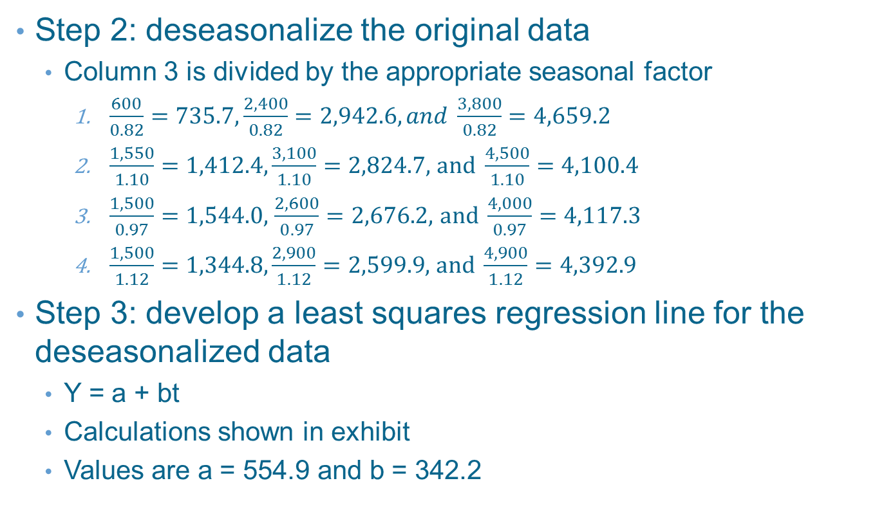
Example Continued
Step 2: deseasonalize the original data
  Column 3 is divided by the appropriate seasonal factor
    $\frac{600}{0.82}=735.7, \frac{2,400}{0.82}=2,942.6, and \frac{3,800}{0.82}=4,659.2$
    $\frac{1,550}{1.10}=1,412.4,\frac{3,100}{1.10}=2,824.7,$ $and \frac{4,500}{1.10}=4,100.4$
    $\frac{1,500}{0.97}=1,544.0,$ $\frac{2,600}{0.97}=2,676.2,$ $and \frac{4,000}{0.97}=4,117.3$
    $\frac{1,500}{1.12}=1,344.8,\frac{2,900}{1.12}=2,599.9,$ $and \frac{4,900}{1.12}=4,392.9$
Step 3: develop a least squares regression line for the deseasonalized data
  Y = a + bt
  Calculations shown in exhibit
  Values are a = 554.9 and b = 342.2

Slide 38
Example Continued
Step 4: project the regression line through the period to be forecast
  Use slope and intercept given earlier
  Use period numbers (t) of 13-16
  Results shown in third column above
Step 5: create the final forecast by adjusting the regression line by the seasonal factor
  Third column times appropriate seasonal factor in column four
  Final forecast shown in fifth column above

Slide 39
Forecast Errors
Forecast error is the difference between the forecast value and what actually occurred
Can come from a variety of sources
All forecasts contain some level of error
Sources of error
  Bias: when a consistent mistake is made
  Random: errors that are not explained by the model being used

Slide 40
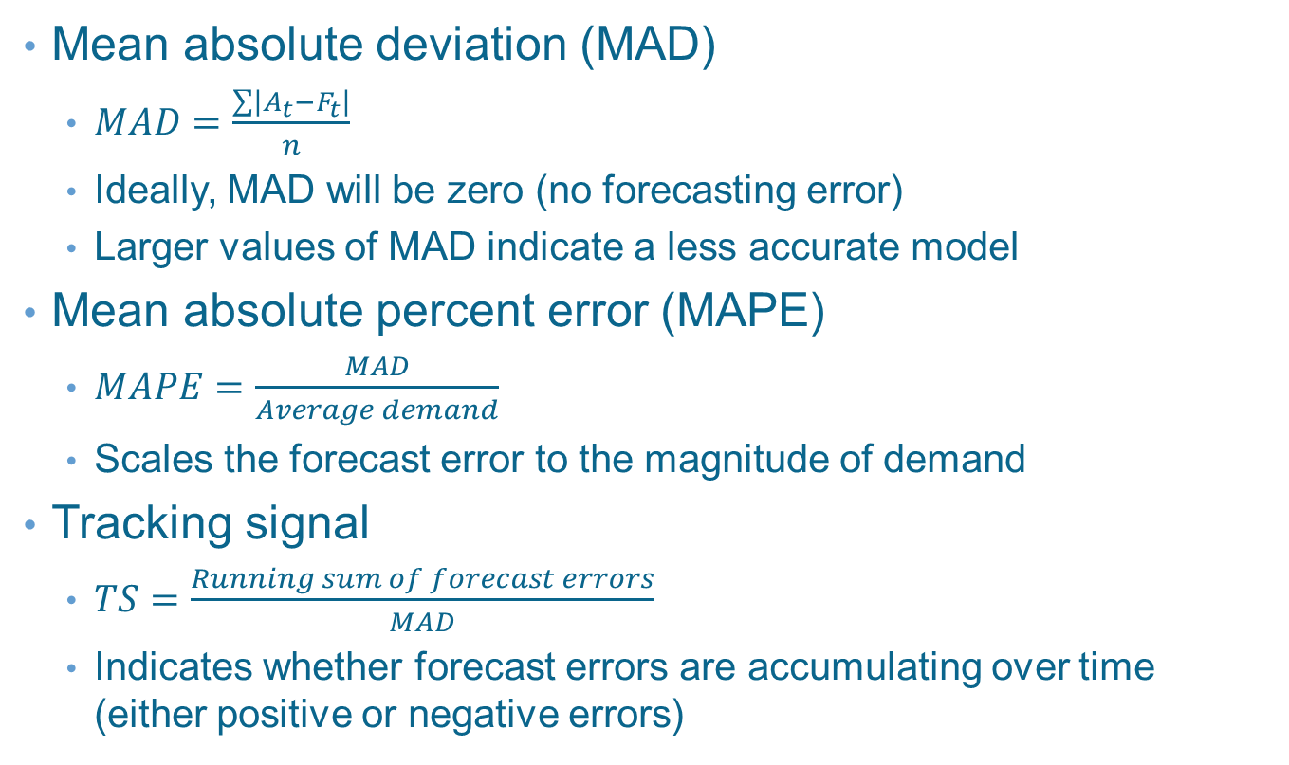
Measures of Error
Mean absolute deviation (MAD)
  $MAD=\frac{\sum{\left|A_{t}−F_{t}\right|}}{n}$
  Ideally, MAD will be zero (no forecasting error)
  Larger values of MAD indicate a less accurate model
Mean absolute percent error (MAPE)
  $MAPE=\frac{MAD}{Average demand}$
  Scales the forecast error to the magnitude of demand
Tracking signal
  $TS=\frac{Running sum of forecast errors}{MAD}$
  Indicates whether forecast errors are accumulating over time (either positive or negative errors)

Slide 41
Computing Forecast Error
Exhibit 18.15

Slide 42
Causal Relationship Forecasting
Causal relationship forecasting uses independent variables other than time to predict future demand
  This independent variable must be a leading indicator
  For example, using rain to forecast sales of umbrellas
Many apparently causal relationships are actually just correlated events
  Care must be taken when selecting causal variables

Slide 43
Multiple Regression Techniques
Often, more than one independent variable may be a valid predictor of future demand
In this case, the forecast analyst may utilize multiple regression
  Analogous to linear regression analysis, but with multiple independent variables
  Multiple regression supported by statistical software packages
Requires collecting additional data to perform the forecast
  Some of that data will likely come from outside the firm
Microsoft Excel supports multiple regression

Slide 44
Qualitative Forecasting Techniques
Generally used to take advantage of expert knowledge
Useful when judgment is required, when products are new, or if the firm has little experience in a new market
Examples…
  Market research
  Panel consensus
  Historical analogy
  Delphi method

Slide 45
Collaborative Planning, Forecasting, and Replenishment (CPFR)
A web-based process used to coordinate the efforts of a supply chain
  Demand forecasting
  Production and purchasing
  Inventory replenishment
Integrates all members of a supply chain – manufacturers, distributors, and retailers
Depends upon the exchange of internal information to provide a more reliable view of demand

Slide 46
CPFR Steps
Creation of a front-end partnership agreement
Joint business planning
Development of demand forecasts
Sharing forecasts
Inventory replenishment

Slide 47
Summary
Strategic forecasts are longer term and usually involve forecasting demand for a group of products
Tactical forecasts would cover only a short period of time
Demand can be broken down or “decomposed” into basic elements, such as trend, seasonality, and random variation
Four different time series models are evaluated
  (1) simple moving average, (2) weighted moving average, (3) exponential smoothing, and (4) linear regression
Causal relationship forecasting is different from time series
The quality of a forecast is measured based on its error
Qualitative techniques depend more on judgment or the opinions of experts
  These techniques typically involve a structured process so that experience can be acquired and accuracy assessed

Slide 48
Practice Exam
This is a type of forecast used to make long-term decisions, such as where to locate a warehouse or how many employees to have in a plant next year
This is the type of demand that is most appropriate for using forecasting models
This is a term used for actually influencing the sale of a product or service
These are the six major components of demand
This type of analysis is most appropriate when the past is a good predictor of the future
This is identifying and separating time series data into components of demand

Slide 49
Practice Exam Continued
Your forecast is, on average, incorrect by about 10 percent
  The average demand is 130 units
  What is the MAD
If the tracking signal for your forecast was consistently positive, you could then say this about your forecasting technique
What would you suggest to improve the forecast described in question 8
You know that sales are greatly influenced by the amount your firm advertises in the local paper
  What forecasting technique would you suggest trying
What forecasting tool is most appropriate when closely working with customers dependent on your products

