Slide 1
chapter 19: sales and operations planning
LO19–1: Understand what sales and operations planning is and how it coordinates manufacturing, logistics, service, and marketing plans.
LO19–2: Construct and evaluate aggregate plans that employ different strategies for meeting demand.
LO19–3: Explain yield management and why it is an important strategy.
McGraw-Hill/Irwin

Slide 2
What Is Sales and Operations Planning?
Aggregate operations plan: translates annual and quarterly business plans into broad labor and output plans for the intermediate term
Sales and operations planning is a process that helps firms provide better customer service, lower inventory, shorten customer lead times, stabilize production rates, and give top management a handle on the business
The process consists of a series of meetings, finishing with a high-level meeting where key intermediate-term decisions are made
This must occur at an aggregate level and also at the detailed individual product level
  Aggregate means at the level of major groups of products

Slide 3
Overview of Major Operations and Supply Planning Activities
Exhibit 19.1

Slide 4
An Overview of Sales and Operations Planning Activities
Sales and operations planning was coined by companies to refer to aggregate planning
The new terminology is meant to capture the importance of cross-functional work
Aggregation on the supply side is done by product families, and on the demand side it is done by groups of customers

Slide 5
Types of Planning
Long-range planning
Planning focusing on a horizon greater than one year
Intermediate-range planning
Planning focusing on a period from 3 to 18 months
Short-range planning
Planning covering a period from 1 day to 6 months
Usually performed annually
Time increments are weekly, monthly, or quarterly
Daily or weekly time increments

Slide 6
The Aggregate Operations Plan
Specifies the optimal combination of
  Production rate (units completed per unit of time)
  Workforce level (number of workers needed in a period)
  Inventory on hand (inventory carried from previous period)
Product group or broad category (aggregation)
Planning done over an intermediate-range planning period of 3 to 18 months

Slide 7
The Production Planning Environment
In general, the external environment is outside the production planner’s direct control
  In some firms, demand can be managed
Complementary products work for firms facing cyclical demand fluctuations
With services, cycles are more often measured in hours than months

Slide 8
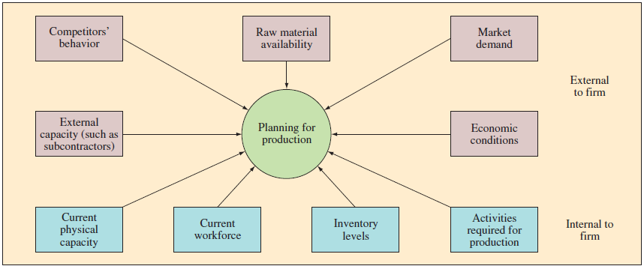
Required Inputs to the Production Planning System
Exhibit 19.2

Slide 9
Production Planning Strategies
Production planning strategies are the plans for meeting demand
Trade offs involved include workers employed, work hours, inventory and shortages
A pure strategy uses just one of these approaches, a mixed strategy uses two or more
  Chase strategy
    Match the production rate by hiring and laying off employees
    Must have a pool of easily trained applicants to draw on
  Stable workforce—variable work hours
    Vary the number of hours worked through flexible work schedules or overtime
  Level strategy
    Demand changes are absorbed by fluctuating inventory levels, order backlogs, and lost sales
Notes:
10
10

Slide 10
Production Planning Strategies Continued
Pure strategy: when just one of the approaches is used to absorb demand fluctuations
Mixed strategy: when two or more of the approaches are used
In addition to these strategies, managers also may choose to subcontract some portion of production
  Similar to the chase strategy, but hiring and laying off are translated into subcontracting

Slide 11
Subcontracting
Managers also may choose to subcontract some portion of production
Similar to the chase strategy, but hiring and laying off are translated into subcontracting and not subcontracting
  Some level of subcontracting can be desirable to accommodate demand fluctuations
Unless the relationship with the supplier is strong, a manufacturer can lose some control over schedule and quality

Slide 12
Relevant Costs
Basic production costs
  The fixed and variable costs incurred in producing a given product type in a given time period
Costs associated with changes in the production rate
  Hiring, training, and laying off personnel
Inventory holding costs
  Capital, storing, insurance, taxes, spoilage, and obsolencence
Backorder costs
  Hard to measure
  Loss of goodwill
  Loss of sales

Slide 13
Budgets
Operations managers are generally required to submit annual budget requests
  Sometimes quarterly
Aggregate plan is key to the success of the budgeting process
  Provides justification for the requested budget amount
Accurate medium-range planning increases the likelihood of…
  Receiving the requested budget
  Operating within the limits of the budget

Slide 14
Aggregate Planning Techniques
Cut-and-try charting and graphic methods
Linear programming
Simulation
Involves costing out various production planning alternatives and selecting the one that is best
Elaborate spreadsheets developed to facilitate the decision process
Use of mathematical analysis to determine an optimal plan
What-if analysis using simulated demand to evaluate effectiveness of alternative plans

Slide 15
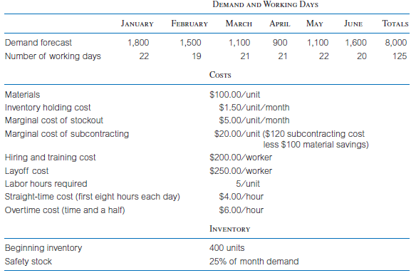
A Cut-and-Try Example: The JC Company

Slide 16
Example: More Data
In solving this problem, we can exclude the material costs
Inventory at the beginning of the first period is 400 units
Assume the safety stock should be one-quarter of the demand forecast
  It is often useful to convert demand forecasts into production requirements
  The should take into account the safety stock estimates

Slide 17
Example: Aggregate Production Planning Requirements
Exhibit 19.3

Slide 18
Example: Evaluate Alternative Plans
Produce to exact monthly production requirements by varying workforce size
Produce to meet expected average demand by maintaining a constant workforce
Produce to meet the minimum expected demand using a constant workforce and subcontract to meet additional requirements
Produce to meet expected demand for all but the first two months using a constant workforce and use overtime to meet additional output requirements

Slide 19
Plan 1: Exact Production; Vary Workforce
Exhibit 19.4

Slide 20
Plan 2: Constant Workforce; Vary Inventory and Stockout
Exhibit 19.4

Slide 21
Plan 3: Constant Low Workforce; Subcontract
Exhibit 19.4

Slide 22
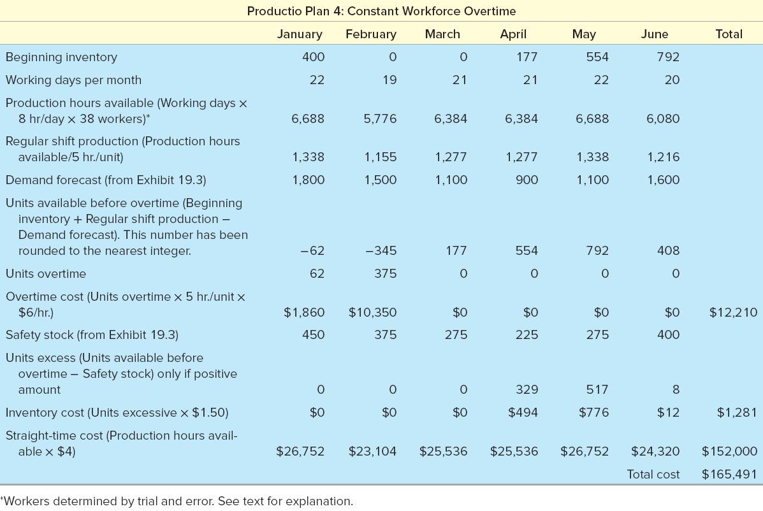
Plan 4: Constant Workforce; Overtime
Exhibit 19.4

Slide 23
Example: Comparison of Four Plans
Exhibit 19.5

Slide 24
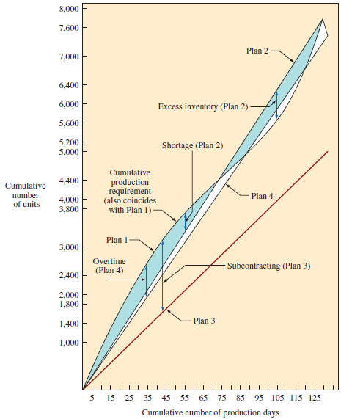
Four Plans for Satisfying a Production Requirement over the Number of Production Days Available
Exhibit 19.6

Slide 25
Yield Management
Yield management: the process of allocating the right type of capacity to the right type of customer at the right price and time to maximize revenue or yield
  Can be a powerful approach to making demand more predictable
Has existed as long as there has been limited capacity for serving customers
Widespread scientific application began with American Airlines’ computerized reservation system (SABRE)

Slide 26
Yield Management Most Successful When…
Demand can be segmented by customer
Fixed costs are high and variable costs are low
Inventory is perishable
Product can be sold in advance
Demand is highly variable

Slide 27
Yield Management – Hotels
Hotels offer one set of rates during the week and another set during the weekend
The variable costs associated with a room are low in comparison to the cost of adding rooms to the property
Available rooms cannot be transferred from night to night
Blocks of rooms can be sold to conventions or tours
Potential guests may cut short their stay or not show up at all

Slide 28
Operating Yield Management Systems
Pricing structures must appear logical to the customer and justify the different prices
  Called rate fences
  Pricing also should relate to addressing specific capacity problems
Must handle variability in arrival or starting times, duration, and time between customers
Must be able to handle the service process
Must train employees to work in an environment where overbooking and price changes are standard occurrences that directly impact the customer

Slide 29
Summary
The aggregate plan is a high-level operational plan that can be executed by the operations and supply chain functions
  Typically, aggregation is done by product families and by groups of customers
Outputs of the plan are planned production rates, aggregate labor requirements, and expected finished good levels
Companies commonly use simple techniques for analyzing aggregate planning problems
  Strategies vary greatly depending on the situation faced by the company
Yield management occurs when a firm adjusts the price of its product or service in order to influence demand

Slide 30
Practice Exam
Term used to refer to the process a firm uses to balance supply and demand
When doing aggregate planning, these are the three general operations–related variables that can be adjusted
A strategy where the production rate is set to match expected demand
When overtime is used to meet demand and avoid the costs associated with hiring and firing
A strategy that uses inventory and backorders as part of the strategy to meet demand
Sometimes a firm may choose to have all or part of the work done by an outside vendor
  This is the term used for the approach

Slide 31
Practice Exam Continued
If expected demand during the next four quarters is 150, 125, 100, and 75 thousand units, and each worker can produce 1,000 units per quarter, how many workers should be used if a level strategy is being employed
Given the data from question 7, how many workers would be needed for a chase strategy
In a service setting, what general operations–related variable is not available compared to a production setting
The practice of allocating capacity and manipulating demand to make it more predictable

