Slide 1
Chapter 20: INVENTORY MANAGEMENT
LO20–1: Explain how inventory is used and understand what it costs.
LO20–2: Analyze how different inventory control systems work.
LO20–3: Analyze inventory using the Pareto principle.
McGraw-Hill/Irwin

Slide 2
Inventory
Inventory can be visualized as stacks of money sitting on forklifts, on shelves, and in trucks and planes while in transit
For many businesses, inventory is the largest asset on the balance sheet at any given time
Inventory can be difficult to convert back into cash
It is a good idea to try to get your inventory down as far as possible
The average cost of inventory in the United States is 30 to 35 percent of its value
If the amount of inventory could be reduced to $10 million, for instance, the firm would save over $3 million

Slide 3
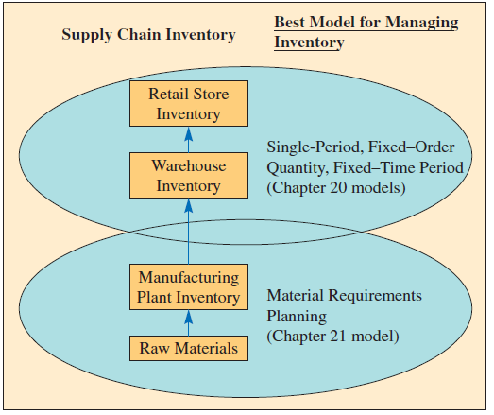
Supply Chain Inventories—Make-to-Stock Environment
Exhibit 3.2

Slide 4
Inventory Models
Single-period model
Fixed-order quantity model
Fixed–time period model
Used when we are making a one-time purchase of an item
Used when we want to maintain an item “in-stock,” and when we restock, a certain number of units must be ordered
Item is ordered at certain intervals of time

Slide 5
Definitions
Inventory: the stock of any item or resource used in an organization
Includes raw materials, finished products, component parts, supplies, and work-in-process
Manufacturing inventory: refers to items that contribute to or become part of a firm’s product
Inventory system: the set of policies and controls that monitor levels of inventory
Determines what levels should be maintained, when stock should be replenished, and how large orders should be
Manufacturing inventory: items that contribute to or become part of a firm’s product output
Raw materials
Finished products
Component parts
Supplies
Work-in-process

Slide 6
Purposes of Inventory
To maintain independence of operations
To meet variation in product demand
To allow flexibility in production scheduling
To provide a safeguard for variation in raw material delivery time
To take advantage of economic purchase order size
Many other domain-specific reasons
In-transit inventory
In anticipation of a price increase
Many others

Slide 7
Inventory Costs
Holding (or carrying) costs
Costs for storage, handling, insurance, and so on
Setup (or production change) costs
Costs for arranging specific equipment setups, and so on
Ordering costs
Costs of placing an order
Shortage costs
Costs of running out

Slide 8
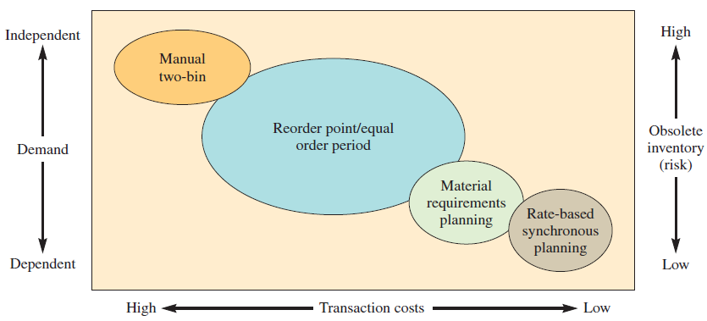
Inventory Control-System Design Matrix: Framework Describing Inventory Control Logic
Exhibit 20.2

Slide 9
Independent Versus Dependent Demand
Independent demand: the demands for various items are unrelated to each other
For example, a workstation may produce many parts that are unrelated but meet some external demand requirement
Dependent demand: the need for any one item is a direct result of the need for some other item
Usually a higher-level item of which it is part
If an automobile company plans on producing 500 cars per day, then obviously it will need 2,000 wheels and tires

Slide 10
Inventory Control Systems
An inventory system provides the organizational structure and the operating policies for maintaining and controlling goods to be stocked
Single-period inventory model
One time purchasing decision
Example: vendor selling t-shirts at a football game
Seeks to balance the costs of inventory overstock and under stock
Multi-period inventory models
Fixed-order quantity models
Event triggered
Example: running out of stock
Fixed-time period models
Time triggered
Example: Monthly sales call by sales representative
Notes:
7

Slide 11
Newsperson Problem
Consider the problem that the newsperson has in deciding how many newspapers to put in the sales stand outside a hotel lobby each morning
Too few papers and some customers will not be able to purchase a paper, and profits associated with these potential sales are lost
Too many papers and the price paid for papers that were not sold during the day will be wasted, lowering profit
This is a very common type of problem

Slide 12
Solving the Newsperson Problem
Consider how much risk we are willing to take of running out of inventory
Assume a mean of 90 papers and a standard deviation of 10 papers
Assume we want an 80 percent chance of not running out
Assume that the probability distribution associated of sales is normal, stocking 90 papers yields a 50 percent chance of stocking out
From Appendix G, we see that we need approximately 0.85 standard deviation of extra papers to be 80 percent sure of not stocking out
Using Excel, “=NORMSINV(0.8)” = 0.84162

Slide 13
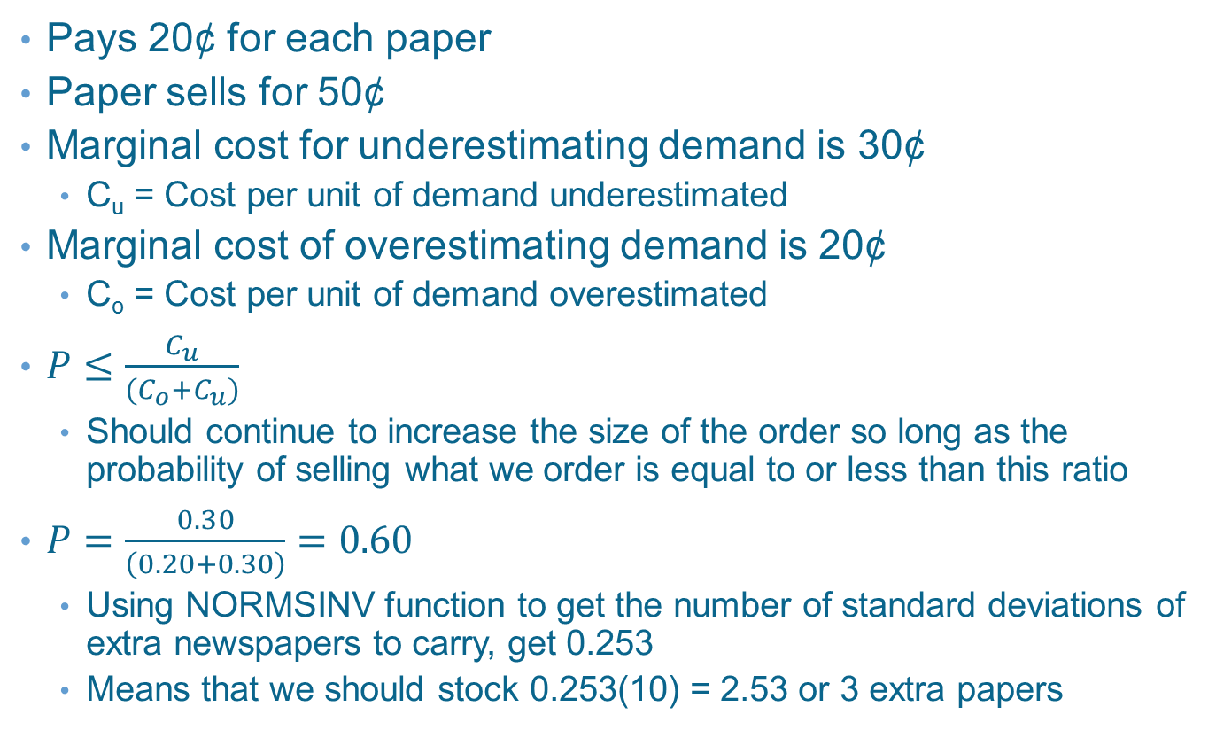
Including Potential Profit and Loss in Newsperson Problem
Pays 20¢ for each paper
Paper sells for 50¢
Marginal cost for underestimating demand is 30¢
C_{u} = Cost per unit of demand underestimated
Marginal cost of overestimating demand is 20¢
C_{o} = Cost per unit of demand overestimated
$P≤\frac{C_{u}}{(C_{o}+C_{u})}$
Should continue to increase the size of the order so long as the probability of selling what we order is equal to or less than this ratio
$P=\frac{0.30}{\left(0.20+0.30\right)}=0.60$
Using NORMSINV function to get the number of standard deviations of extra newspapers to carry, get 0.253
Means that we should stock 0.253(10) = 2.53 or 3 extra papers

Slide 14
Single Period Model Applications
Overbooking of airline flights
Ordering of clothing and other fashion items
One-time order for events
Example: t-shirts for a concert

Slide 15
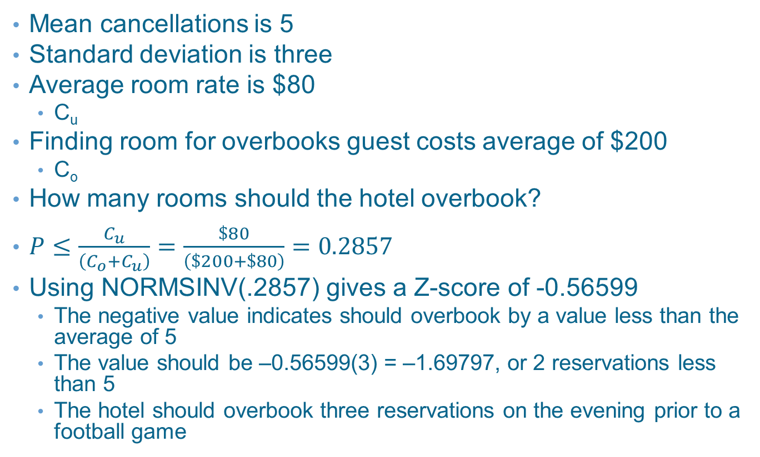
Example 20.1: Hotel Reservations
Mean cancellations is 5
Standard deviation is three
Average room rate is $80
C_{u}
Finding room for overbooks guest costs average of $200
C_{o}
How many rooms should the hotel overbook?
$P≤\frac{C_{u}}{\left(C_{o}+C_{u}\right)}=\frac{\$80}{\left(\$200+\$80\right)}=0.2857$
Using NORMSINV(.2857) gives a Z-score of -0.56599
The negative value indicates should overbook by a value less than the average of 5
The value should be –0.56599(3) = –1.69797, or 2 reservations less than 5
The hotel should overbook three reservations on the evening prior to a football game

Slide 16
Example 20.1: Discrete Probabilities
Another method for analyzing this type of problem is with a discrete probability distribution
Found using actual data
This is combined with marginal analysis

Slide 17
Overbook by One and Zero No-Shows
Overbook by one and have zero no-shows
Incur the penalty of $200
One person must be compensated for having no room

Slide 18
Overbook by One and Two No-Shows
Overbook by one and have two no-shows
Have one unsold room
Cost is $80

Slide 19
Overbook by One and Two No-Shows
Total cost of a policy of overbooking by one room is the weighted average of the events and the outcome of those events
Minimum cost is overbooking by three rooms ($212.40)

Slide 20
Multiperiod Inventory Models
There are two general types of multi-period inventory systems
Fixed–order quantity models
Also called the economic order quantity, EOQ, and Q-model
Event triggered
Perpetual system
Fixed–time period models
Also called the periodic system, periodic review system, fixed-order interval system, and P-model
Time triggered
Designed to endure that an item will be available on an ongoing basis

Slide 21
Multi-Period Models – Comparison
Fixed-Order Quantity
Fixed-Time Period
Inventory remaining must be continually monitored
Has a smaller average inventory
Favors more expensive items
Is more appropriate for important items
Requires more time to maintain – but is usually more automated
Is more expensive to implement
Counting takes place only at the end of the review period
Has a larger average inventory
Favors less expensive items
Is sufficient for less-important items
Requires less time to maintain
Is less expensive to implement

Slide 22
Fixed–Order Quantity and Fixed–Time Period Differences
Exhibit 20.3

Slide 23
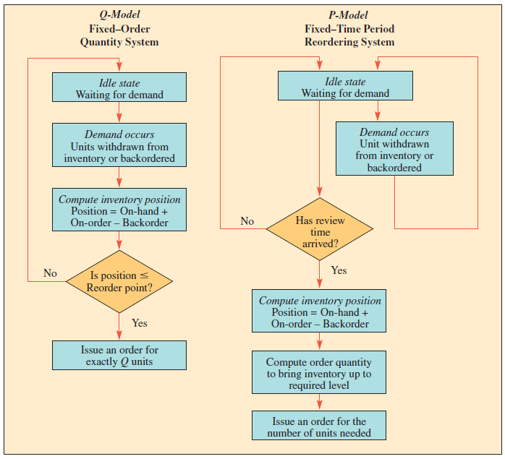
Multi-Period Models – Process
Exhibit 20.4

Slide 24
Fixed-Order Quantity Models Assumptions
Demand for the product is constant and uniform throughout the period
Lead time (time from ordering to receipt) is constant.
Price per unit of product is constant
Inventory holding cost is based on average inventory
Ordering or setup costs are constant
All demands for the product will be satisfied

Slide 25
Basic Fixed–Order Quantity Model
Always order Q units when inventory reaches reorder point (R)
Inventory arrives after lead time (L)
Inventory is raised to maximum level (Q)
Inventory is consumed at a constant rate

Slide 26
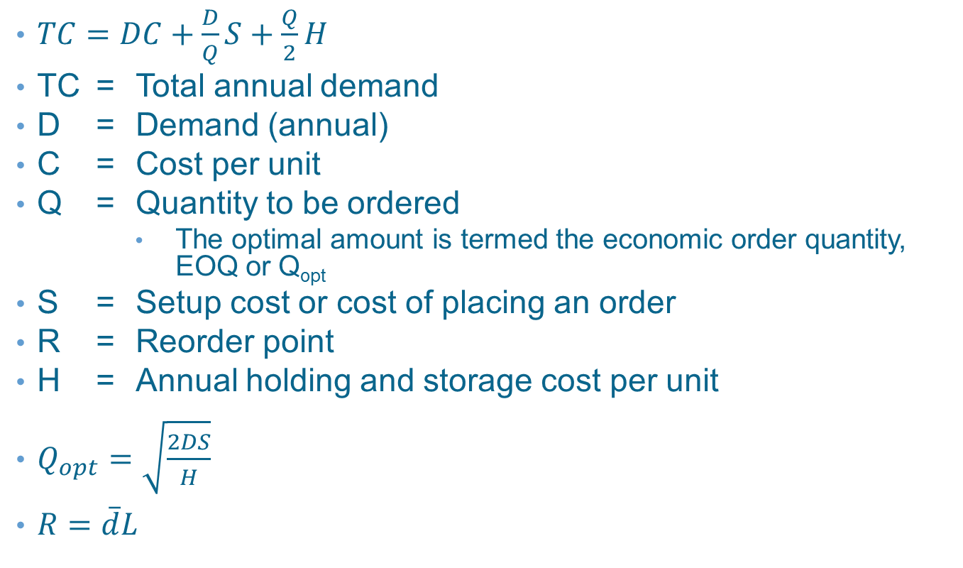
Basic Fixed-Order Quantity Model Equation
$TC=DC+\frac{D}{Q}S+\frac{Q}{2}H$
TC = Total annual demand
D = Demand (annual)
C = Cost per unit
Q = Quantity to be ordered
The optimal amount is termed the economic order quantity, EOQ or Q_{opt}
S = Setup cost or cost of placing an order
R = Reorder point
H = Annual holding and storage cost per unit
$Q_{opt}=\sqrt{\frac{2DS}{H}}$
$R=\overline{d}L$

Slide 27
Annual Product Costs, Based on Size of the Order
Exhibit 20.6

Slide 28
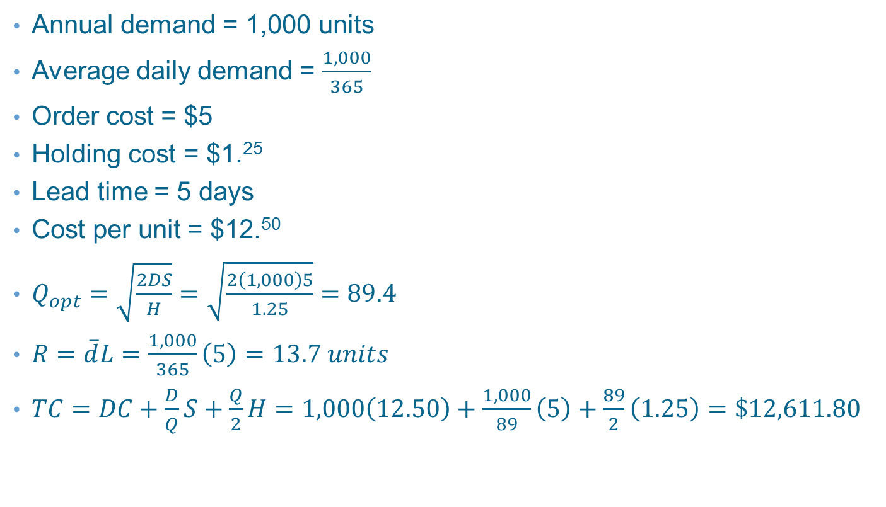
Example 20.2: Economic Order Quantity and Reorder Point
Annual demand = 1,000 units
Average daily demand = $\frac{1,000}{365}$
Order cost = $5
Holding cost = $1.²⁵
Lead time = 5 days
Cost per unit = $12.⁵⁰
$Q_{opt}=\sqrt{\frac{2DS}{H}}=\sqrt{\frac{2\left(1,000\right)5}{1.25}}=89.4$
$R=\overline{d}L=\frac{1,000}{365}\left(5\right)=13.7 units$
$TC=DC+\frac{D}{Q}S+\frac{Q}{2}H=1,000\left(12.50\right)+\frac{1,000}{89}\left(5\right)+\frac{89}{2}\left(1.25\right)=\$12,611.80$

Slide 29
Establishing Safety Stock Levels
Safety stock: refers to the amount of inventory carried in addition to expected demand
Safety stock can be determined based on many different criteria
A common approach is to simply keep a certain number of weeks of supply
A better approach is to use probability
Assume demand is normally distributed
Assume we know mean and standard deviation
To determine probability, we plot a normal distribution for expected demand and note where the amount we have lies on the curve

Slide 30
Example
Expected demand next month is 100 units
Standard deviation is 20 units
If start month with 100 units, there is a 50 percent chance of a stockout
Would expect a stockout six months out of the year
To have a 95 percent chance of not running out, would need to carry 1.64 standard deviations of safety stock
1.64 x 20 = 32.8
Would still order a month’s worth each time, but would schedule the receipt to have 33 units in inventory when the order arrives
Would now expect a stockout 0.6 month per year or one out of every 20 months

Slide 31
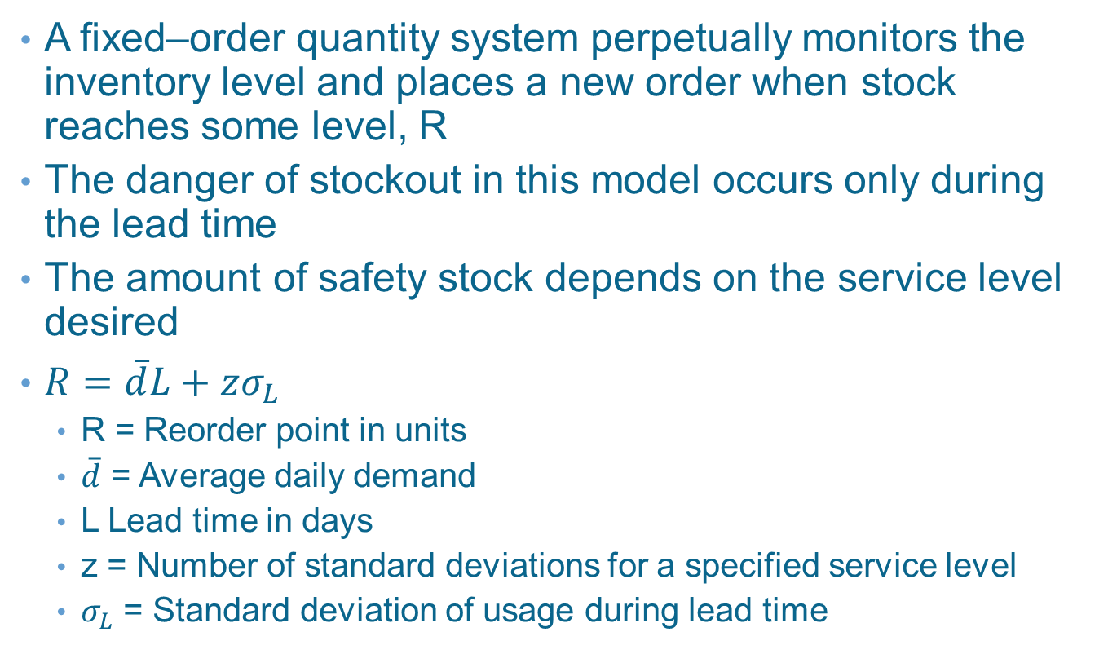
Fixed-Order Quantity Model with Safety Stock
A fixed–order quantity system perpetually monitors the inventory level and places a new order when stock reaches some level, R
The danger of stockout in this model occurs only during the lead time
The amount of safety stock depends on the service level desired
$R=\overline{d}L+zσ_{L}$
R = Reorder point in units
$\overline{d}$ = Average daily demand
L Lead time in days
z = Number of standard deviations for a specified service level
$σ_{L}$ = Standard deviation of usage during lead time

Slide 32
Fixed–Order Quantity Model
Exhibit 20.7

Slide 33
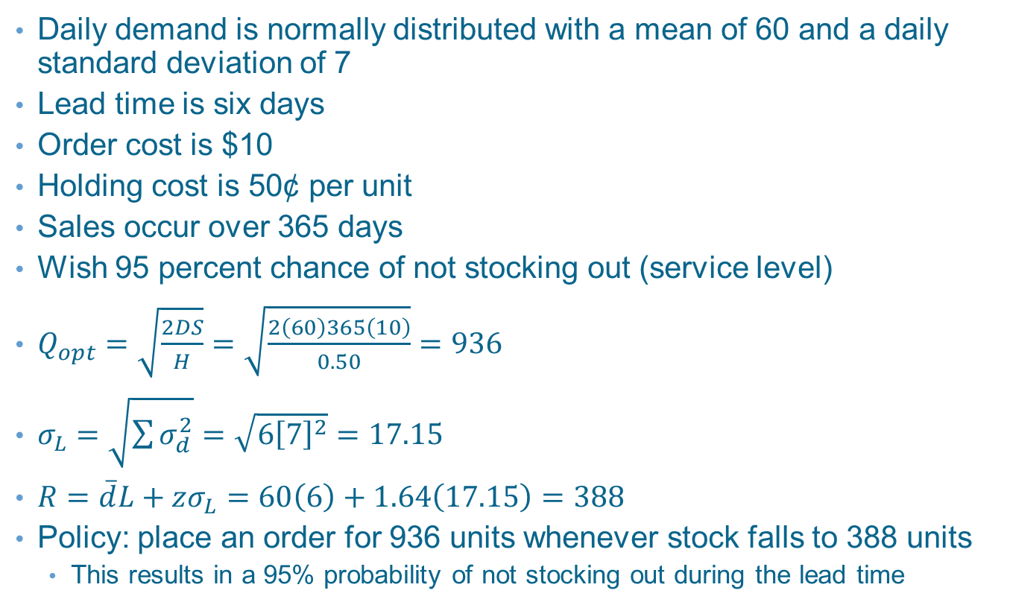
Example 20.4: Order Quantity and Reorder Point
Daily demand is normally distributed with a mean of 60 and a daily standard deviation of 7
Lead time is six days
Order cost is $10
Holding cost is 50¢ per unit
Sales occur over 365 days
Wish 95 percent chance of not stocking out (service level)
$Q_{opt}=\sqrt{\frac{2DS}{H}}=\sqrt{\frac{2\left(60\right)365\left(10\right)}{0.50}}=936$
$σ_{L}=\sqrt{\sum{σ_{d}^{2}}}=\sqrt{6{\left[7\right]}^{2}}=17.15$
$R=\overline{d}L+zσ_{L}=60\left(6\right)+1.64\left(17.15\right)=388$
Policy: place an order for 936 units whenever stock falls to 388 units
This results in a 95% probability of not stocking out during the lead time

Slide 34
Fixed-Time Period Model
Inventory is counted only at particular times
Such as every week or every month
Desirable when vendors make routine visits to customers and take orders for their complete line of products
Or when buyers want to combine orders to save transportation costs
Order quantities that vary from period to period, depending on the usage rates
Generally require higher levels of safety stock

Slide 35
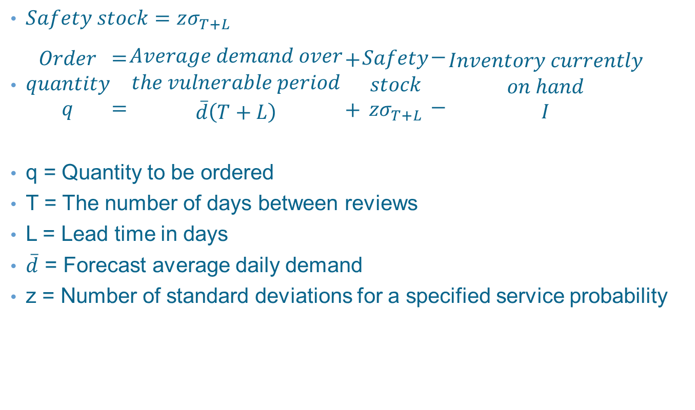
Fixed–Time Period Model with Safety Stock
$Safety stock=zσ_{T+L}$
$\begin{matrix}Order \\ quantity \\ q\end{matrix}\begin{matrix}= \\ \\ =\end{matrix}\begin{matrix}Average demand over \\ the vulnerable period \\ \overline{d}\left(T+L\right)\end{matrix}\begin{matrix}+ \\ \\ +\end{matrix}\begin{matrix}Safety \\ stock \\ zσ_{T+L}\end{matrix}\begin{matrix}− \\ \\ −\end{matrix}\begin{matrix}Inventory currently \\ on hand \\ I\end{matrix}$
q = Quantity to be ordered
T = The number of days between reviews
L = Lead time in days
$\overline{d}$ = Forecast average daily demand
z = Number of standard deviations for a specified service probability

Slide 36
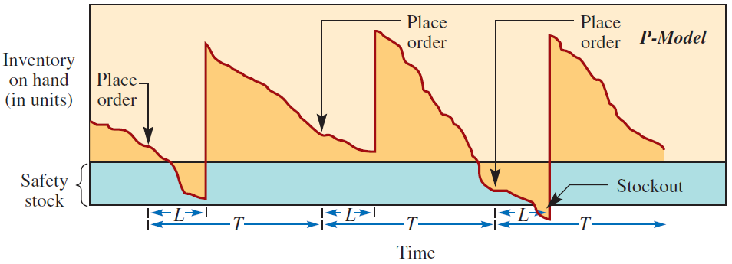
Fixed-Time Period Inventory Model
Exhibit 20.8

Slide 37
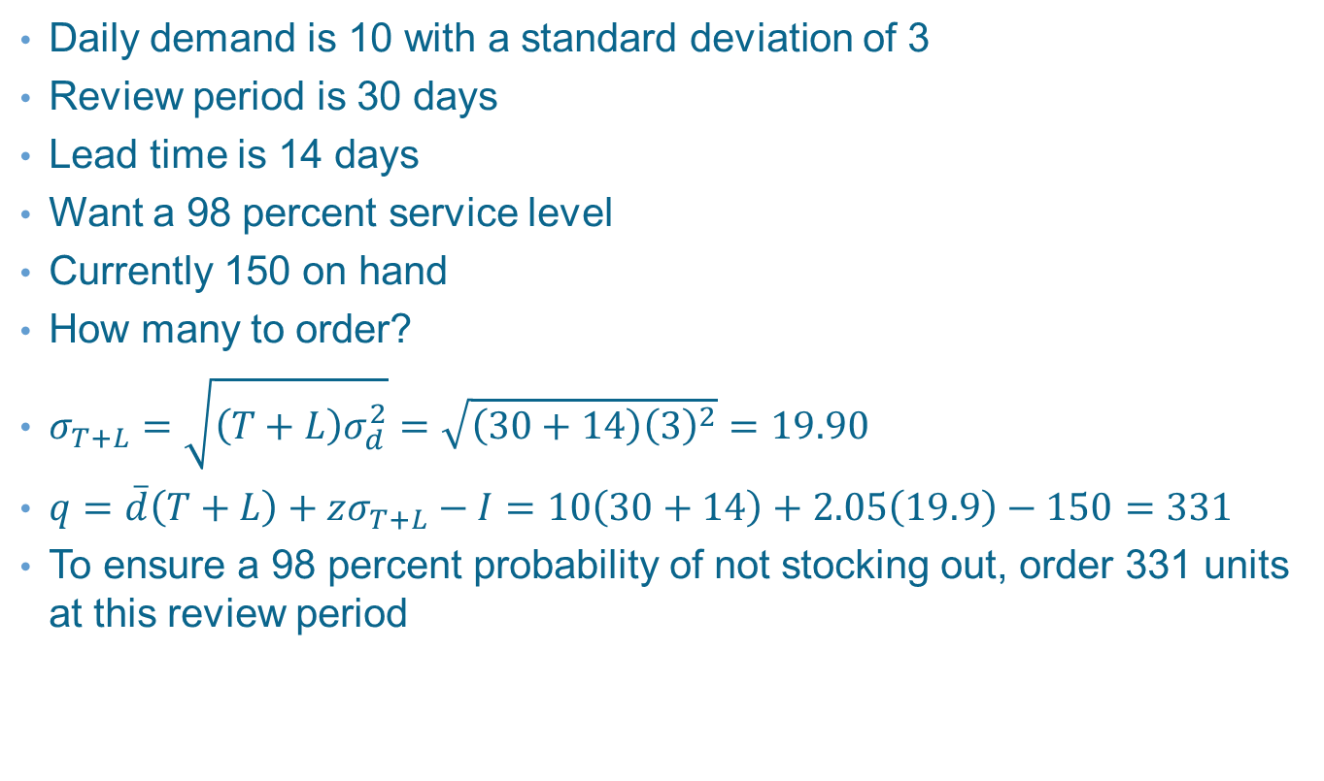
Example 20.5: Quantity to Order
Daily demand is 10 with a standard deviation of 3
Review period is 30 days
Lead time is 14 days
Want a 98 percent service level
Currently 150 on hand
How many to order?
$σ_{T+L}=\sqrt{\left(T+L\right)σ_{d}^{2}}=\sqrt{\left(30+14\right){\left(3\right)}^{2}}=19.90$
$q=\overline{d}\left(T+L\right)+zσ_{T+L}−I=10\left(30+14\right)+2.05\left(19.9\right)−150=331$
To ensure a 98 percent probability of not stocking out, order 331 units at this review period

Slide 38
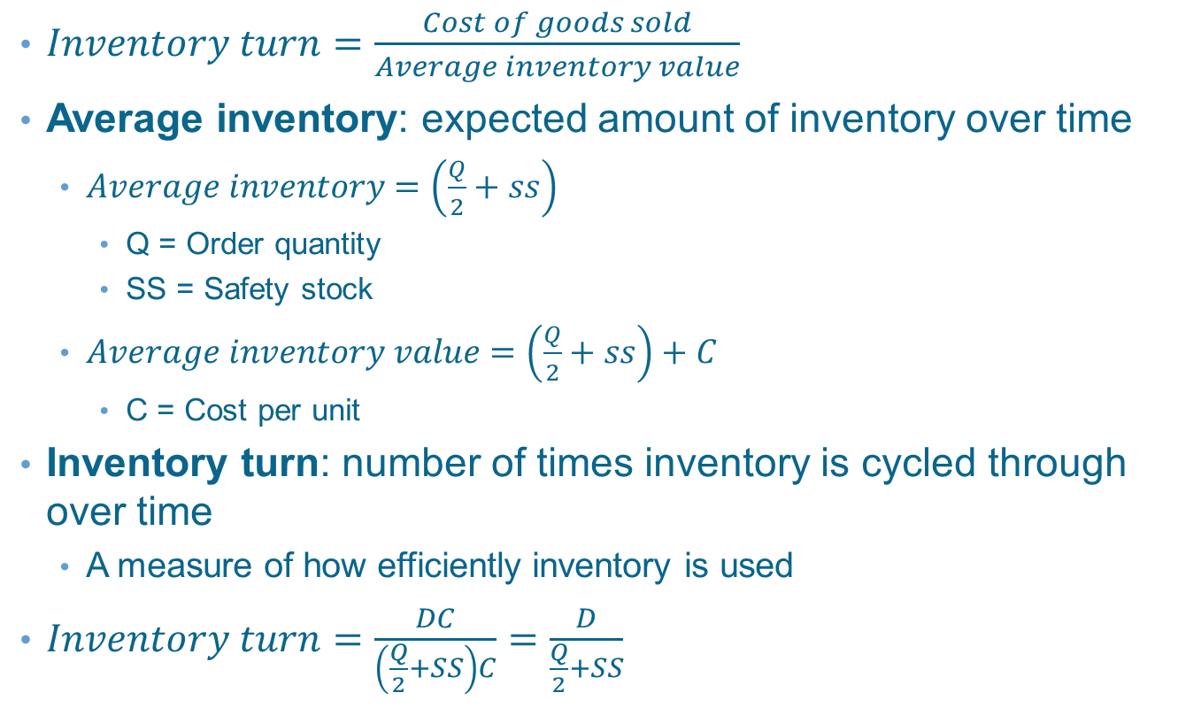
Inventory Turn Calculation
$Inventory turn=\frac{Cost of goods sold}{Average inventory value}$
Average inventory: expected amount of inventory over time
$Average inventory=\left(\frac{Q}{2}+ss\right)$
Q = Order quantity
SS = Safety stock
$Average inventory value=\left(\frac{Q}{2}+ss\right)+C$
C = Cost per unit
Inventory turn: number of times inventory is cycled through over time
A measure of how efficiently inventory is used
$Inventory turn=\frac{DC}{\left(\frac{Q}{2}+SS\right)C}=\frac{D}{\frac{Q}{2}+SS}$

Slide 39
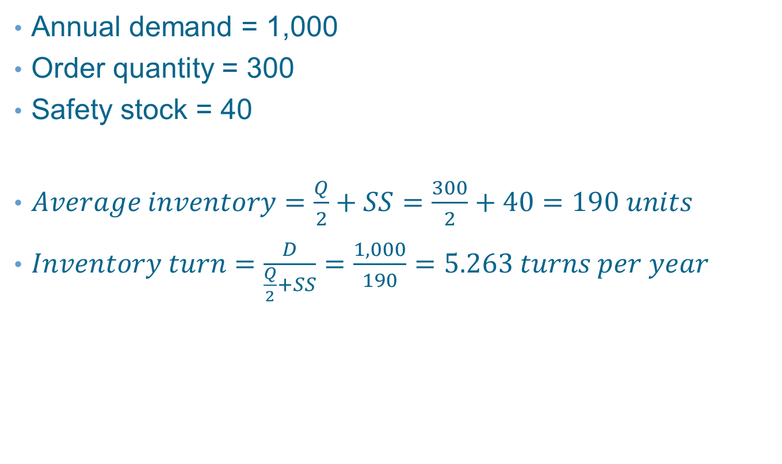
Example 20.6: Average Inventory Calculation—Fixed–Order Quantity Model
Annual demand = 1,000
Order quantity = 300
Safety stock = 40
$Average inventory=\frac{Q}{2}+SS=\frac{300}{2}+40=190 units$
$Inventory turn=\frac{D}{\frac{Q}{2}+SS}=\frac{1,000}{190}=5.263 turns per year$

Slide 40
Inventory Models with Price Breaks
Price varies with the order size
To find the lowest-cost, calculate the order quantity for each price and see if the quantity is feasible
Sort prices from lowest to highest and calculate the order quantity for each price until a feasible order quantity is found
If the first feasible order quantity is the lowest price, this is best; otherwise, calculate the total cost for the first feasible quantity and calculate total cost at each price lower than the first feasible order quantity

Slide 41
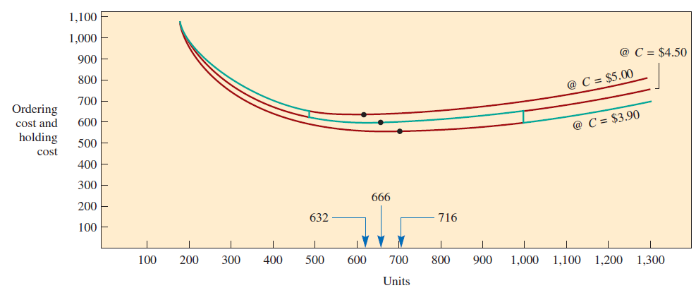
Inventory Models with Price Breaks
Exhibit 20.9

Slide 42
Example 20.8: Price Break
Annual demand = 10,000
Order cost = $20
Hold cost is 20 percent of cost
Cost per unit…
0-499 units cost $5.⁰⁰
500-999 units cost $4.⁵⁰
1,000 units and up cost $3.⁹⁰
Order 1,000 is optimal
C = $5.00 | Q = 632 | TC_{Q=499} = $50,650
C = $4.50 | Q = 667 | TC_{Q=667} = $45,600
C = $3.90 | Q = 716 | TC_{Q=1,000} = $39,590

Slide 43
Inventory Planning and Accuracy
Maintaining inventory takes time and costs money
Makes sense to focus on most important inventory items
Villefredo Pareto found that 20 percent of the people controlled 80 percent of the wealth
Broadened and known as Pareto principle
Most inventory control situations involve so many items that it is not practical to model each item
ABC inventory classification scheme divides inventory items into three groupings
High dollar volume
Moderate dollar volume
Low dollar volume

Slide 44
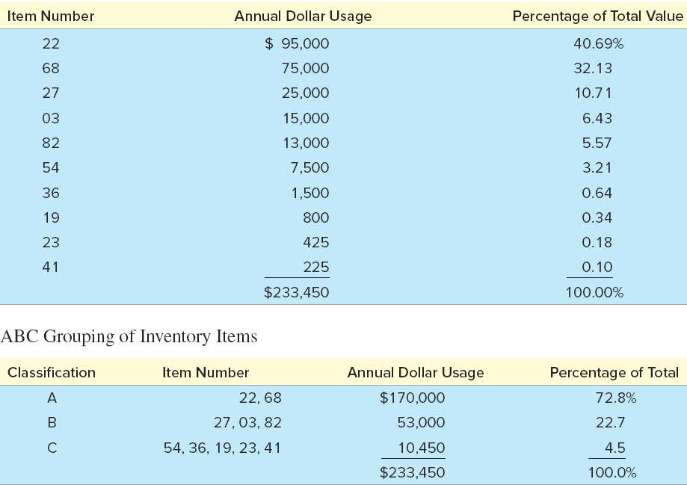
Annual Usage of Inventory by Value and ABC Grouping of Inventory Items
Exhibit 20.11 A and B

Slide 45
ABC Inventory Classification Graphically
Exhibit 20.11 C

Slide 46
Inventory Management
Inventory accuracy: refers to how well the inventory records agree with physical count
How much error is acceptable?
Cycle counting: a physical inventory-taking technique in which inventory is counted on a frequent basis rather than once or twice a year
When the record shows a low/zero balance on hand
When record shows a positive balance but there has been a backorder
After some specified level of activity
To signal a review based on the importance of the item

Slide 47
Summary
Inventory is expensive mainly due to storage, obsolescence, insurance, and the value of the money invested
The basic decisions are: (1) when should an item be ordered, and (2) how large should the order be
The main costs relevant to these models are(1) the cost of the item itself, (2) the cost to hold an item in inventory, (3) setup costs, (4) ordering costs, and (5) costs incurred when an item runs short
An inventory system provides a specific operating policy for managing items to be in stock
Single-period model—When an item is purchased only one time and it is expected that it will be used and then not reordered
Multiple-period models—When the item will be reordered and the intent is to maintain the item in stock
There are two basic types of multiple-period models, with the key distinction being what triggers the timing of the order placement

Slide 48
Summary Continued
With the fixed–order quantity model, an order is placed when inventory drops to a low level called the reorder point
With the fixed–time period model, orders are placed at fixed intervals of time
Safety stock is extra inventory that is carried for protection in case the demand for an item is greater than expected
Inventory turn measures the expected number of times that average inventory is replaced over a year
One way to categorize inventory is ABC
Cycle counting is a useful method for scheduling the audit of each item carried in inventory

Slide 49
Practice Exam
The model most appropriate for making a one-time purchase of an item
The model most appropriate when inventory is replenished only in fixed intervals of time—for example, on the first Monday of each month
The model most appropriate when a fixed amount must be purchased each time an order is placed
Term used to describe demand that is uncertain and needs to be forecast
If we take advantage of a quantity discount, would you expect your average inventory to go up or down
Assume that the probability of stocking out criterion stays the same
This is an inventory auditing technique where inventory levels are checked more frequently than one time a year

