Slide 1
Chapter 25: Operations Consulting
LO25–1: Explain operations consulting and how money is made in the industry.
LO25–2: Illustrate the operations analysis tools that are used in the consulting industry.
LO25–3: Analyze processes using business process reengineering concepts.
McGraw-Hill/Irwin

Slide 2
What is Operations Consulting?
Operations consulting: assisting clients in developing operations strategies and in improving production
Operations consulting has become one of the major areas of employment for business school graduates
An effective job of operations consulting results in an alignment between strategy and process dimensions that enhances the business performance of the client
Notes:
3

Slide 3
The Management Consulting Industry
By size
Most consulting firms are small
By specialization
Frequently characterized as
Strategic planning
Tactical analysis and implementation
As in-house or external
Are also frequently characterized according to whether their primary skill is in strategic planning or in tactical analysis and implementation

Slide 4
Some Well-Known Consulting Firms
Strategy type firms
McKinsey & Company
Boston Consulting Group
Tactical and implementation types
Gemini Consulting
A. T. Kearney
The big accounting firms and Accenture
New players (mostly IT firms)
Infosys Technology
Computer Sciences Corporation (CSC)
Electronic Data Systems (EDS)
IBM

Slide 5
Hierarchy of Assignments
At the top are the partners or seniors
Primary function is sales and client relations
Finders: members who find new business
In the middle are managers, who manage consulting projects or engagements
Minders: managers of project teams
At the bottom are juniors, who carry out the consulting work
Grinders: the consultants who do the work
Typically work in project teams
Selected according to
Client needs
Project manager’s preference
Other first-line consultants’ preference
It pays to be in demand!

Slide 6
Economics of Consulting Firms
David H. Maister’s article on consulting draws an analogy between the consulting firm and a job shop operation
Three types of jobs
Brain surgery
Requiring innovation and creativity
High partner-to-consultant ratio
Usually risky
Gray hair
Requiring a great deal of experience
Not demanding innovation
Medium risk
Procedures
Requiring activities similar to other existing projects
Low partner-to-consultant ratio
Low risk
Notes:
7

Slide 7
Where Operations Consulting Is Needed
Plants
Adding and locating new plants
Expanding, contracting, or refocusing facilities
People
Quality improvement
Setting/revising work standards
Learning curve analysis
Parts
Make or buy decisions
Vendor selection decisions
Notes:
8

Slide 8
Where Operations Consulting is Needed Continued
Processes
Technology evaluation
Process improvement
Reengineering
Planning and control systems
Supply chain management
ERP
MRP
Shop floor control
Warehousing
Distribution
Notes:
9

Slide 9
Some Themes of Consulting Streams
Developing manufacturing strategy
Designing and implementing JIT systems
Implementing MRP or proprietary ERP software such as SAP
Systems integration involving client–server technology

Slide 10
When do Services Need Operations Consultants
Financial services
Staffing, automation, quality studies
Health care
Staffing, billing, office procedures, phone answering, layout
Transportation
Route scheduling and shipping logistics for goods haulers
Reservation systems
Baggage handling for airlines
Hospitality
Reservations, staffing, cost containment, quality programs

Slide 11
When are Operations Consultants Needed?
When faced with a major investment decision
When management believes it is not getting the maximum effectiveness from the organization’s productive capability
Notes:
10

Slide 12
The Operations Consulting Process
The broad steps in the operations consulting process are roughly the same as for any type of management consulting
The major differences exist in the nature of the problem to be analyzed and the kinds of analytical methods to be employed
May focus on the strategic level or tactical level
The process itself generally requires extensive interviewing of employees, managers, and, frequently, customers
If there is a large difference, it is that operations consulting leads to changes in physical or information processes whose results are measurable immediately

Slide 13
Stages in Operations Consulting Process
Develop sales and proposal development
Analyze problem
Design, develop, and test alternative solutions
Develop systematic performance measures
Present final report
Implement changes
Assure client satisfaction
Assemble learnings from the study
Notes:
11

Slide 14
Practical Guidelines for Conducting Consulting Projects
Under-promise and over-deliver
Get the team mix right
The 80-20 rule is true
Do not analyze everything
Use the elevator test
Pluck the low-hanging fruit
Make a chart every day
Hit singles

Slide 15
Practical Guidelines for Conducting Consulting Projects Continued
Do not accept “I have no idea”
Engage the client in the process
Get buy-in throughout the organization
Be rigorous about implementation

Slide 16
Operations Consulting Tool Kit
Problem definition
Data gathering
Data analysis and solution development
Cost impact and payoff analysis
Implementation

Slide 17
Problem Definition Tools
Issue trees
See following slide
Customer surveys
Gap analysis
See following slide
Employee surveys
Five forces model
Buyer power
Potential entrants
Suppliers
Substitute products
Industry rivals

Slide 18
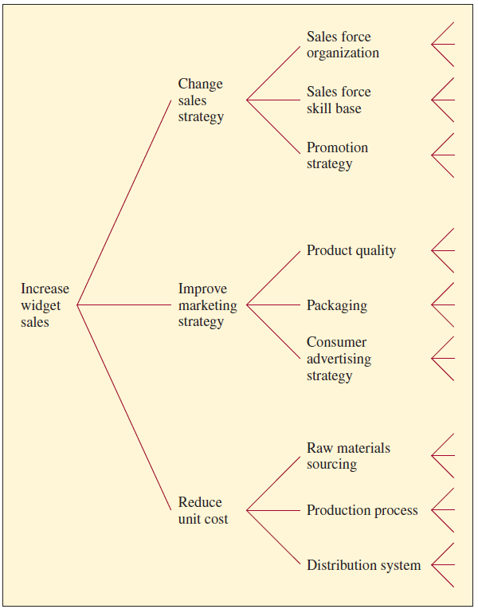
Issue Tree for Acme Widgets
Exhibit 25.4

Slide 19
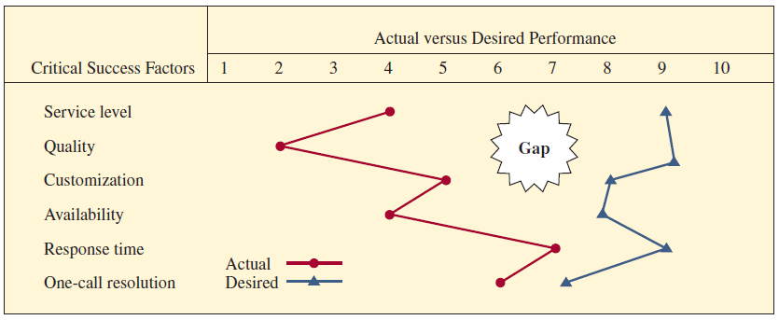
Gap Analysis
Exhibit 25.5

Slide 20
Data Gathering Tools
Plant tours/audits
Full manufacturing audits are a major undertaking
Plant tours are usually much less detailed
Purpose is to get a general understanding
Work sampling
Random sampling observations of work activities
Designed to give a statistically valid picture of how time is spent by a worker or the utilization of equipment
Flowcharts
Help define a process
In services, are called a flowchart
Organizational charts
Shows who reports to whom

Slide 21
Data Analysis and Solution Development Tools
Problem analysis (SPC tools)
Pareto analysis, fishbone diagrams, run charts, scatter diagrams, and control charts
Bottleneck analysis
Resource bottlenecks appear in most OSCM consulting projects
Consultant has to specify how available capacity is related to required capacity in order to identify and eliminate the bottleneck
Computer simulation
A very common tool in OSCM consulting
The most common general-purpose simulation packages are Extend and Crystal Ball
Excel can also be used
Statistical tools
Correlation analysis and regression analysis are expected skills
Hypothesis testing is mentioned frequently
Two other widely used tools that use statistical analysis are queuing theory and forecasting

Slide 22
Cost Impact and Payoff Analysis Tools
Decision trees
Represent a fundamental tool from the broad area of risk analysis
Widely used in examining plant and equipment investments and R&D projects
Stakeholder analysis
Most consulting projects impact in some way each of five types of stakeholders
Customers, stockholders, employees, suppliers, and the community
Balanced scorecard
Used to reflect the particular needs of each stakeholder
Process Dashboards
Designed to provide summary performance updates for specific processes
Consist of performance metrics presented in graphical form with color-coding of trend lines, alarms in the form of exclamation marks, and so forth
Show when key indicators are nearing a problem level

Slide 23
Implementation Tools
Responsibility charts
Used in planning the task responsibilities for a project
Goal is to assure that a person is assigned to each task
Project management techniques
Used to plan and monitor the entire portfolio of consulting engagements of the firm
Also used for individual projects

Slide 24
Business Process Reengineering (BPR)
Reengineering: the fundamental rethinking and radical redesign of business processes to achieve dramatic improvements in critical, contemporary measures of performance such as cost, quality, service, and speed
As a engineering discipline, reengineering can be applied to any process in manufacturing and service businesses, education, and the government
Often compared to TQM
Business process reengineering (BPR) is focused on reengineering business processes
Notes:
3

Slide 25
Principles of Reengineering
Rule 1: Organize around outcomes, not tasks
Rule 2: Have those who use the output of the process perform the process
Rule 3: Merge information-processing work into the real work that produces the information
Rule 4: Treat geographically dispersed resources as though they were centralized
Rule 5: Link parallel activities instead of integrating their results
Rule 6: Put the decision point where the work is performed, and build control into the process
Rule 7: Capture information once and at the source
Notes:
6

Slide 26
Guidelines for Implementation
Codification of reengineering
Reengineering is a complex processes whose implementation may be separated by space and time
Clear goals and consistent feedback
Goals and expectations must be clearly established
Pre-application baseline data gathered
The results monitored and fed back to employees
High executive involvement in clinical changes
High level of involvement by the chief executive officer in major process changes improves reengineering outcomes

Slide 27
Summary
Consulting firms specializing in operations and supply chain management focus on improving a firm’s competitiveness by improving processes
These firms can bring expertise that the client firm does not have
They makes money by charging for services, typically based on a set of rates that depend on the relative experience of the consultant
The consulting firm uses tools to aid in understanding problems, collecting data, developing solutions, analyzing the payoff from proposed changes, and implementing recommendations
The idea of reengineering is to radically rethink how business processes are done with the goal of achieving a dramatic improvement in performance

Slide 28
Practice Exam
Name the three categories of consultants
This type of project requires a great deal of experience but little innovation
Accenture is well known for this type of approach to training consultants
Target utilization is usually highest for which level of consultant
McKinsey uses these to structure or map the key problems to be investigated

Slide 29
Practice Exam Continued
These are the five forces of the five forces model
Gap analysis measures the difference between these two factors
Rapid plant assessment is used to measure this variable
An accounting approach to reflect the needs of each stakeholder is called this
In contrast to TQM, this approach seeks radical change through innovation

